Slide 1
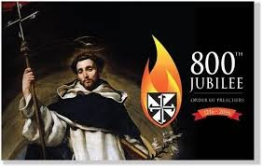
Celebrating 800 years of Dominican Life and Mission
Dominican Sisters Conference
Leadership Meeting
October 5-9, 2016

Slide 2
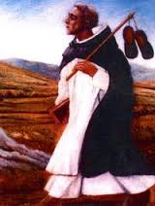

Slide 3
Let us pray together:
God of Mercy,
who called your servant
Dominic de Guzman
to set out in faith
as an itinerant pilgrim
and preacher of grace,
as we celebrate the Jubilee of the Order
we ask you to pour again
into us the Spirit of the Risen Christ,
that we might faithfully
and joyfully proclaim
the Gospel of peace,
through the same
Jesus Christ our Lord. Amen.

Slide 4
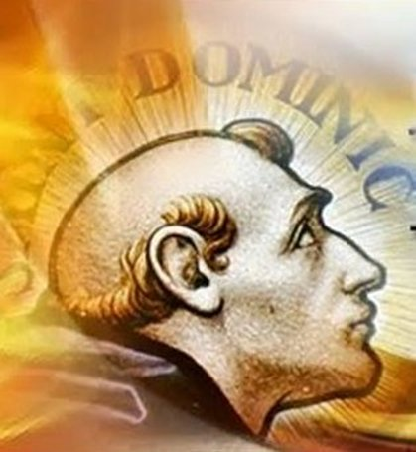
O LUMEN
O Lumen ecclesiae,
Doctor veritatis,
Rosa patientiae
Ebur castitatis,
Aquam sapientiae
Propinasti gratis;
Praedicator gratiae
Nos junge beatis.

Slide 5
Celebrating 800 years of Dominican Life and Mission
Dominican Sisters Conference
Leadership Meeting
October 5-9, 2016

