Slide 1
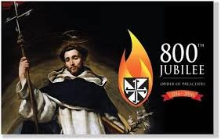
Celebrating 800 years of Dominican Life and Mission
Dominican Sisters Conference
Leadership Meeting
October 5-9, 2016

Slide 3
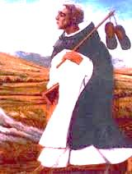
Gracious God, may we
as Dominican preachers,
followers of Dominic de Guzman,
make of our lives a song of truth
on the paths of contemplation
and solidarity with our wounded world.
May our feminine voices,
like that of Catherine of Siena,
widen the preaching horizon of the Church,
so that together, with many other voices,
we may praise and bless you
forever and ever. Amen.
Dominican Sisters of San Rafael

Slide 4
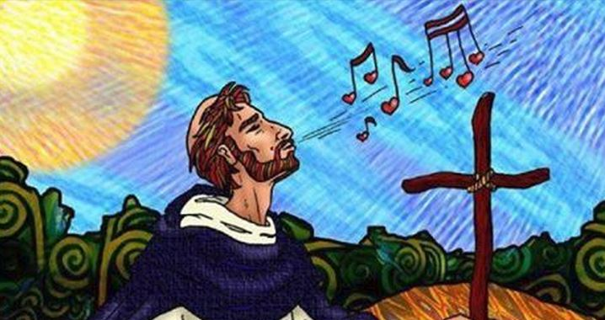
Walk with me for the journey is long (4 x)
The journey, the journey, the journey is long (4x) v. 2 Sing v. 3 Come

Slide 5
Celebrating 800 years of Dominican Life and Mission
Dominican Sisters Conference
Leadership Meeting
October 5-9, 2016

