Slide 1
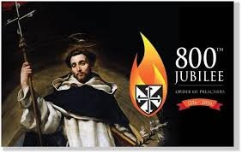
Celebrating 800 years of Dominican Life and Mission
Dominican Sisters
Gathering and sharing wisdom

Slide 2
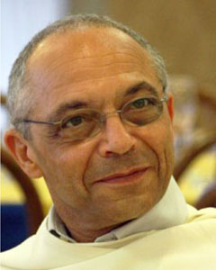

Slide 3
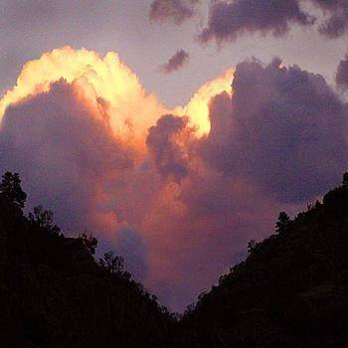
May they all be one,
as you, Father, are in me
and I am in you.
May they also be one in us,
so that the world may believe
that you have sent me.
The glory you have given me
I have given them,
so that they may be one,
as we are one,
I in them and you in me,
that they may become completely one,
so that the world may know
that you have sent me and
have loved them
even as you have loved me. John 17:21-23

Slide 4
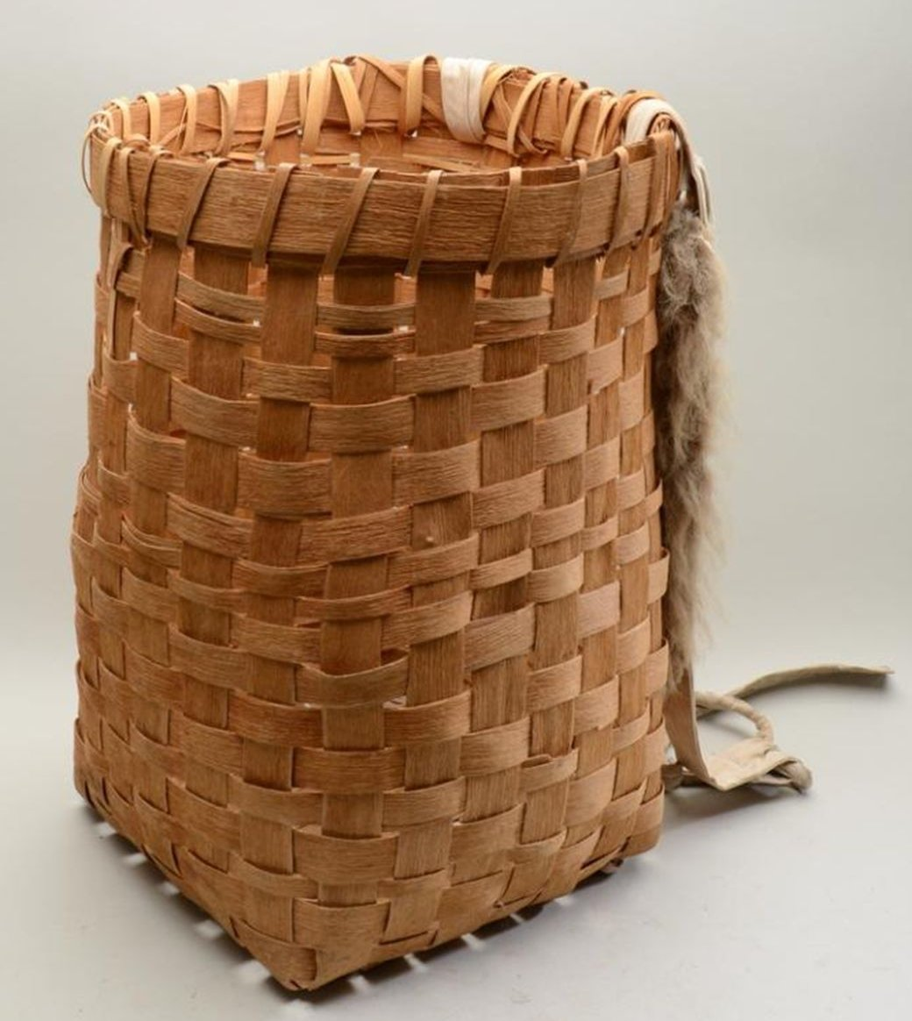
A STORY

Slide 5
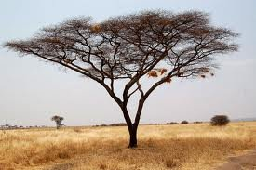

Slide 6
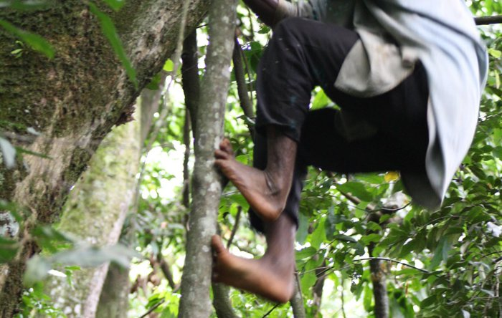

Slide 7
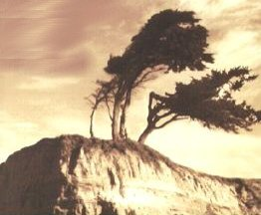

Slide 8
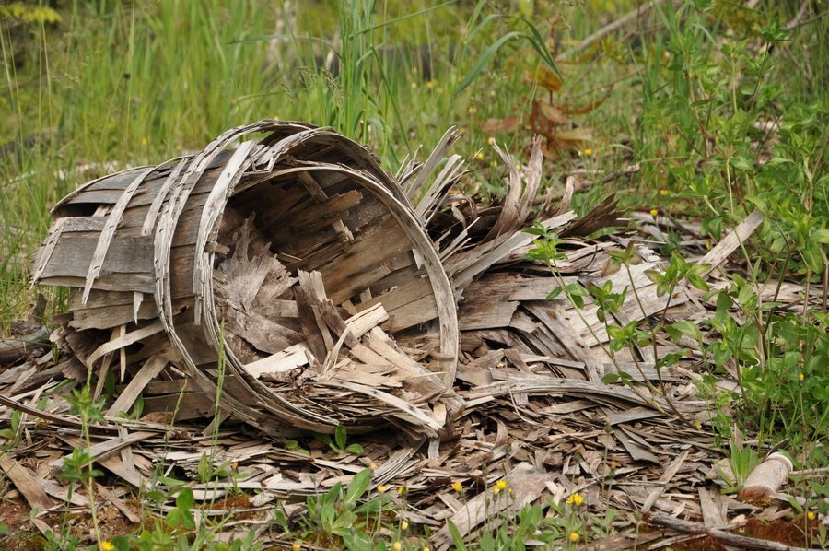

Slide 9
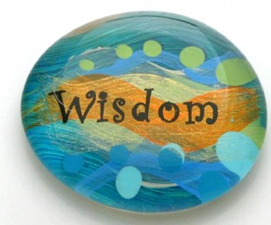

Slide 10
By Breath
Sara Thomsen
By breath, by blood, by body, by spirit, we are all one 2 x
The air that is my breath is the air that you are breathing And the air that is your breath is the air that I am breathing The wind rising in my breast is the wind
from the east, from the west, from the north,
from the south, breathing in, breathing out
By breath, by blood, by body, by spirit, we are all one 2 x

Slide 11
The water that is my blood, my sweat, tears from crying Is the water that is your blood, your sweat,
tears from crying And the rising of the tide is in our veins
and in the ocean wide We are in the rising steam, rushing river, running stream
By breath, by blood, by body, by spirit, we are all one 2 x

Slide 12
The earth is dust, the earth is clay,
flow’rs blossoming and fading
We are dust and we are clay,
we are blossoming and fading Every color, every sound, every place is holy ground Oh, every living thing, can you hear it laugh?
Can you hear it sing?
By breath, by blood, by body, by spirit, we are all one 2 x

Slide 13
The fire in my heart, my soul flame burning Is the fire in your heart, your soul flame burning We are Spirit burning bright, by the light of day,
in the dark of night We are shining like the sun, and like the moon,
like the Holy One
By breath, by blood, by body, by spirit,
we are all one 4x
By breath…

Slide 14
THE GATHERING CONTINUES
Let us continue the work of gathering wisdom that is within and among us.

