Slide 1
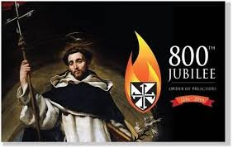
Celebrating 800 years of Dominican Life and Mission
Celebrating the
Dominican Sisters Conference …

Slide 2
YouTube prepared by Pat Farrell, OP

Slide 3
Celebrating 800 years of Dominican Life and Mission

Slide 4
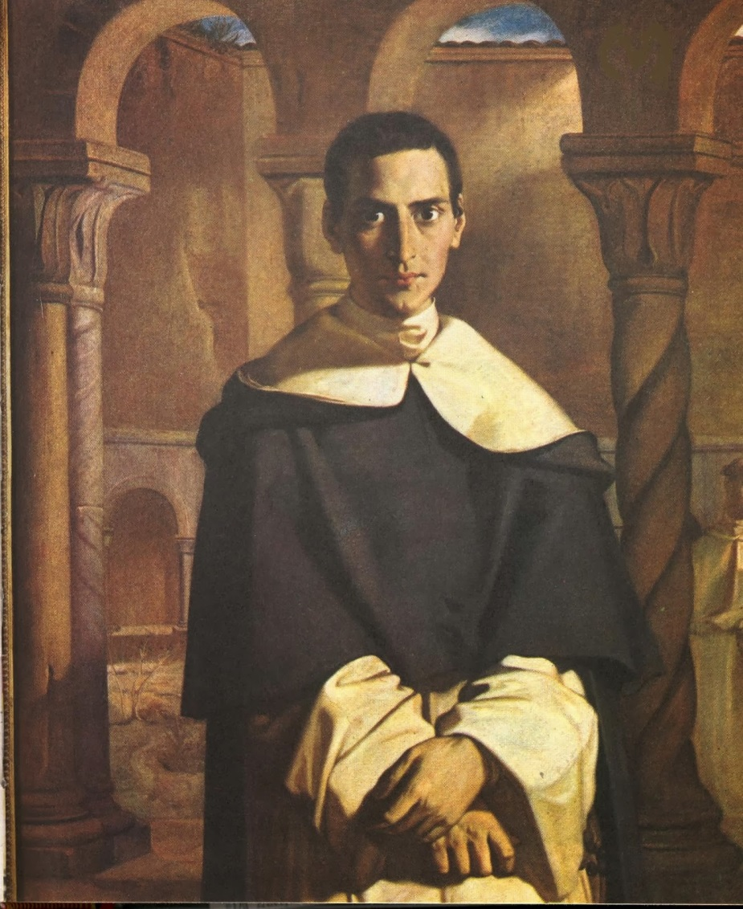
A Reading
from
Henri Lacordaire

Slide 5
Silent Reflection: Let the heart speak.
Where and how are you finding your heart stirred
at this time?
What passion is alive in you?

Slide 6
God of all truth,
You have given the Order of Preachers
Dominic de Guzman, a light in your church,
a teacher of truth, and a preacher of grace.
We thank you for this gift
and pray that through Dominic’s intercession
the people of God
may come to the joys of heaven.
We ask this in the name of Jesus
and in the love of the Holy Spirit,
now and forever.
Amen.

Slide 7
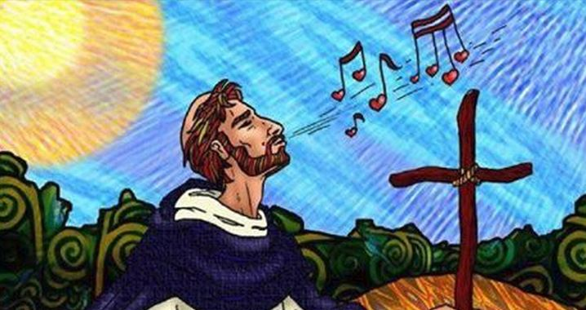
Laudare Benedicere Praedicare
Laudare
Benedicere
Praedicare
Laudare, we praise our Lord with our saints.
Benedicere, we lift our voice in song.
Praedicare, we proclaim Your Word to the world.
Laudare Benedicere Praedicare (Repeat)

