Slide 1

DOMINICAN SISTERS CONFERENCE
OCTOBER 2015
UNFCCC COP 21, November 28 – December 12, 2015
Third World Tribunal on the Rights of Mother Earth

Slide 2
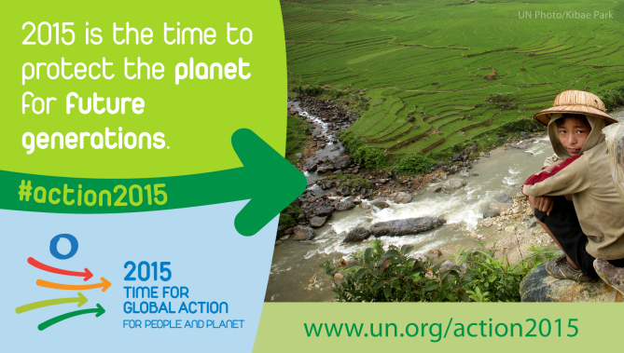

Slide 3
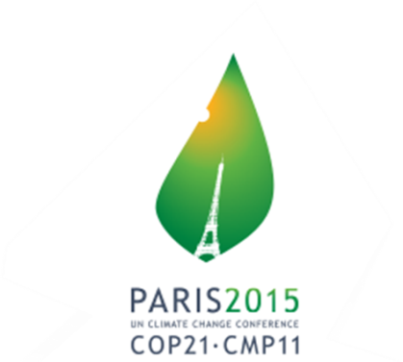
The UN and the Environment
1968 – Recommendation that GA convene a conference on the
“problems of the human environment”
1972 – United Nations Environment Programme (UNEP)
- World Charter for Nature
- World Commission on Environment & Development
- Bruntlandt Report - Our Common Vision
- UN Conference on Environment & Development
- Intergovernmental Panel on Climate Change (IPCC)
1992 - UN Conference on Sustainable Development - Earth Summit
1992 - UN Framework Convention on Climate Change

Slide 4
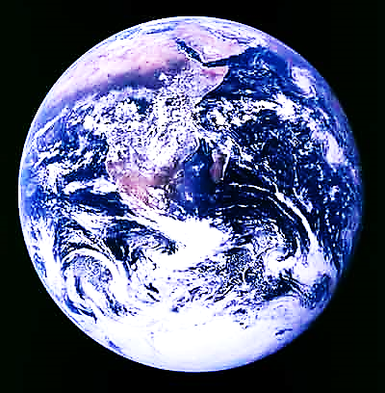
2012 - RIO + 20 - THE FUTURE WE WANT
We recognize that planet Earth and its ecosystems are our home and that Mother Earth is a common expression in a number of countries and regions and we note that some countries recognize the rights of nature in the context of the promotion of sustainable development.
We are convinced that in order to achieve a just balance among the economic, social and environmental needs of present and future generations, it is necessary to promote harmony with nature.

Slide 5
Post-2015 Development Agenda
Sustainable Development Goals
Sustainable Development :
meets the needs of the present generation without compromising the ability of future generations to meet their own needs. (1987)
a new vision?
universal agenda?
global partnership?
transformative approach?
“You cannot solve a problem from the same consciousness that created it.”
— Albert Einstein

Slide 6
Sustainable Development Goals:
End poverty / hunger / achieve food security
Ensure healthy lives; quality education
Gender equality & empower all women and girls
Availability/sustainable management of water and sanitation for all
Reduce inequality within/among countries
Ensure sustainable production / consumption
Take urgent action on climate change
Promote peaceful / inclusive societies for sustain-
development, provide access to justice for all,
build effective, accountable institutions
BUT………POLITICAL WILL? BINDING?
VOLUNTARY?

Slide 7
Another UN Track –
UNITED NATIONS FRAMEWORK CONVENTION ON CLIMATE CHANGE 1992
“At the very heart of the response to climate change, is the need to reduce emissions.”
Limit average global temperature increases & resulting climate change
1995 – realized that emissions provisions inadequate
1997 - KYOTO PROTOCOL
CONFERENCE OF THE PARTIES - COP
Highest decision-making body of UNFCCC
All states party to the Convention attend
Review and evaluate the implementation of the Convention
Meets yearly - venue shifts
COP 21 - PARIS

Slide 8
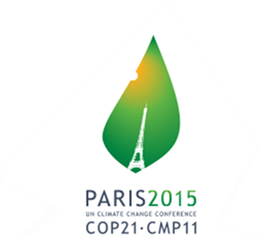
What do we need from Paris?
Environmentally ambitious agreement → LIMIT INCREASE
2 / 1.5 DEGREES CELSIUS
Fair & equitable - NORTH must take the lead
NORTH resistant -
wants same treatment for all (except LDCs)
New plan – all countries undertake same emissions reduction
now – or in future
Interim – ALL contribute to reduction in present/future emissions –
even if do not receive the funds/technology requested
SOUTH –
this shifts burden of change away from the NORTH…
to the SOUTH
Moving from cheap oil-based energy to renewables is costly
Who will pay?
Will development goals be affected?
What obligations should the SOUTH take on under Paris agreement, if
the NORTH does not meet obligations to assist?

Slide 9

FUNDING –
NORTH pledged us$100 billion annually by 2020
SOUTH wants firm commitment in Paris and a road-map on how
this goal will be reached
NORTH resistant
LEGALLY BINDING?
Will it be a protocol…another legally binding agreement…or an
outcome with legal force? ( COP 17 – DURBAN )
Will there be any real accountability?
Is there the necessary political will?

Slide 10

The Kyoto Protocol was the first critical step. Today, we must take further and more far reaching action towards a truly sustainable future for seven billion, rising to over nine billion people. Despite our best efforts, greenhouse gases continue to rise, threatening sustainable development and putting millions, if not billions of people at risk over the coming decades.
The Paris agreement of December this year, will bring all nations into common cause in support of men, women and children everywhere. It needs to be a long-term paradigm shift, that reflects today’s scientific reality - one that speaks to the urgency of swiftly peaking global greenhouse gas emissions, triggering a deep de-carbonization of the global economy and achieving climate neutrality in the second half of this century.
Christiana Figueres – Executive Secretary, UNFCCC

Slide 11
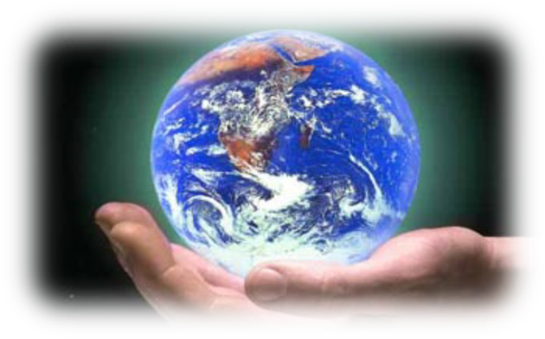
The Earth Charter asked us to leave behind a period of self-destruction and make a new start, but we have not as yet developed a universal awareness needed to achieve this. We still lack the culture needed to confront the crisis. We lack leadership capable of striking out on new paths and meeting the needs of the present with concern for all.
Pope Francis - Laudato, Si

Slide 12
What kind of world do we want to leave to leave to those who come after us?
What is the purpose of our life in this world?
Why are we here?
What is the goal of our work and of all our efforts?
What need does Earth have of us?
We need to see that what is at stake is our own dignity.

Slide 13
WHAT IS EARTH ASKING OF US?

Slide 14
DOMINICAN SISTERS CONFERENCE
OCTOBER 2015 – Part II
COP 21 – November 30 – December 11, 2015
Third International Tribunal on the Rights of Mother Earth, December 4 -5, 2015

Slide 15
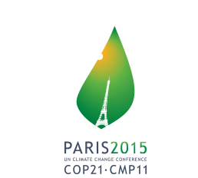
COP 21 – November 30 – December 11, 2015
UNFCCC Since 1995 Secretariat charged with supporting the operation of the Convention, located in Bonn, Germany,
Executive Secretary Christiana Figueres, serving since July 2010
195 countries are Parties of the Convention (COP)
Divided into 3 different groupings
Annex I, II, III countries

Slide 16
The ultimate objective of the Convention
stabilize greenhouse gas concentrations “at a level that would prevent dangerous anthropogenic (human induced) interference with the climate system”. (Article 2) (not more than 1.5 C)
“such a level should be achieved within a time-frame sufficient to allow ecosystems to adapt naturally to climate change, to ensure that food production is not threatened, and to enable economic development to proceed in a sustainable manner”.

Slide 17
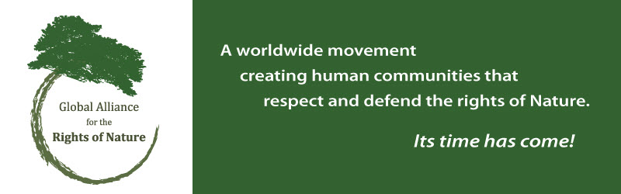
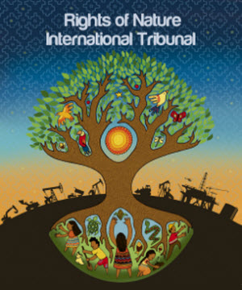
Third International Tribunal on Rights of Mother Earth
December 4 – 5, 2015

Slide 18
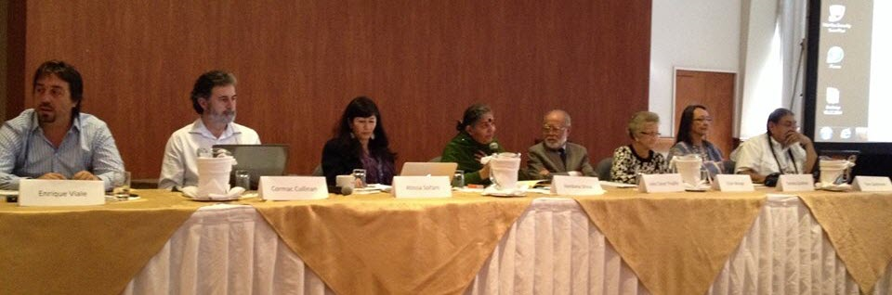
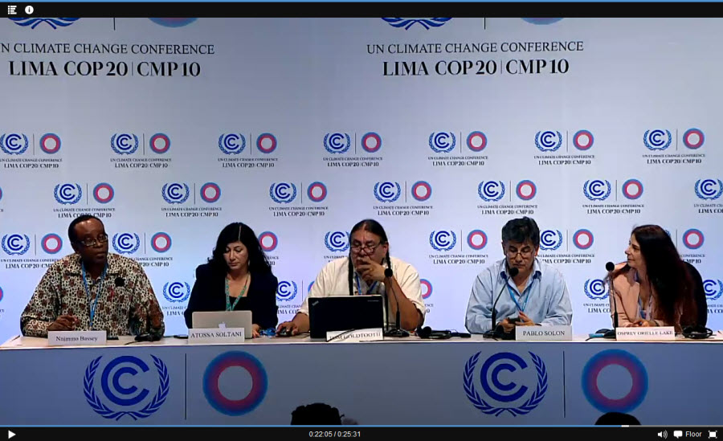

These are the first two international ETHICS tribunals on the Rights of Mother Earth
First Tribunal of Rights of Mother EArth – Quito, Ecuador
January 14, 2014
Second Tribunal of Rights of Mother Earth - Lima, Peru
December 9, 2014

Slide 19
Cases to be heard: Co-violations of
Environmental and Human Rights
Financialization/commodification of Nature
Fracking
Climate Change: False Solutions
Agro-food industry
GMOs
Mega Dams in the Amazon
Oil and minerals extraction
Eliminating Ecocide/Crimes against Nature
Defenders of Mother Earth

Slide 20

Judges issue evidentiary findings
Each judge issues an opinion on a single case whether there is a violation of the Universal Declaration of the Rights of Mother Earth. If yes, the judge will:
Recommend actions for reparation, mitigation, restoration and prevention of further damages and harm.
Advance notice to appropriate national governmental body, if responsible
Notify CEO/Board of Directors of corporation responsible
Leverage of press coverage and building of public opinion

Slide 21
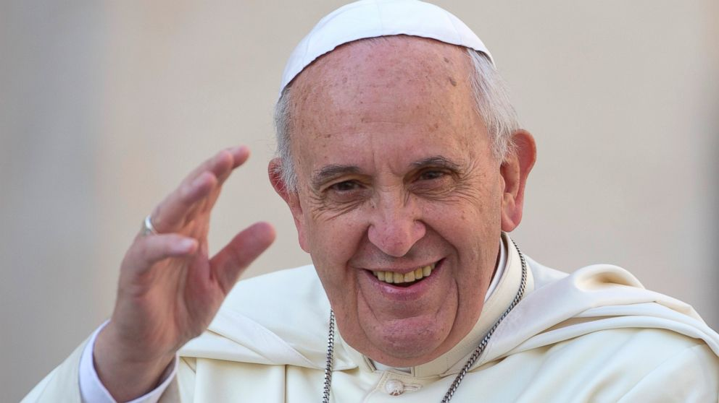
Unexpected support for RON at the UN
“It must be stated that a true ‘right of the environment does exist.”
“Any harm done to the environment, therefor is harm to humanity.”
Laudato Sí spoke of rights of individuals, the poor, and future generations, but not of Earth itself.

Slide 22
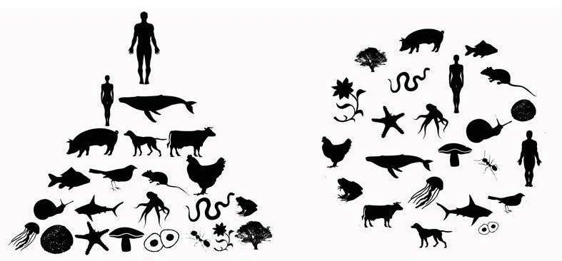
Building a Peoples’ Movement
for Climate Justice for All
Just like ending slavery of people we must also end the slavery of Nature: being treated as mere property.
We must recognize the rights of Nature that already inherently exist and protect its right to flourish in balance with human and other species’ well-being.
This requires massive shifts in consciousness, ethics, culture and legal systems.

Slide 23

Hope is a state of mind, not of the world.
Hope, in this deep and powerful sense, is not the same as joy that things are going well,
or willingness to invest in enterprises
that are obviously heading for success,
but rather an ability to work for something
because it is good.
Hope is definitely not the same as optimism.
It is not the conviction that something
will turn out well,
but the certainty that something
makes sense,
regardless of how it turns out.
Vaclav Havel

