Slide 1


Slide 2


Slide 3
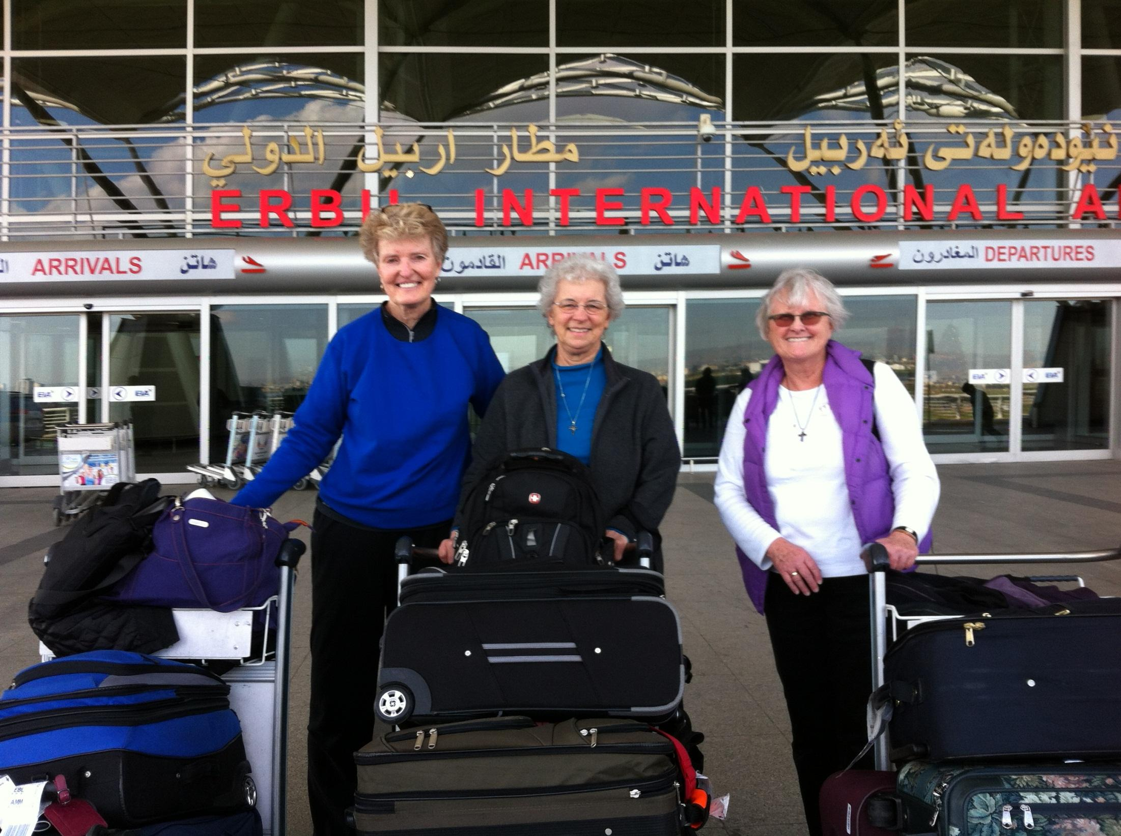

Slide 4
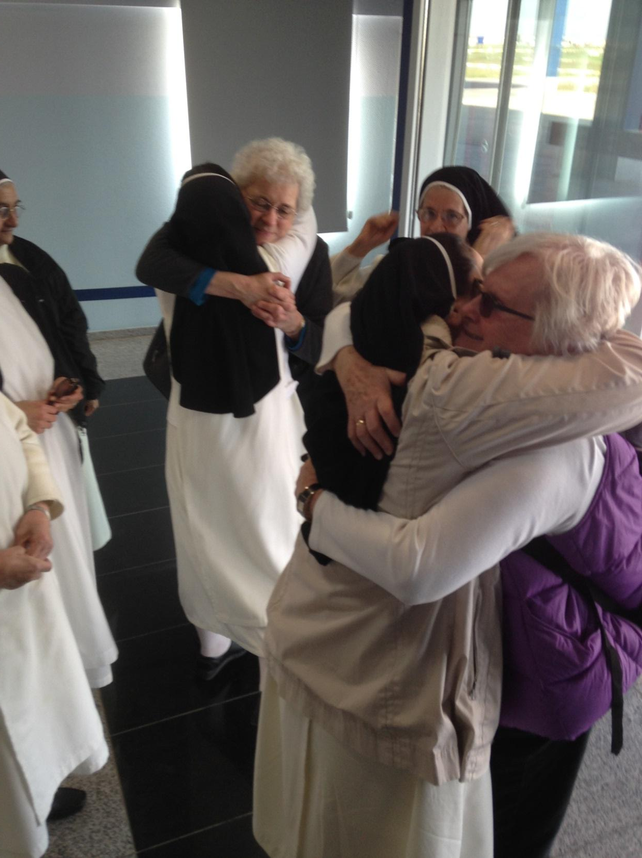
Notes:
Erbil runion Marceline, Dusty and Iraqi Sisters

Slide 5
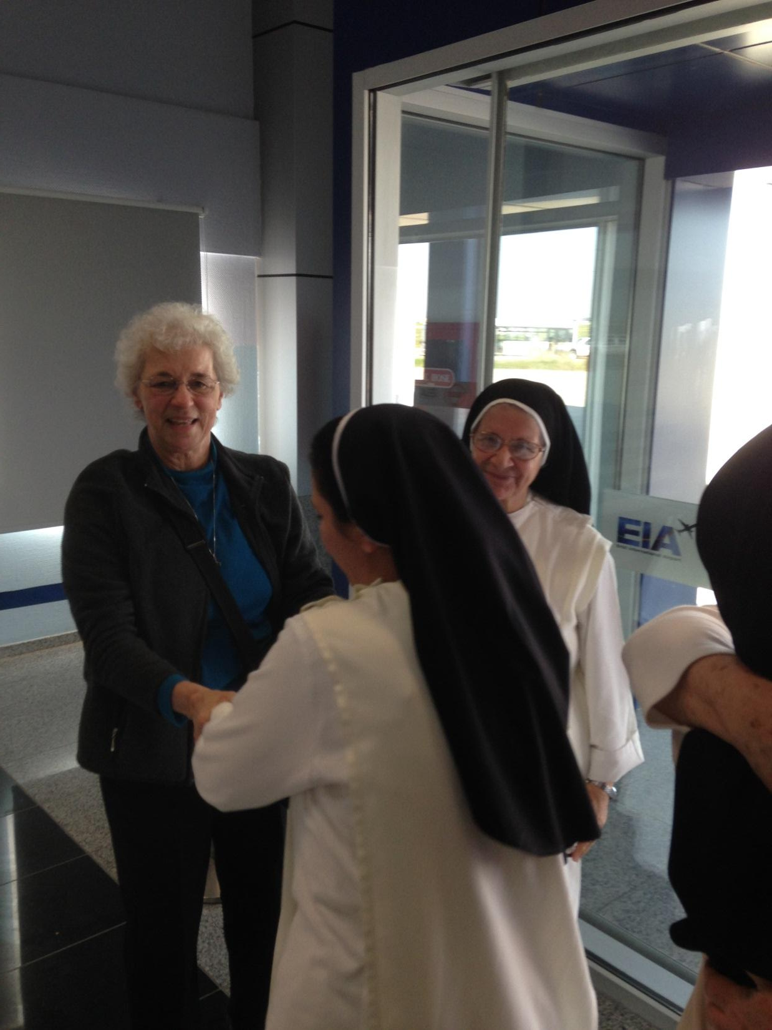
Notes:
Sr Marcelline and Sr. Luma reunited in Erbil

Slide 6
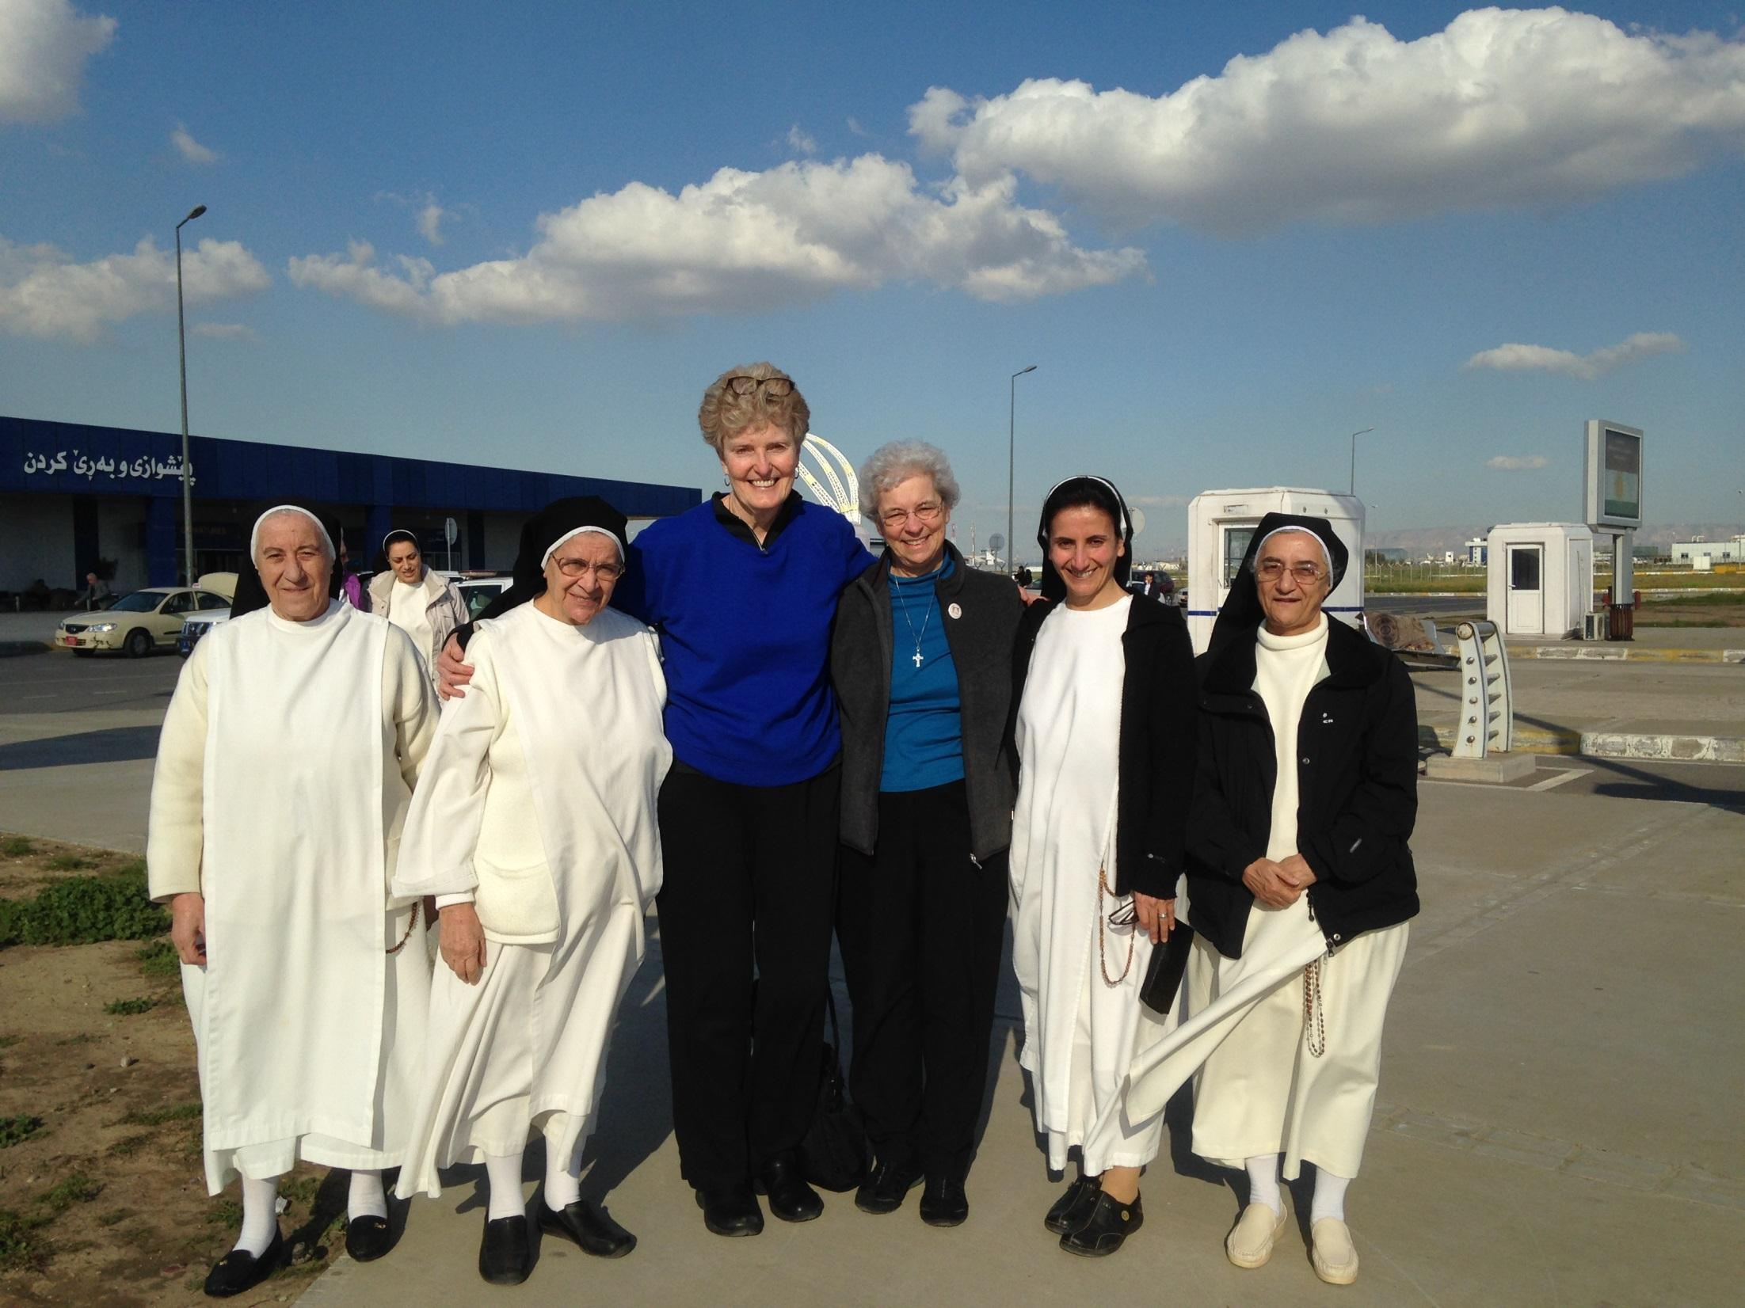
Notes:
Greeted at airport Lto R SRS Habiba, M therese, Arlene Marcelling, Luma and Huda

Slide 7
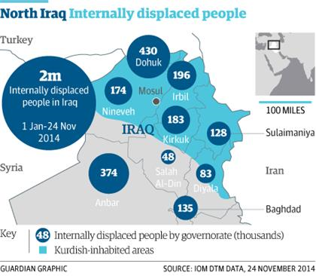

Slide 8
January 2015 Statistics on IDPS
Displaced in Iraq now at 2.1 million
Women and girls remain particularly vulnerable

Slide 9
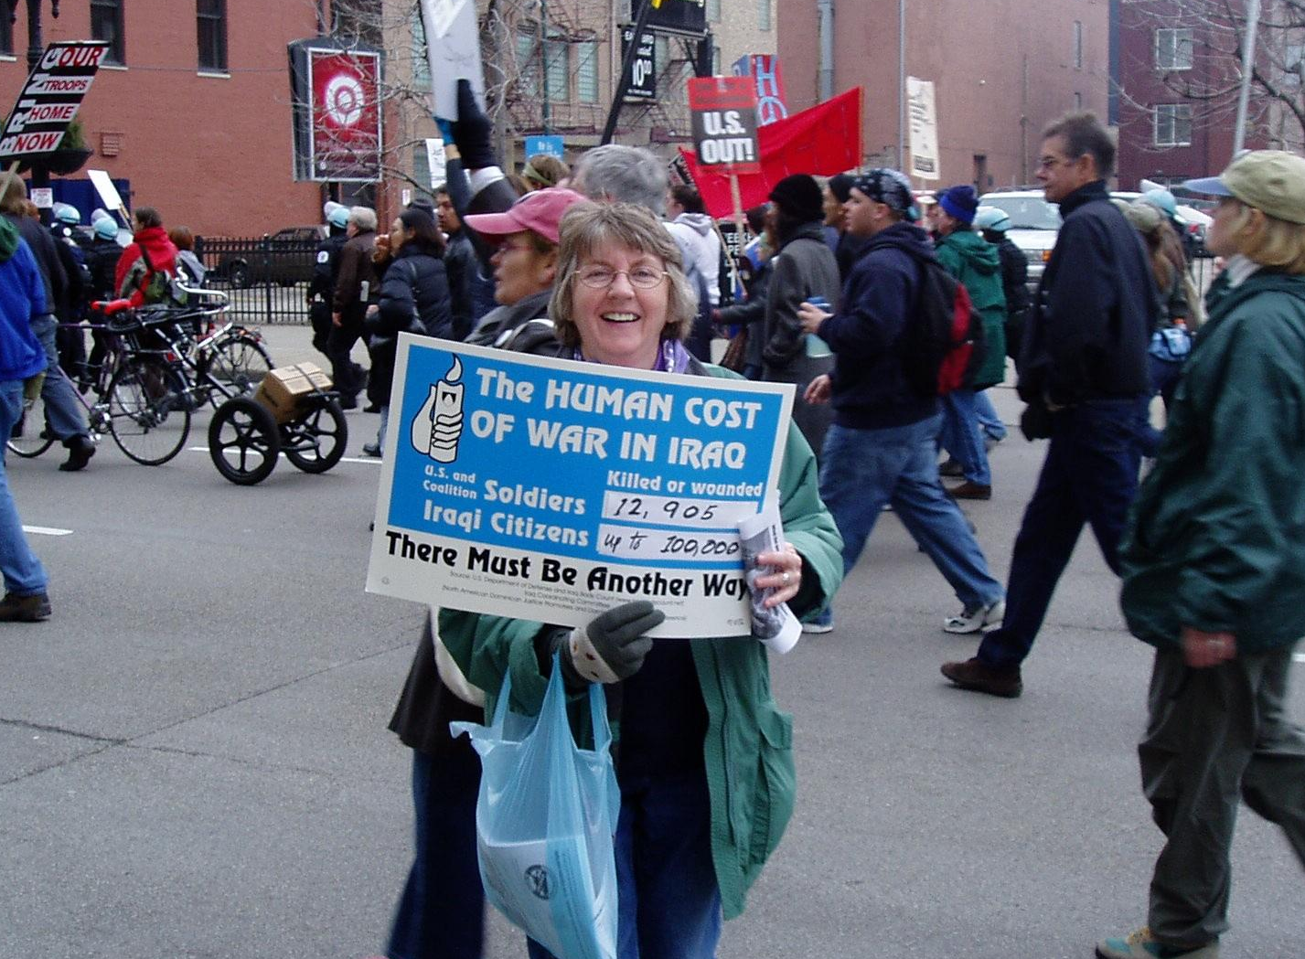

Slide 10
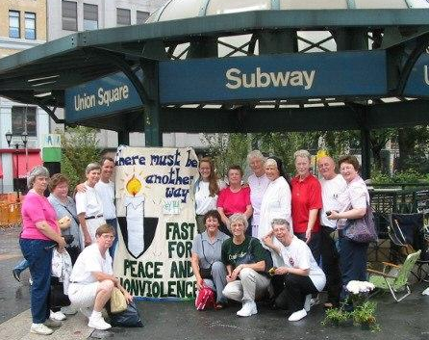
S
E
P 2
T 0
E 0
M 2
B
E
R
Dominican Fast for Peace in Iraq, NYC

Slide 11

Iraqi Refugee Resettlement Post card Campaign, 2008

Slide 12
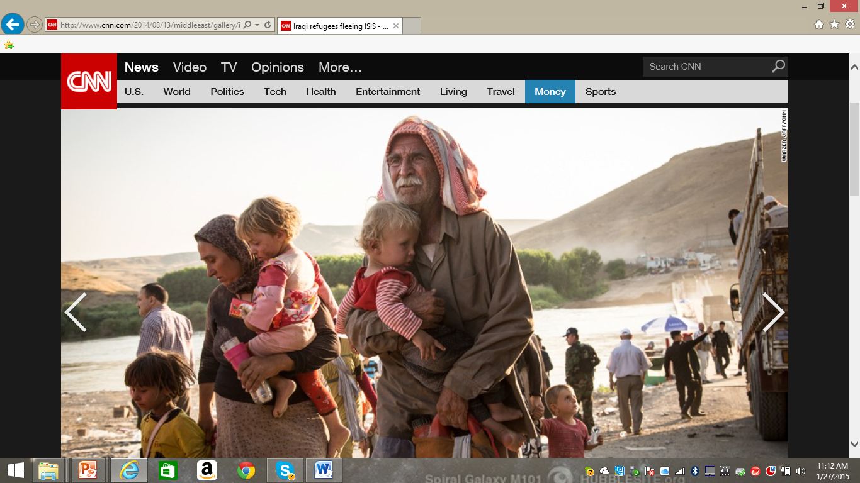

Slide 13
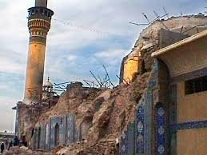
Bombing of Golden Dome,
Shia Mosque in Samarra, Iraq,

Slide 14
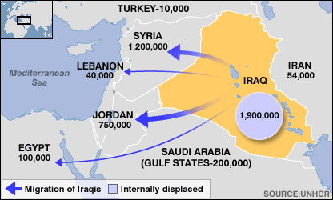
Iraqis: Fleeing for their Lives

Slide 15
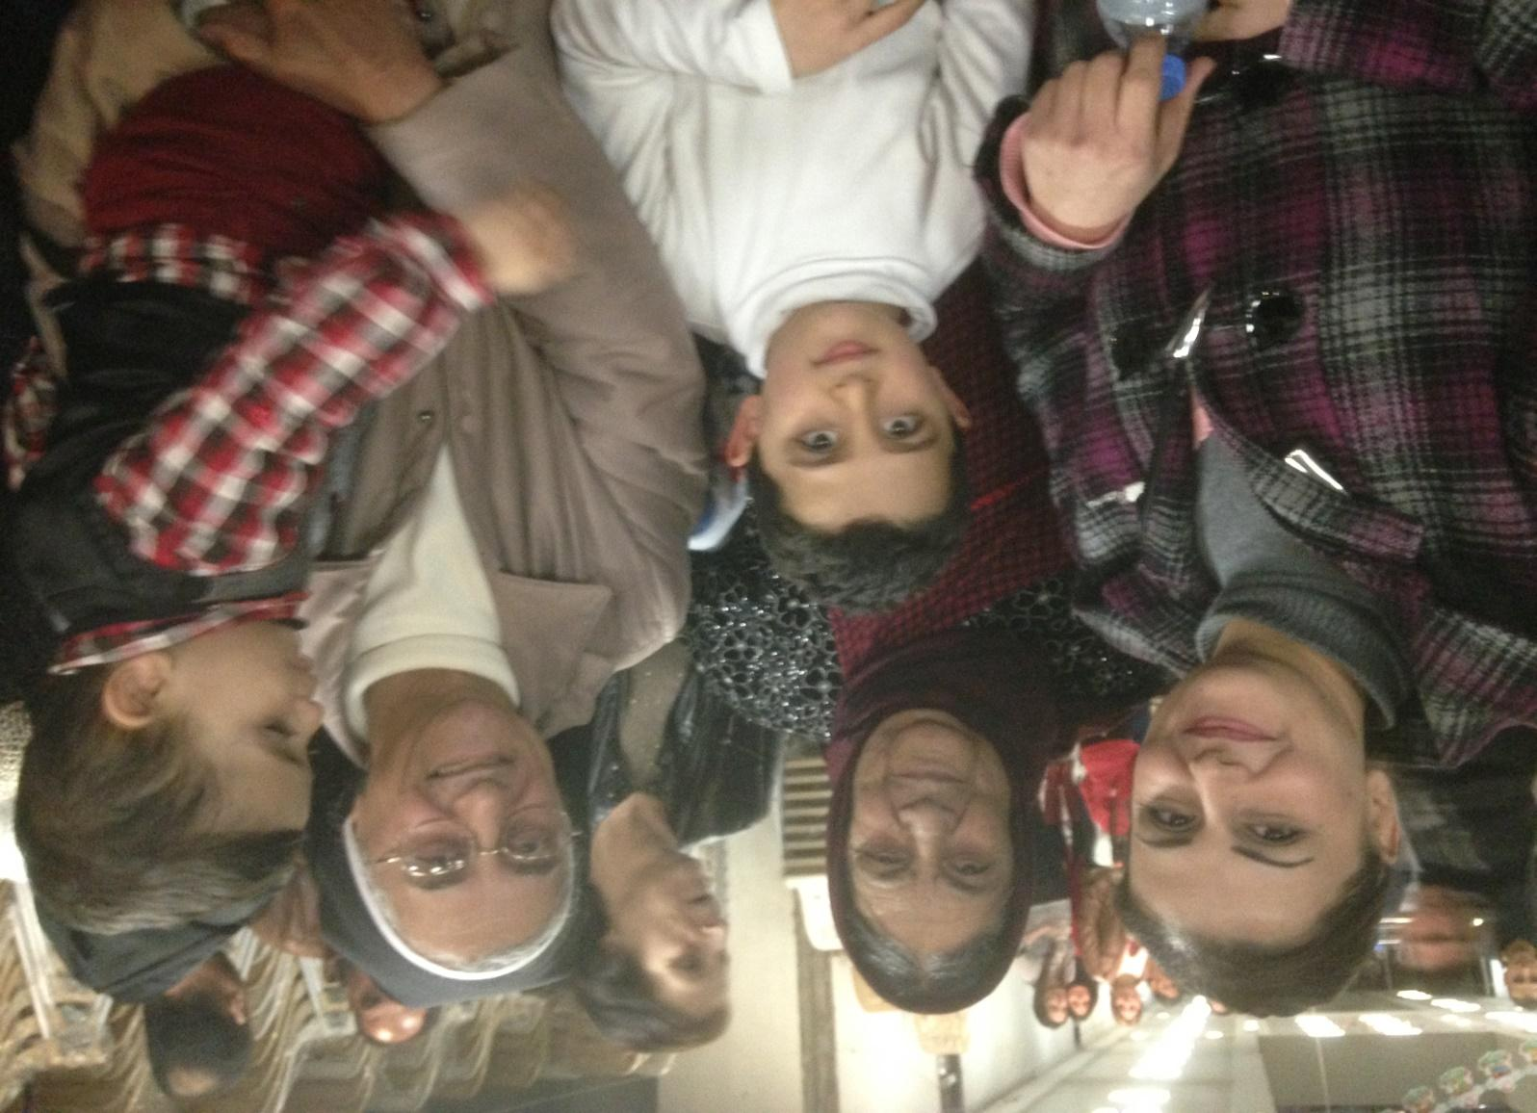
Sr. Huda, OP and her family in IDP Center, Erbil

Slide 16
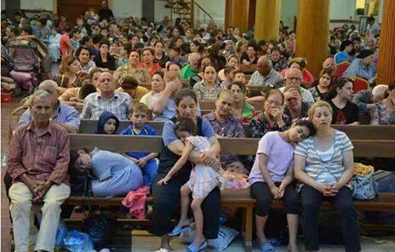
August 2014, Fleeing ISIS/L
Exhausted Iraqi Christians arrive in
Erbil , IRAQ

Slide 17
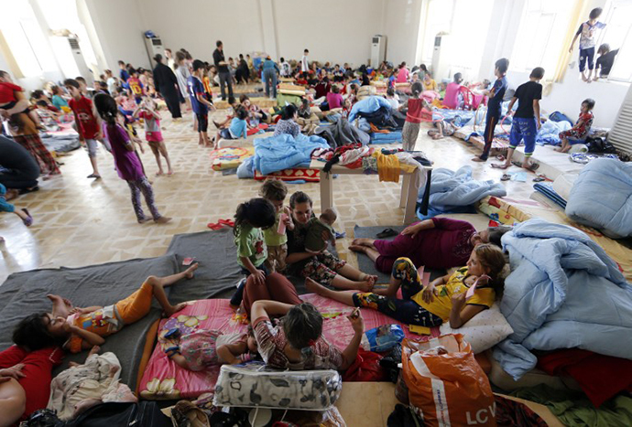

Slide 18
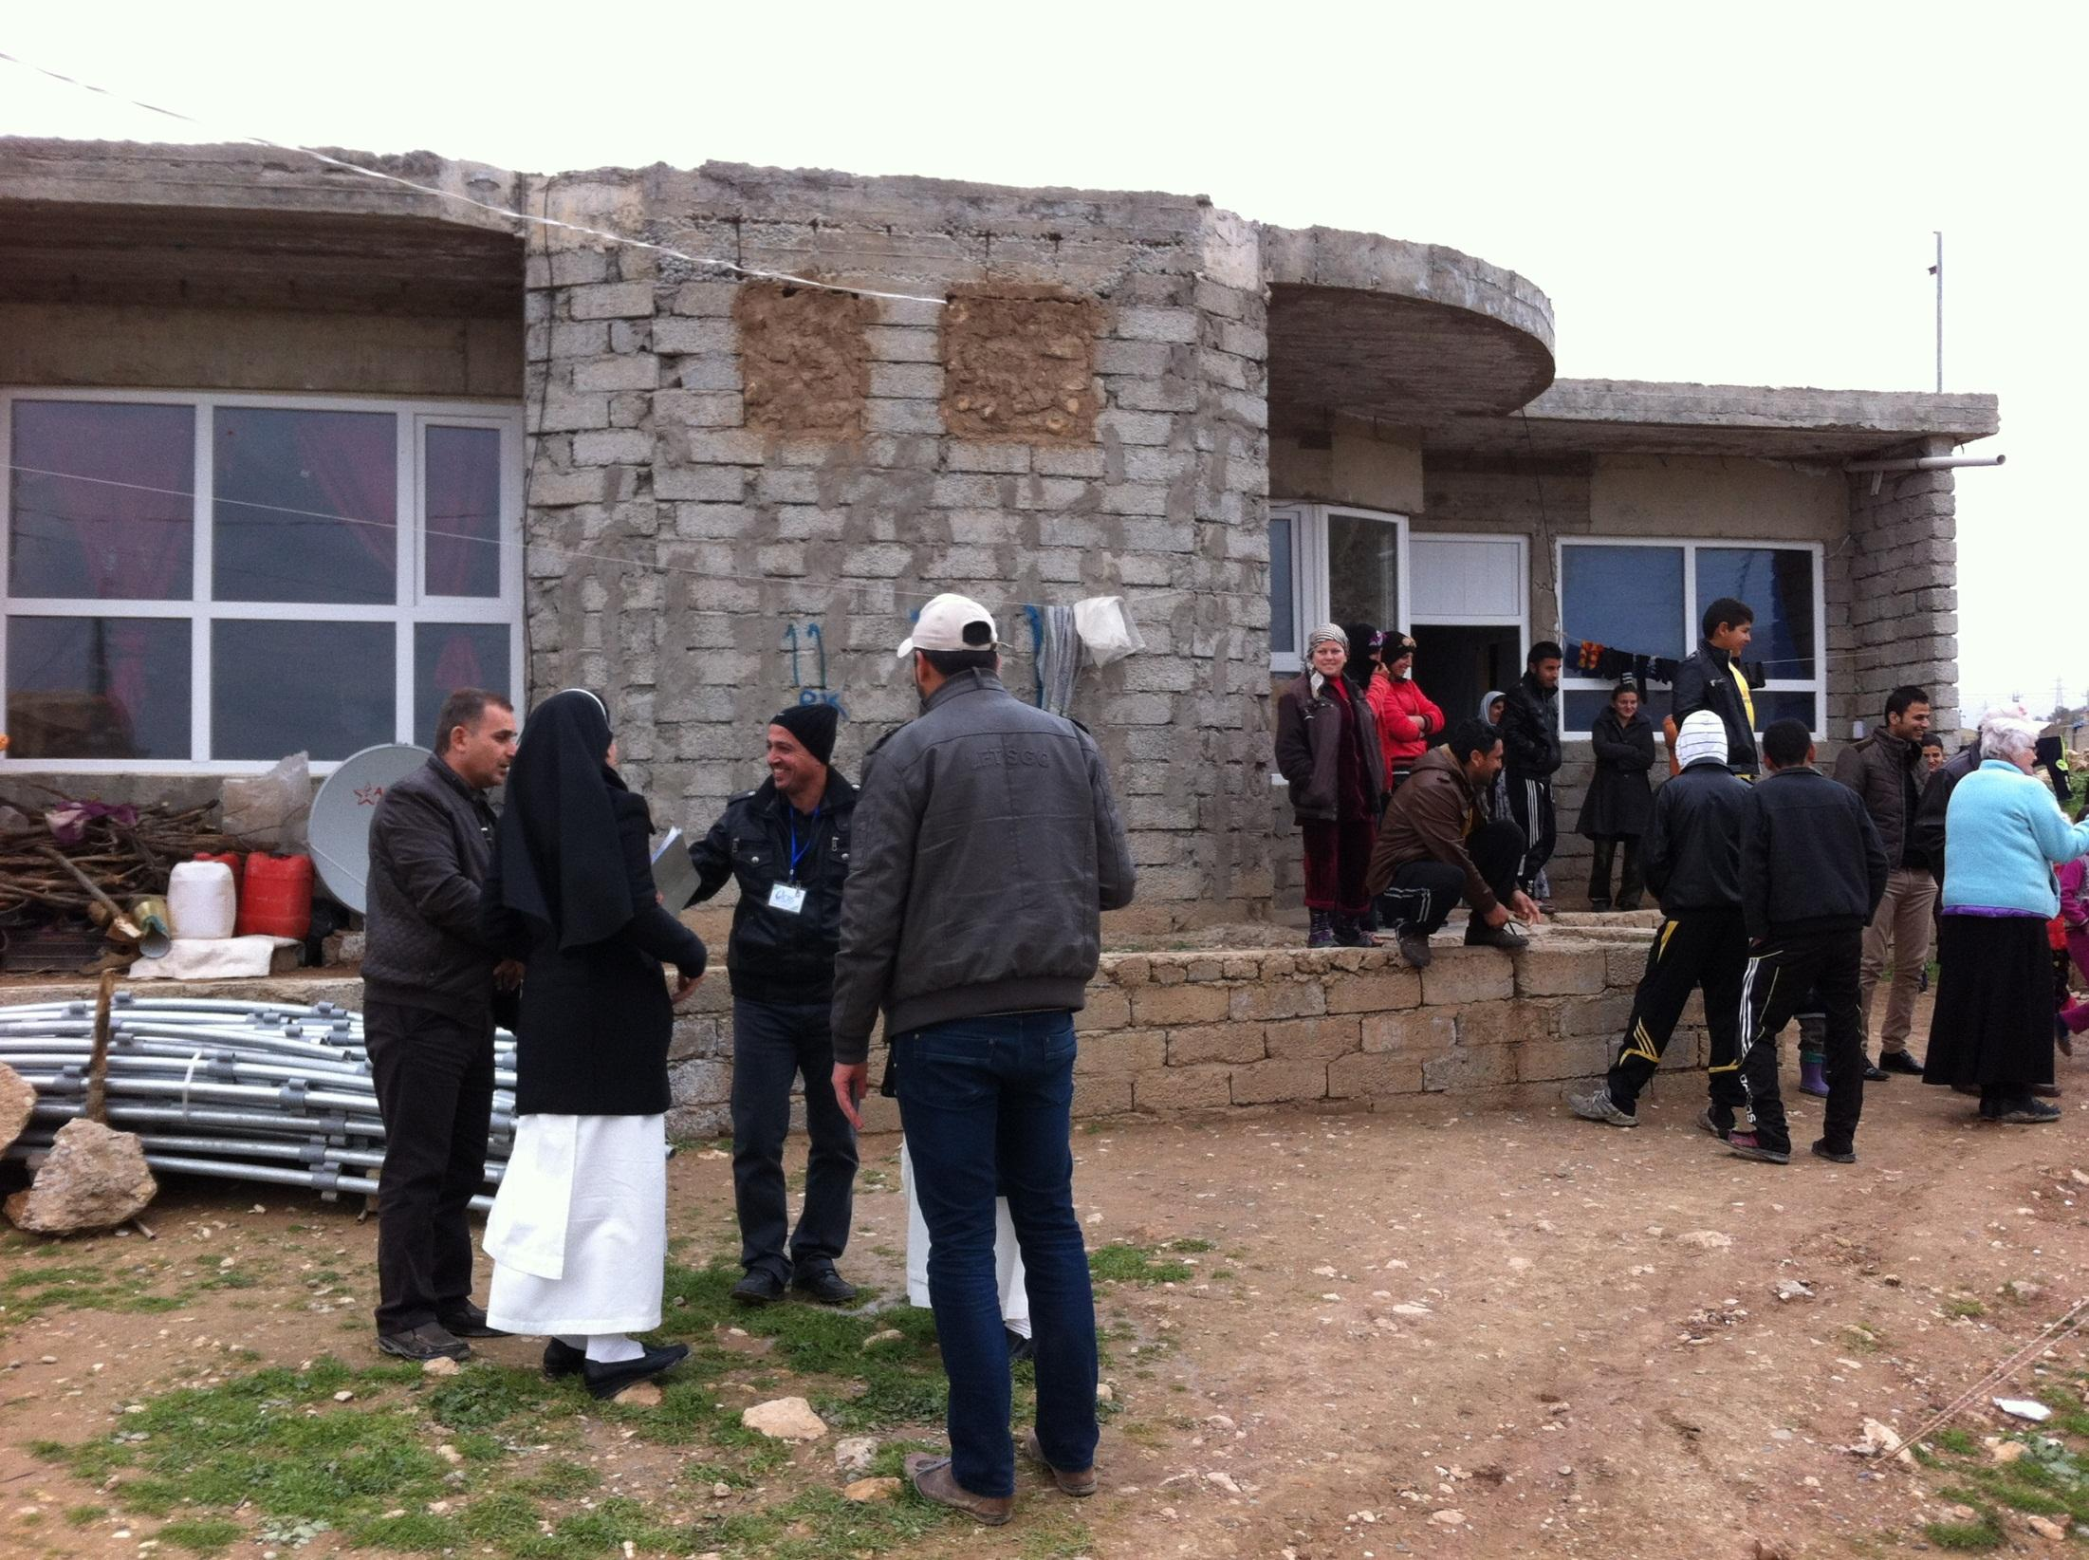
Notes:
Twin's family at Brazilian camp

Slide 19
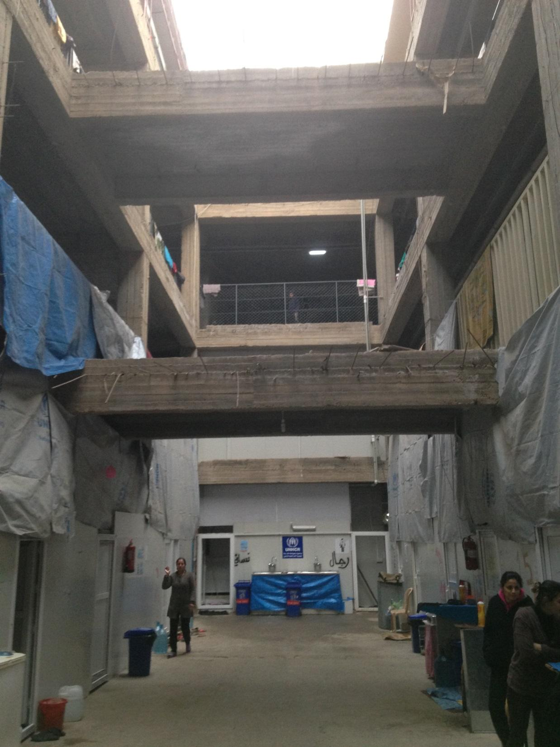
Notes:
Ankawa Mall 4

Slide 20
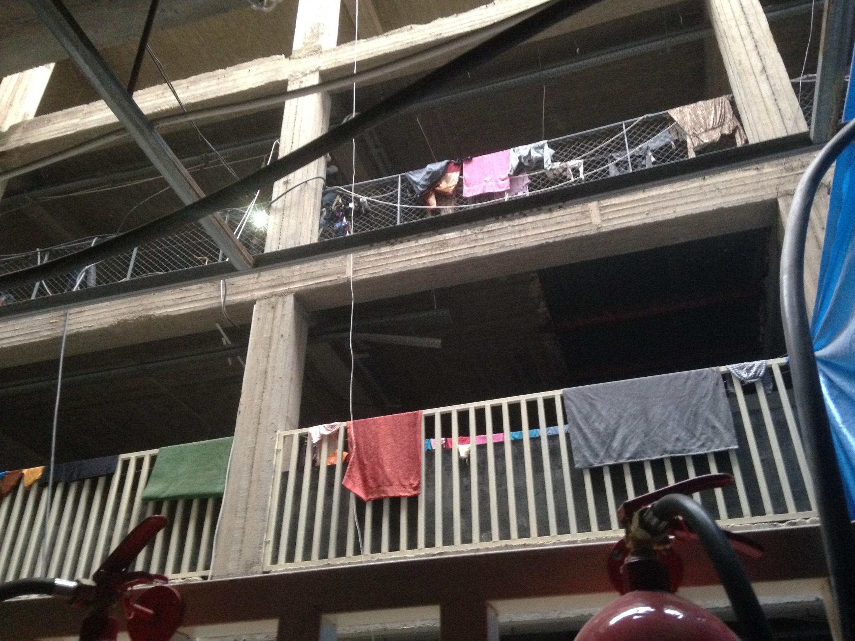
Notes:
Ankawa Mall where several hundred families are in shelter

Slide 21
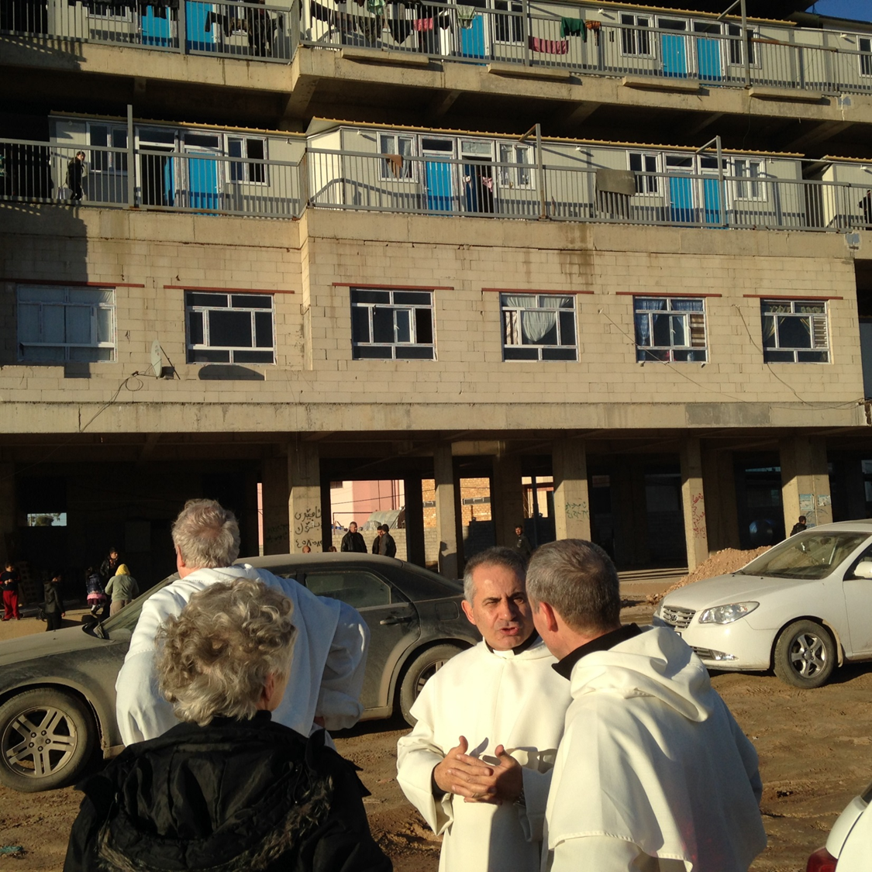
Fr. Najeeb OP
in front of
IDP Center
in Erbil

Slide 22
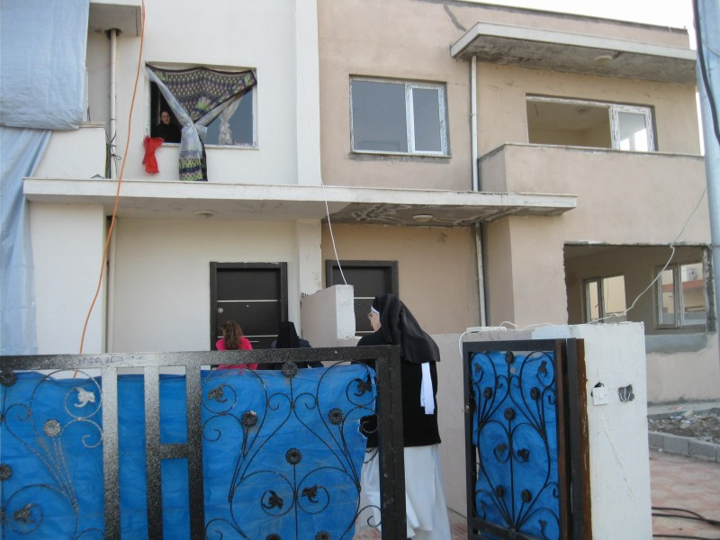
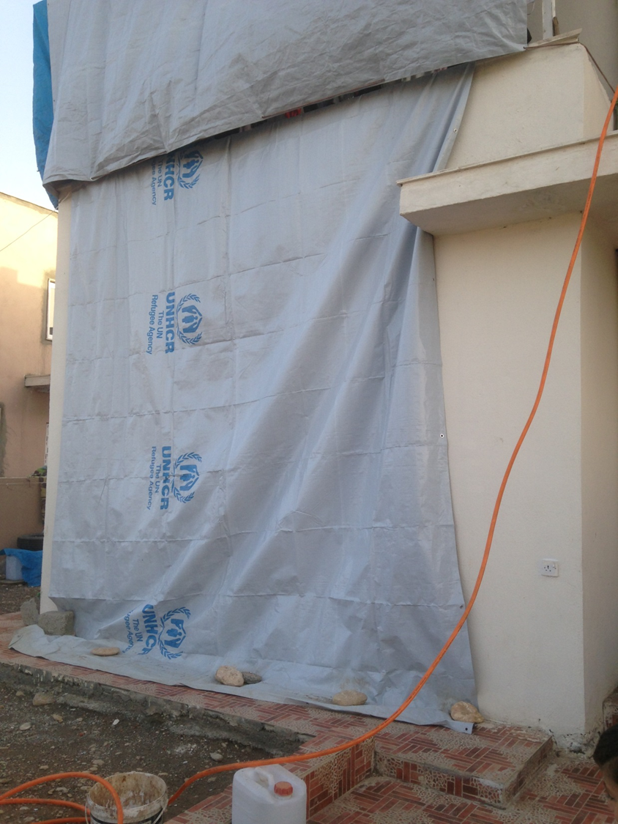
Notes:
unfinished homes at Kaznazan

Slide 23
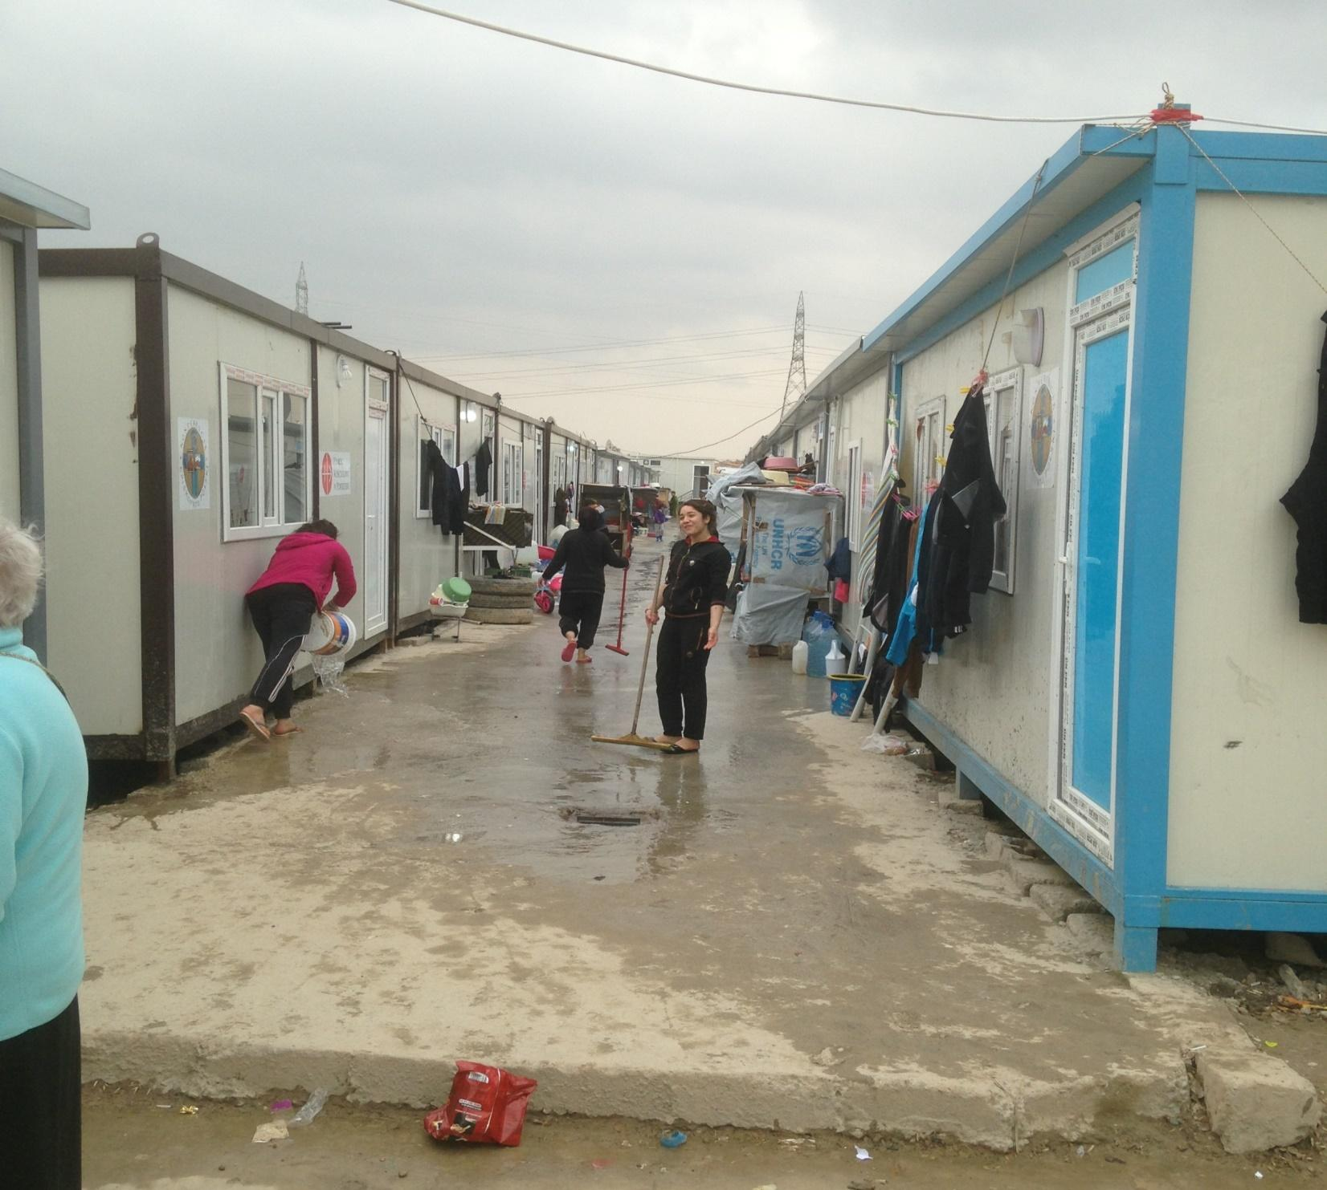
Notes:
The Braziilian Camp 2

Slide 24
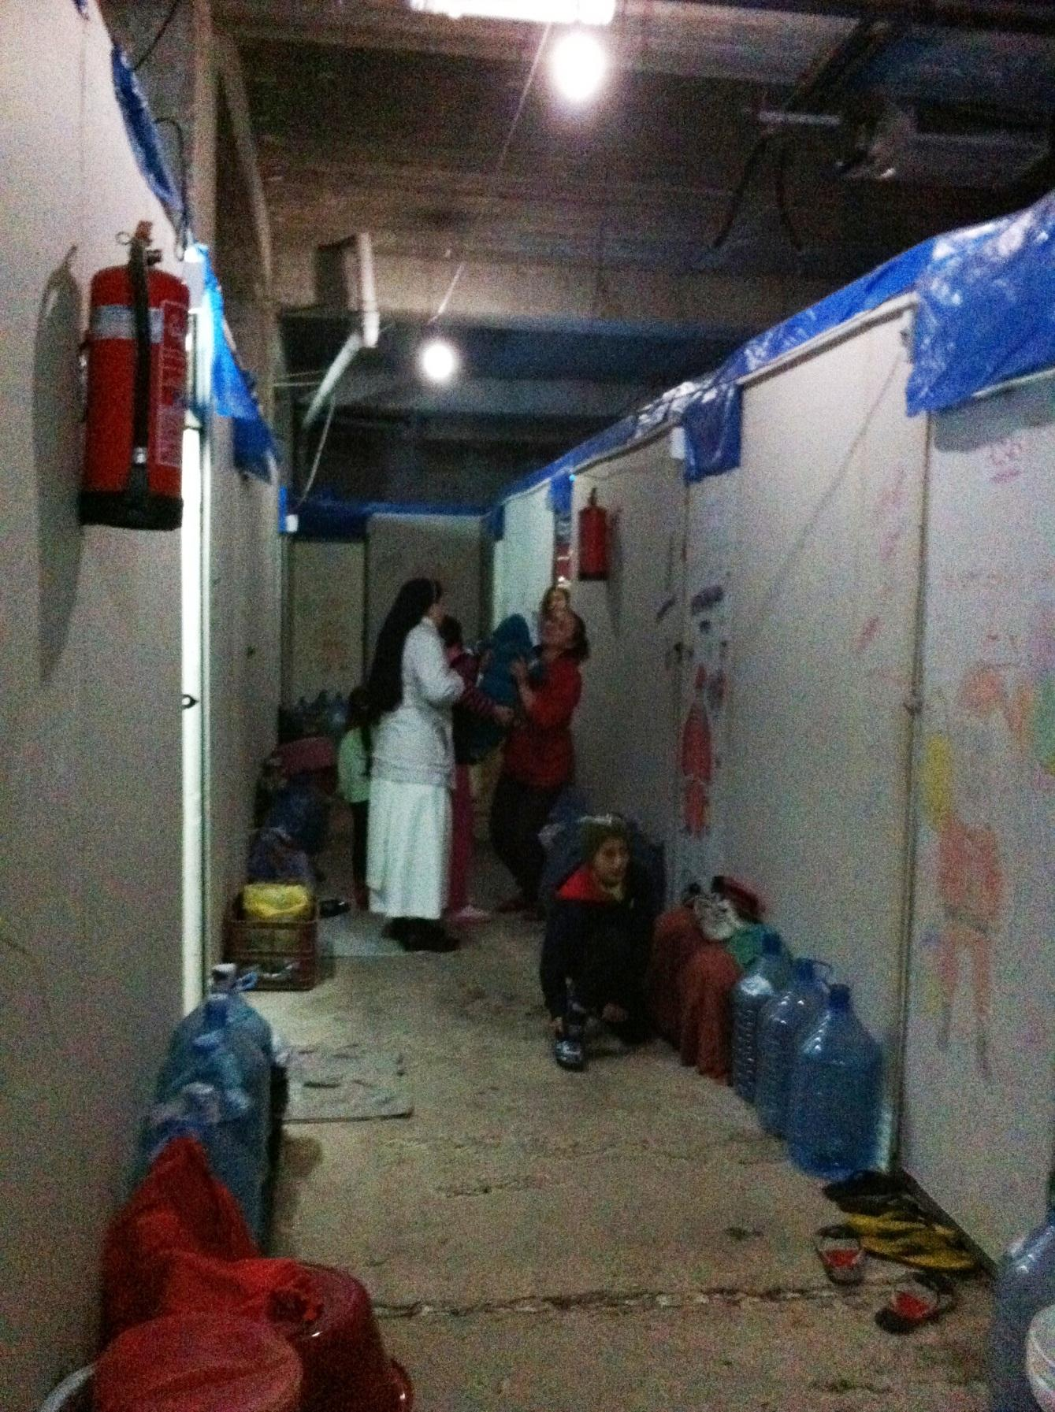
Notes:
unfinished buildings at Kaznazan

Slide 25
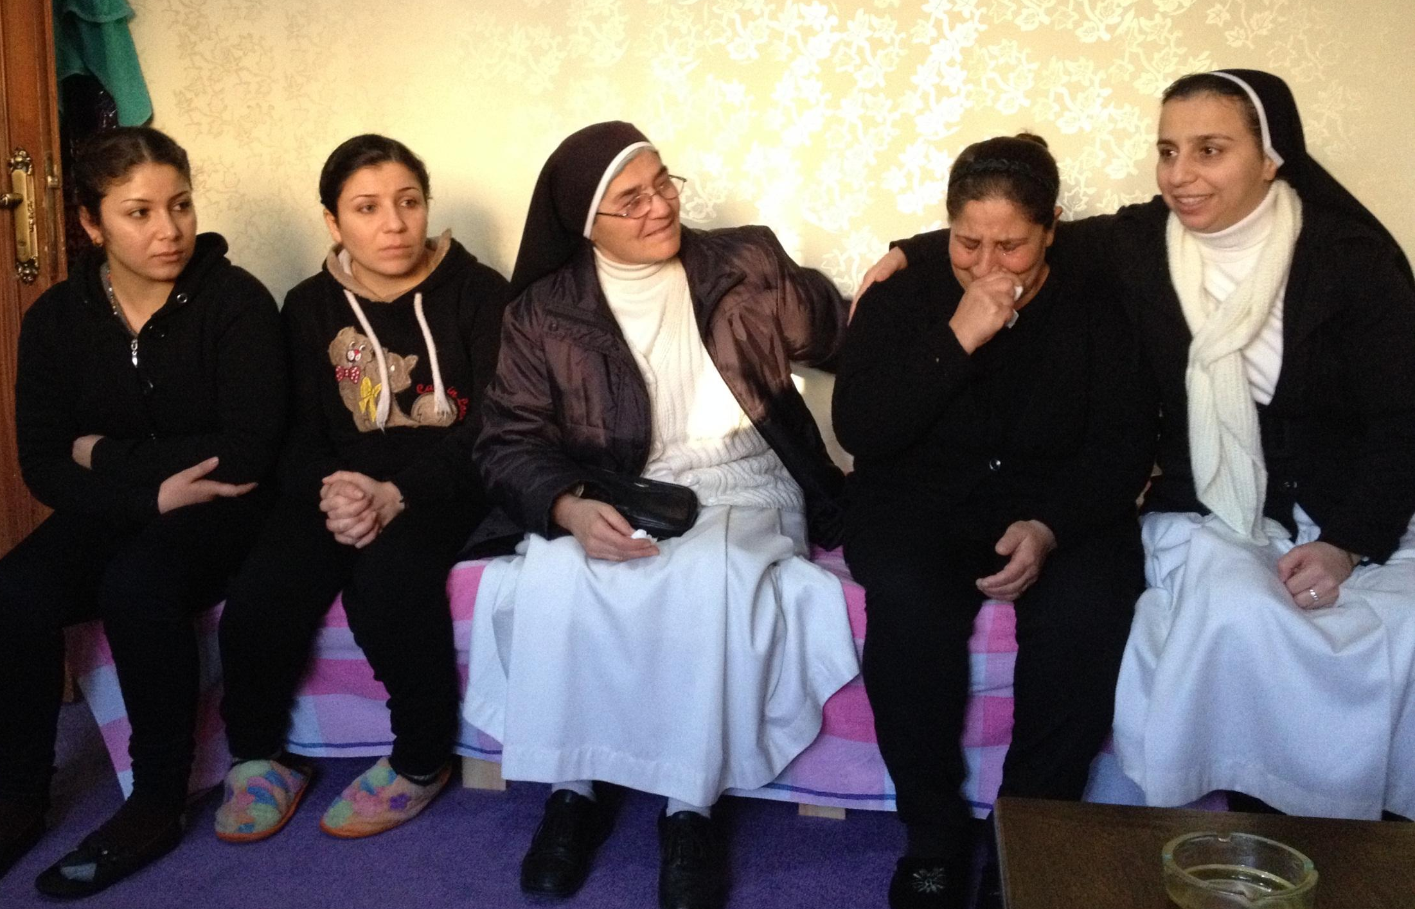
Notes:
Center 1 Children and Adults at Mass

Slide 26
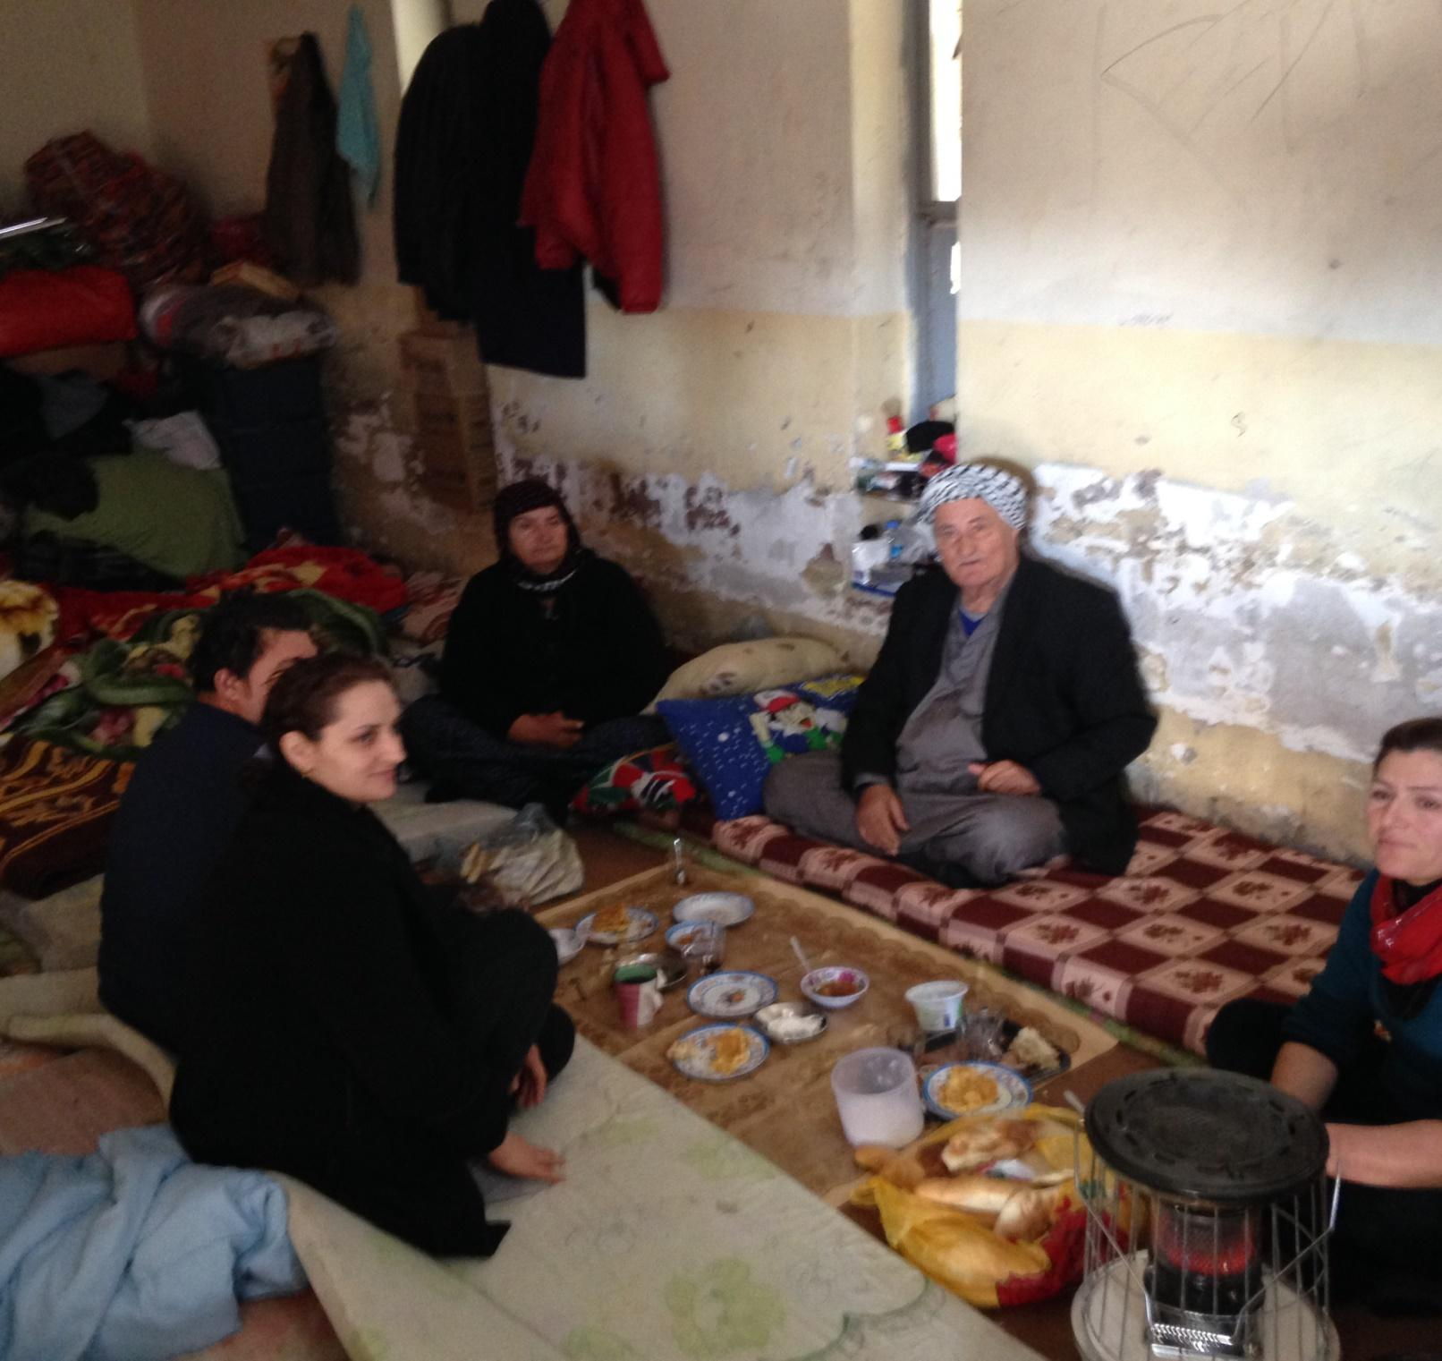

Slide 27
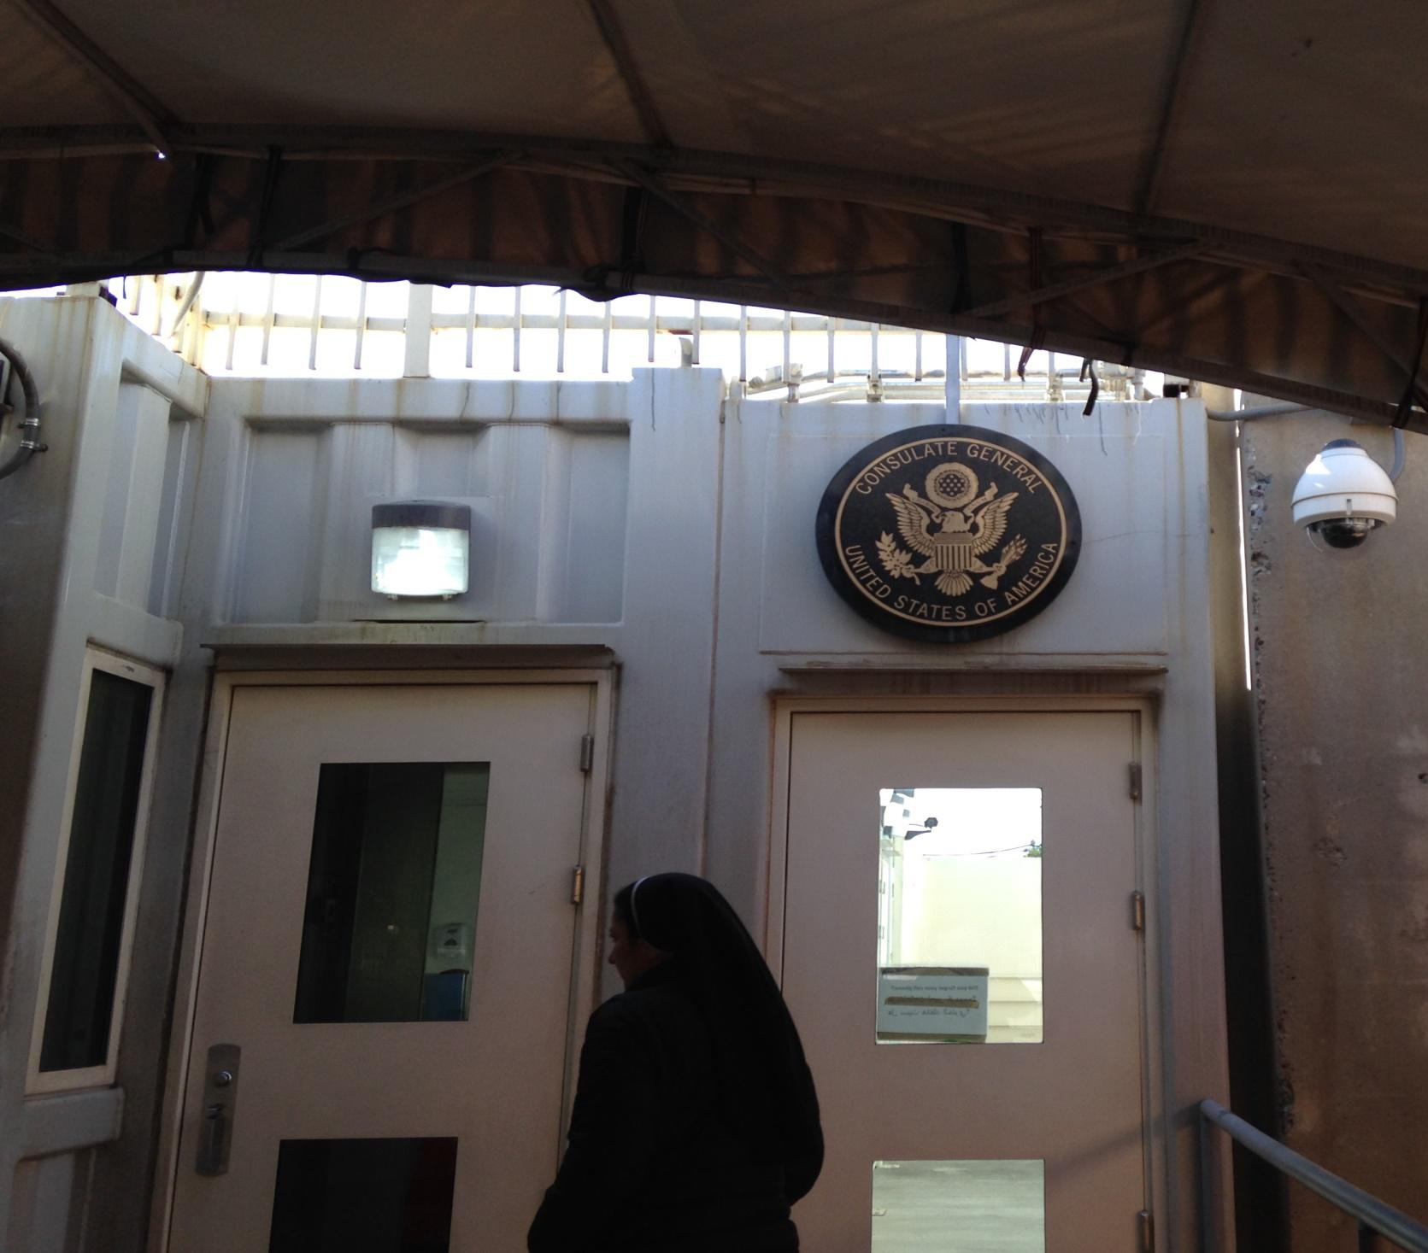

Slide 28
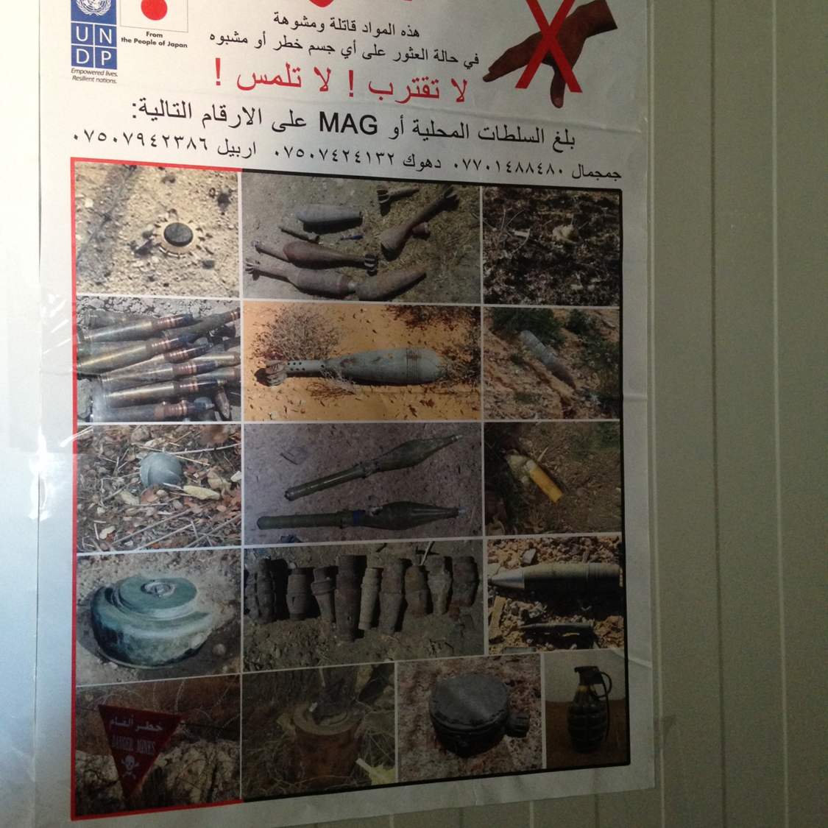

Slide 29
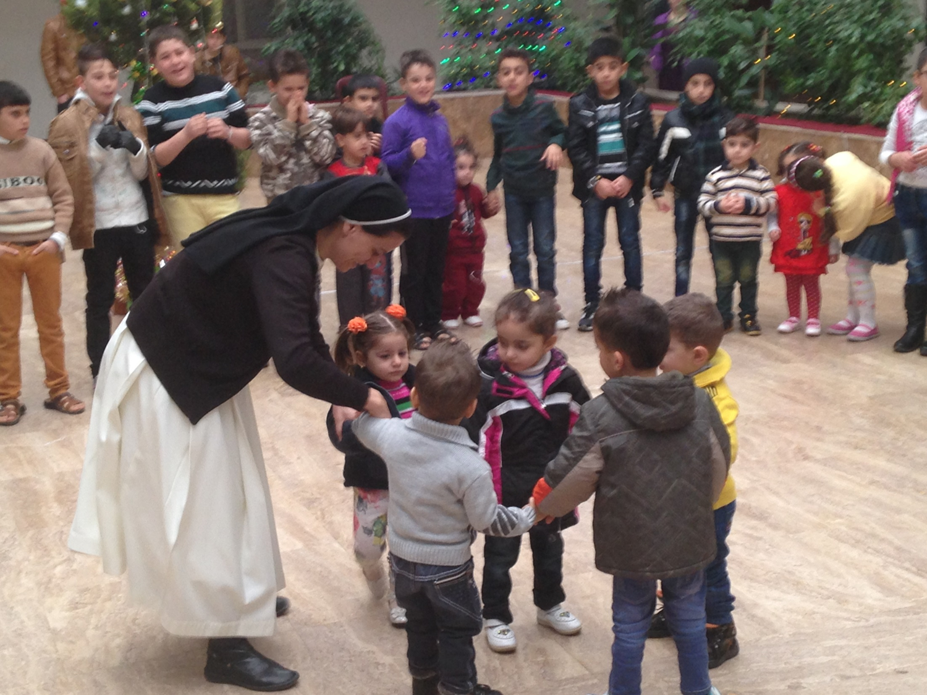

Slide 30
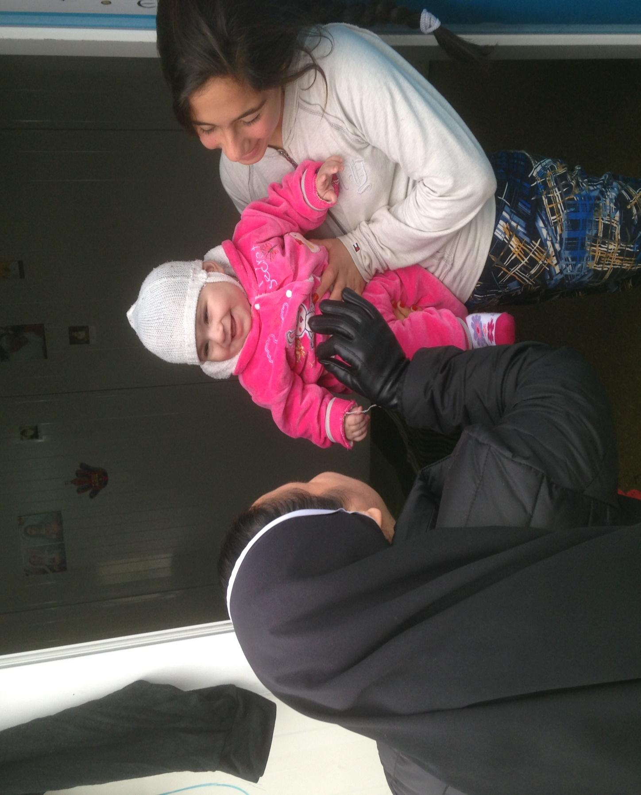

Slide 31
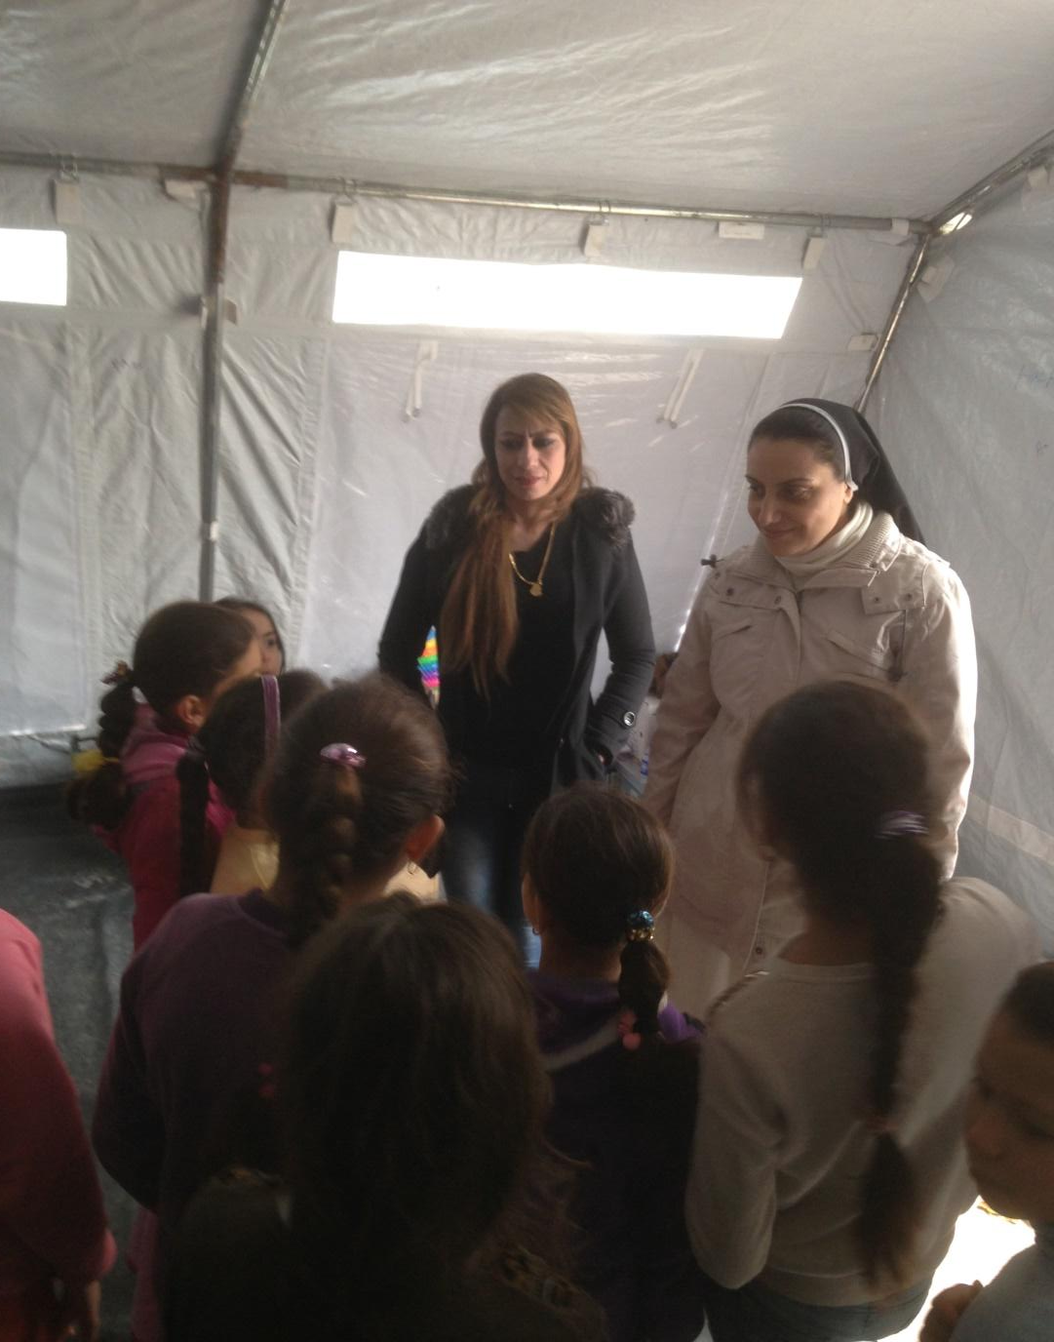
Witnesses to a "hope which turns its face toward the future while anchoring its feet in the now.”
from Nadine Foley, OP, Advent, 2014 preaching

Slide 32
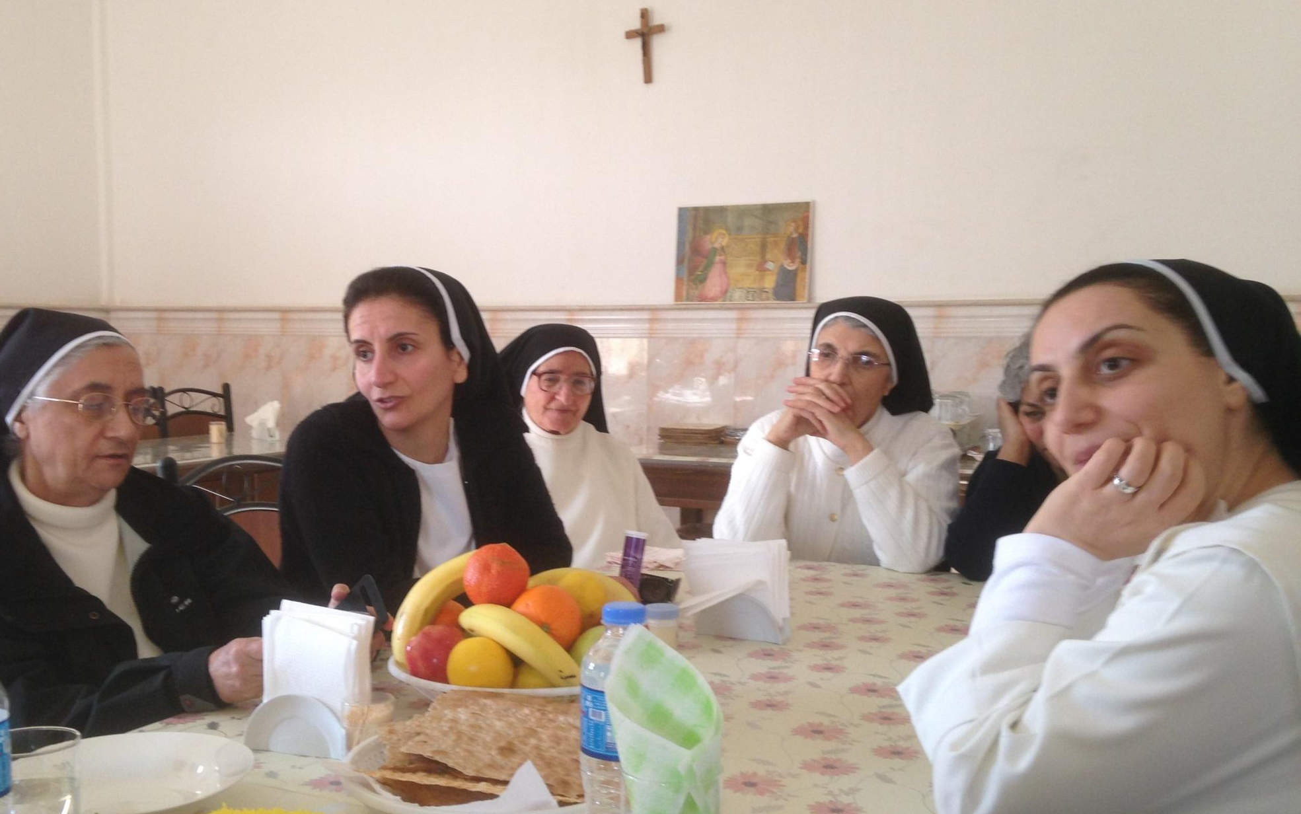

Slide 33
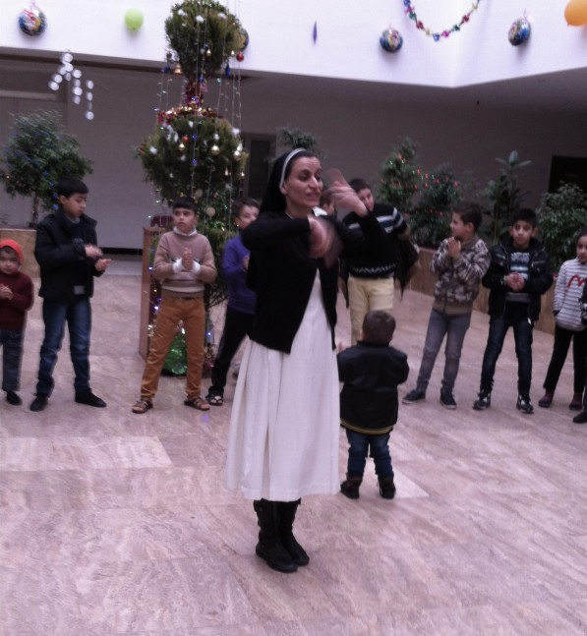
Notes:
Op Sisters of Mosul with Christian IDP Dohuk

Slide 34
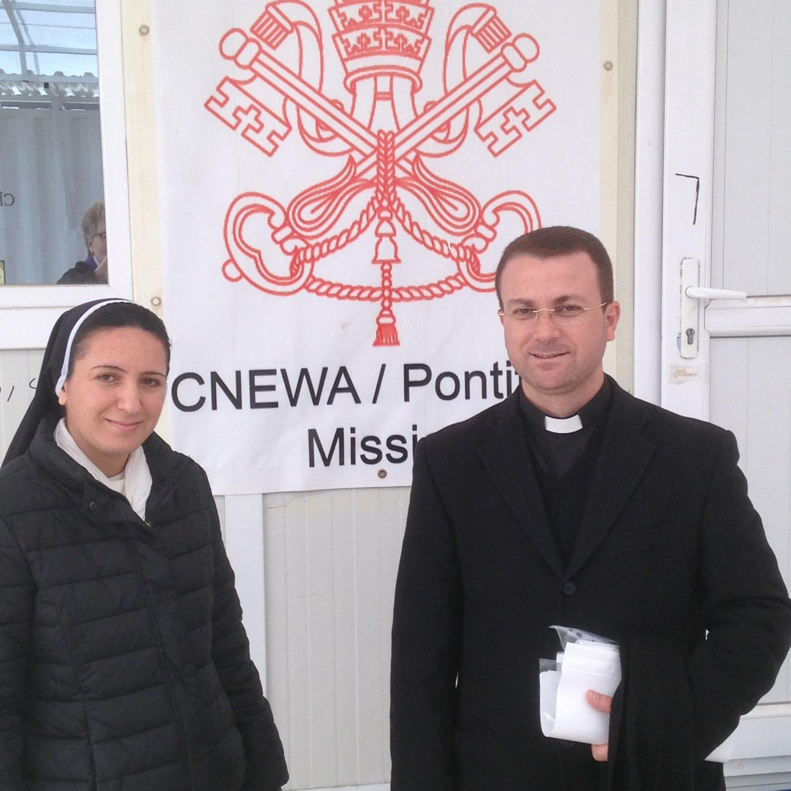
Clinic in Erbil, Iraq for Refugees
Notes:
Fr Benham and Sr Diana

Slide 35
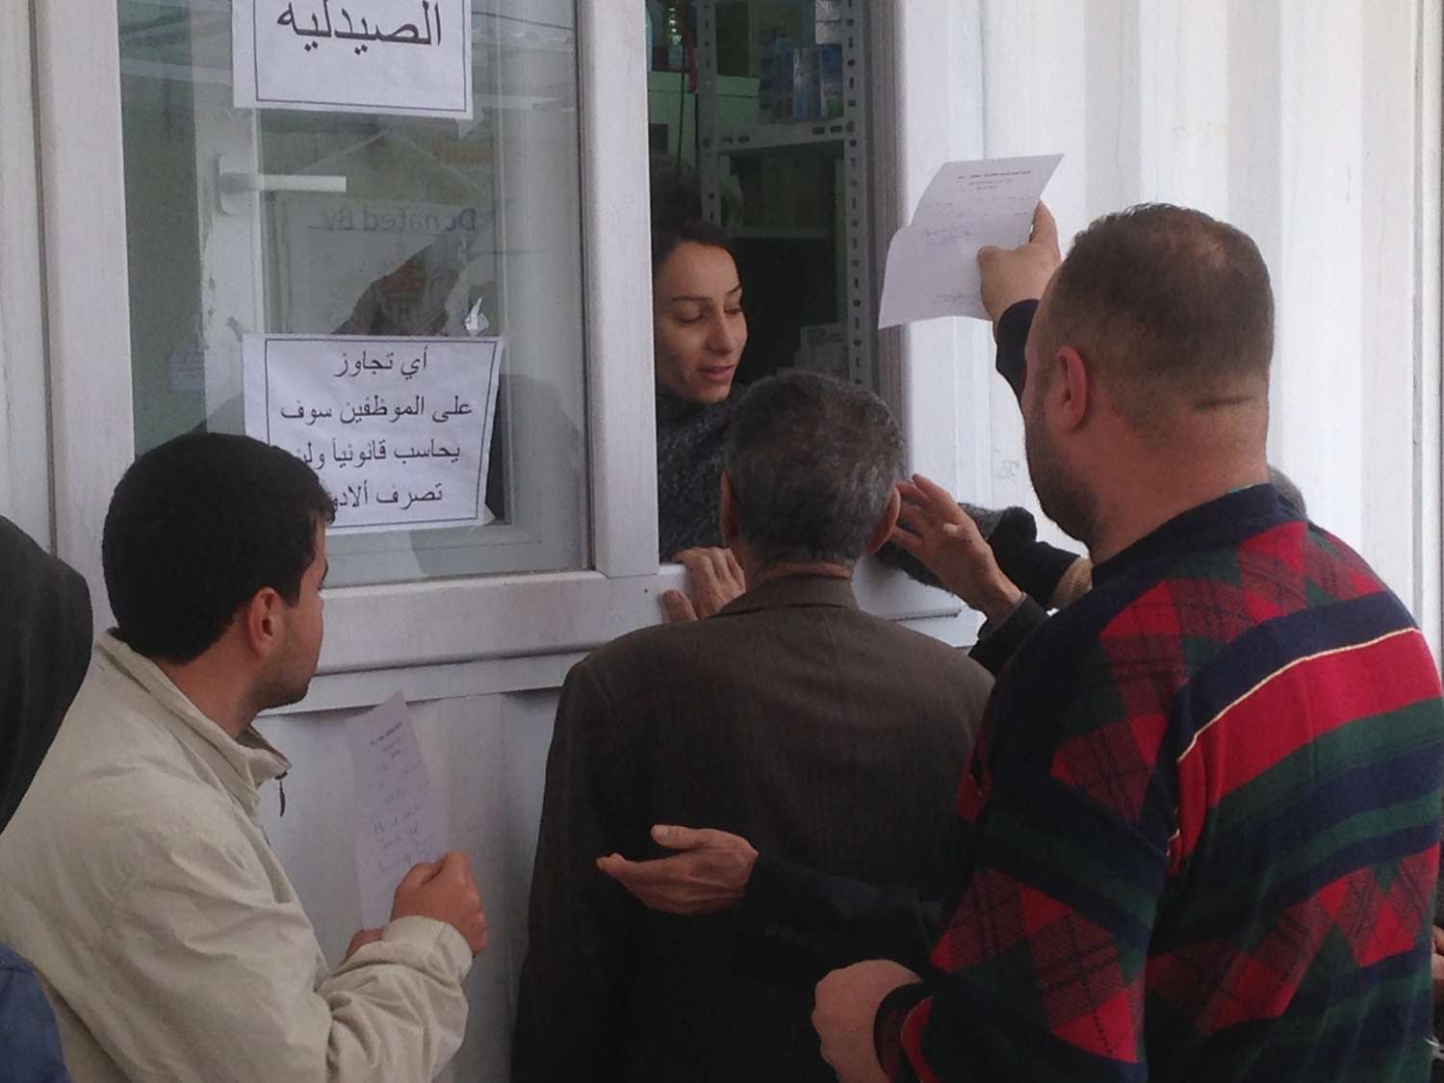

Slide 36
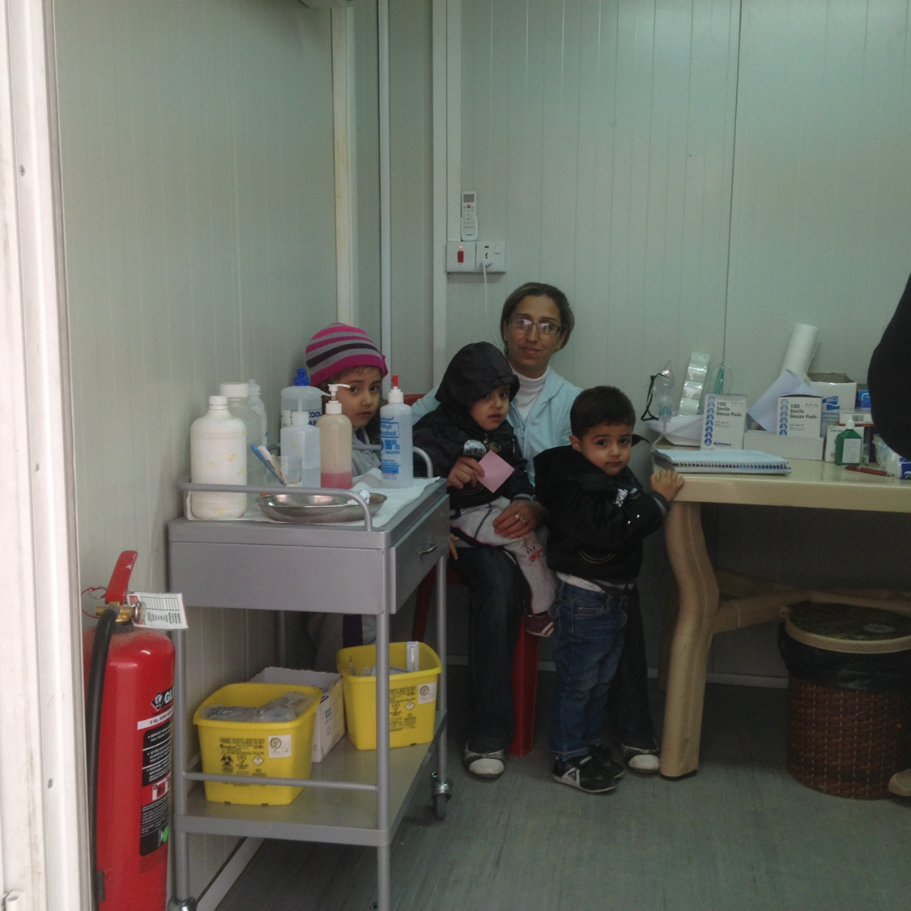

Slide 37
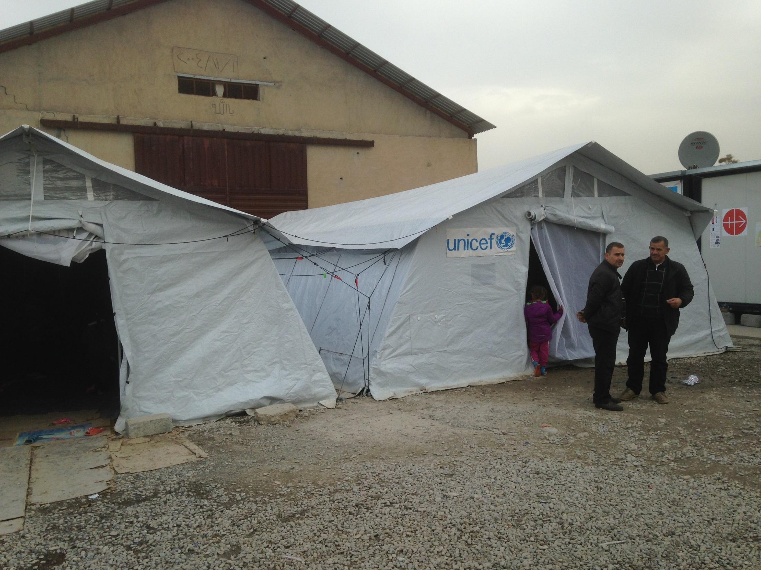
Notes:
Camp 128 UNIEF tents for child friendly spaces

Slide 38
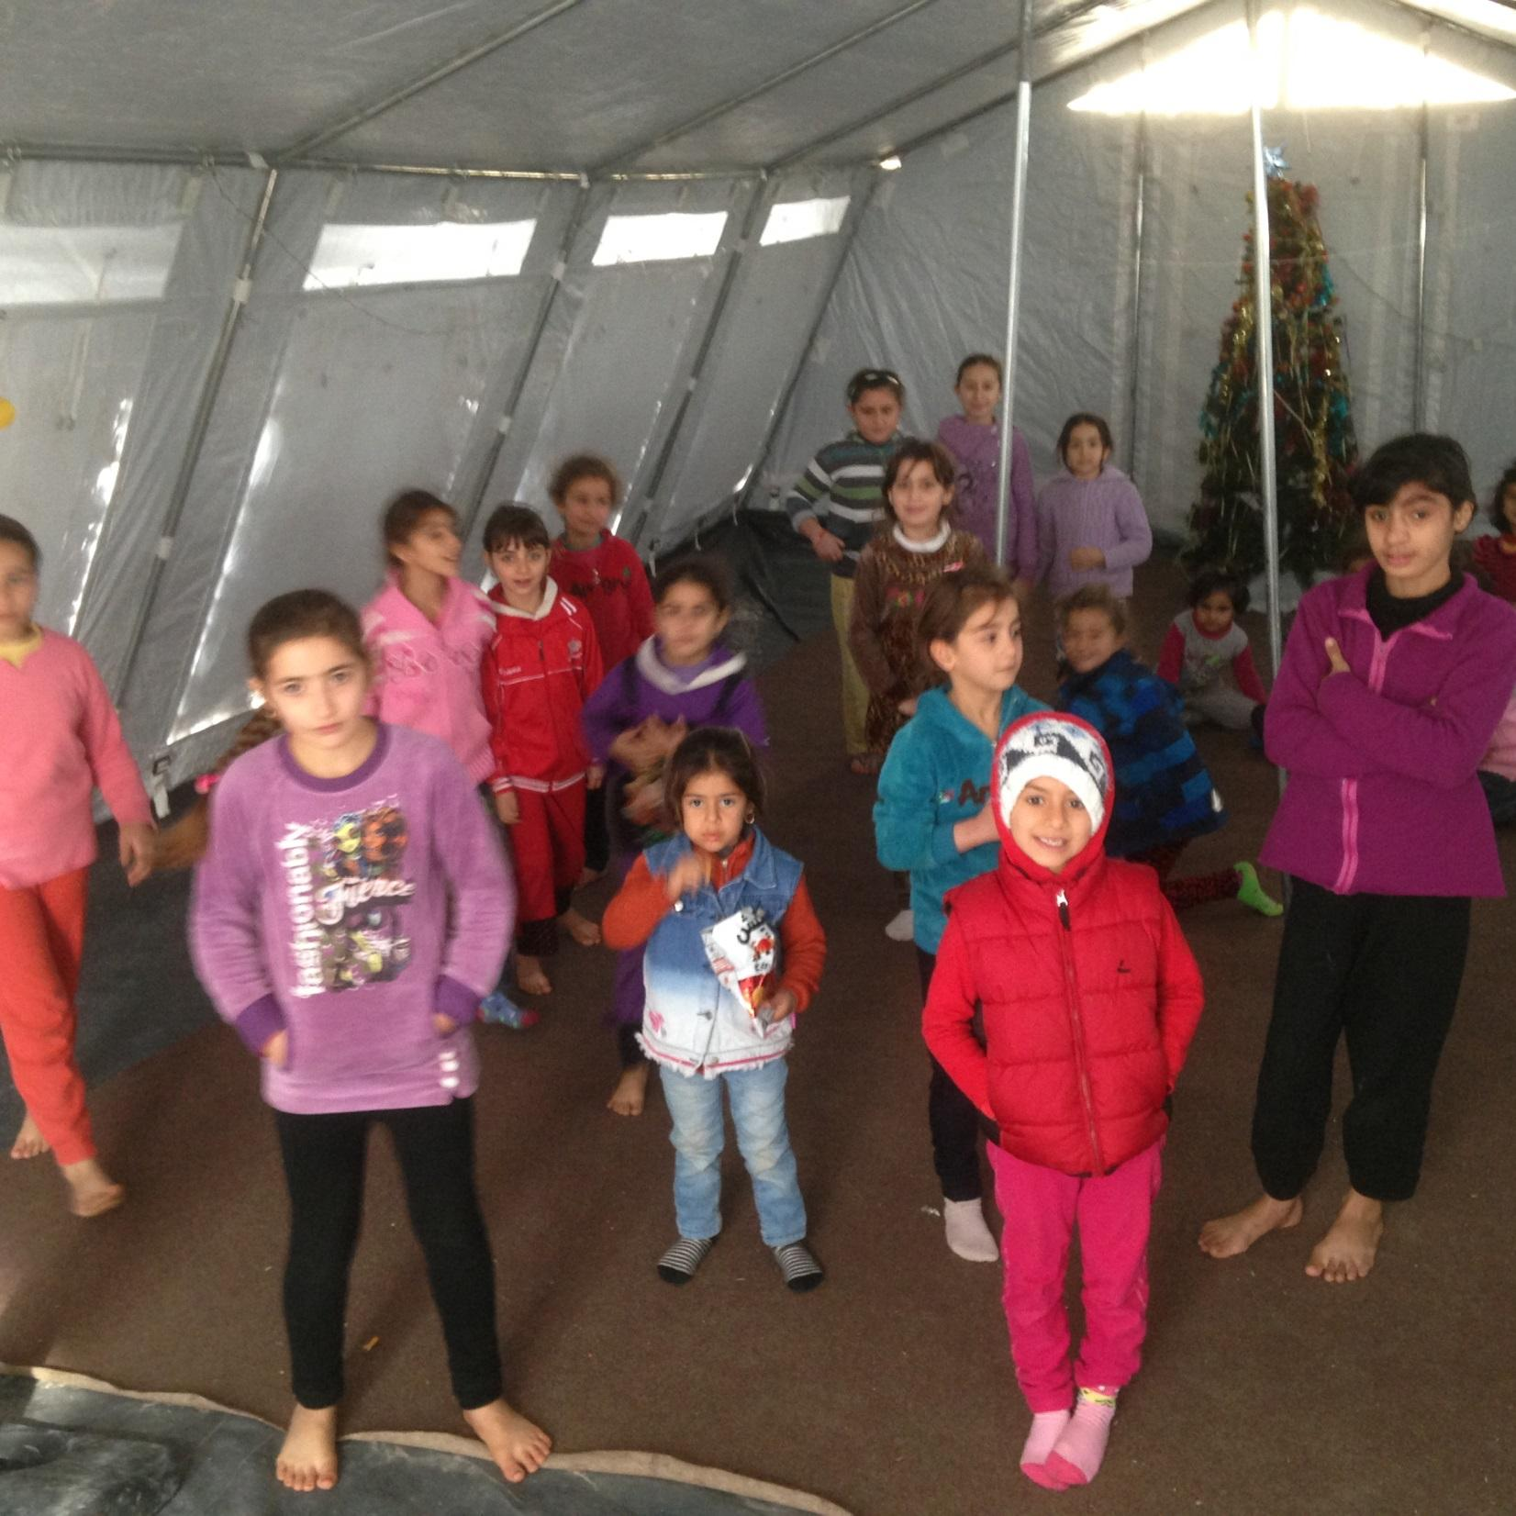
Notes:
Child Friendly spaces at Cmp 128 v. 1

Slide 39
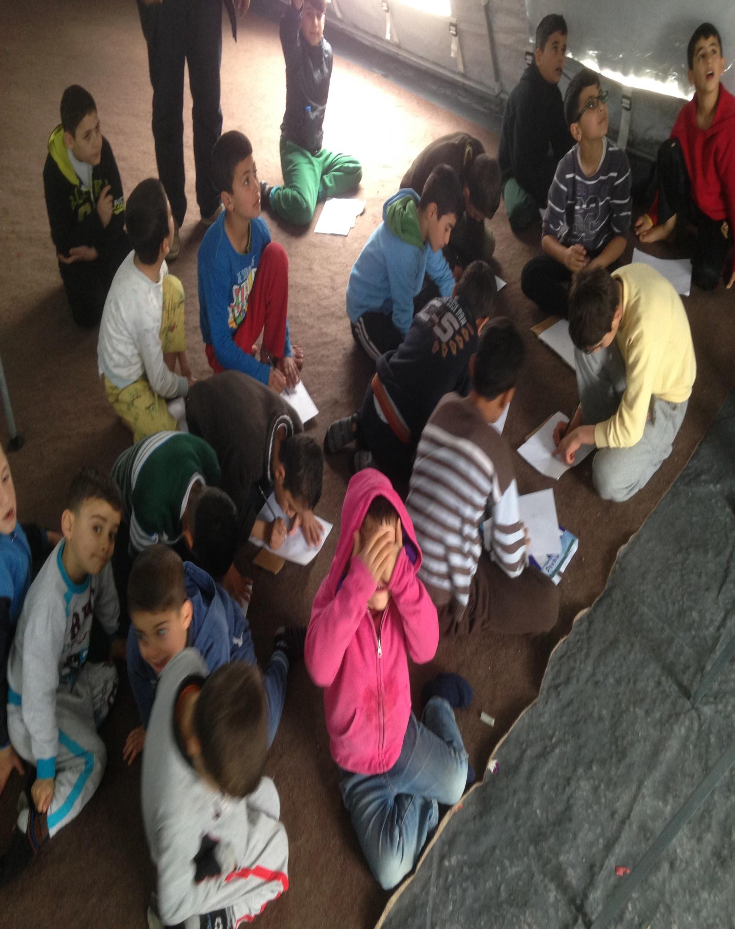

Slide 40
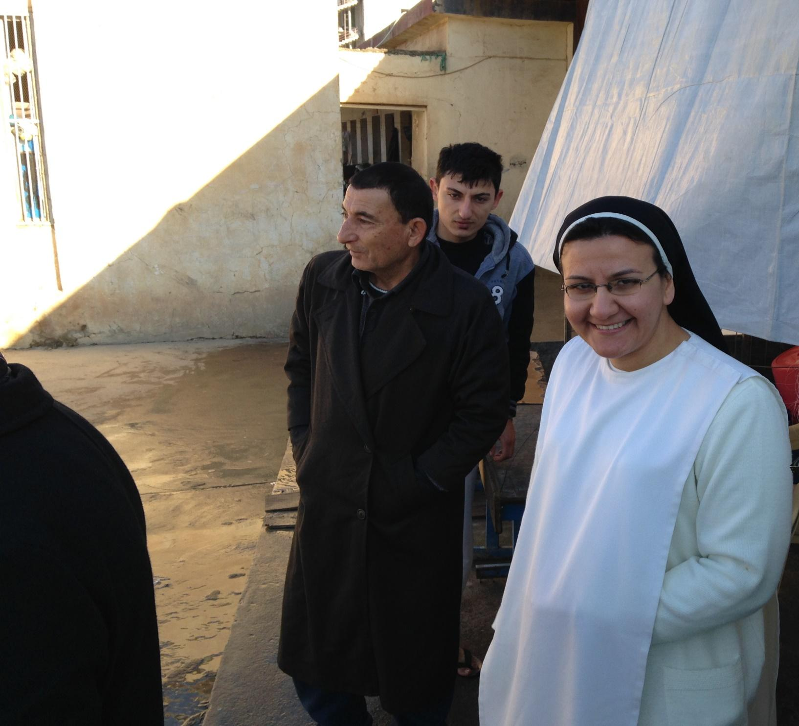

Slide 41
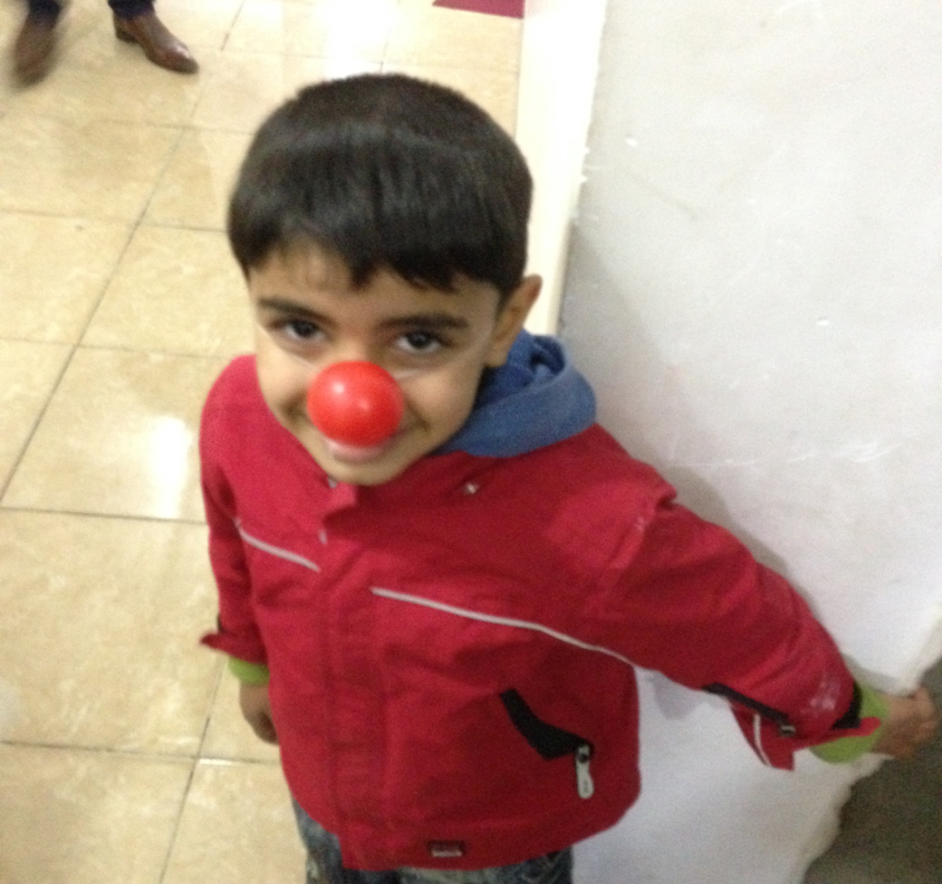
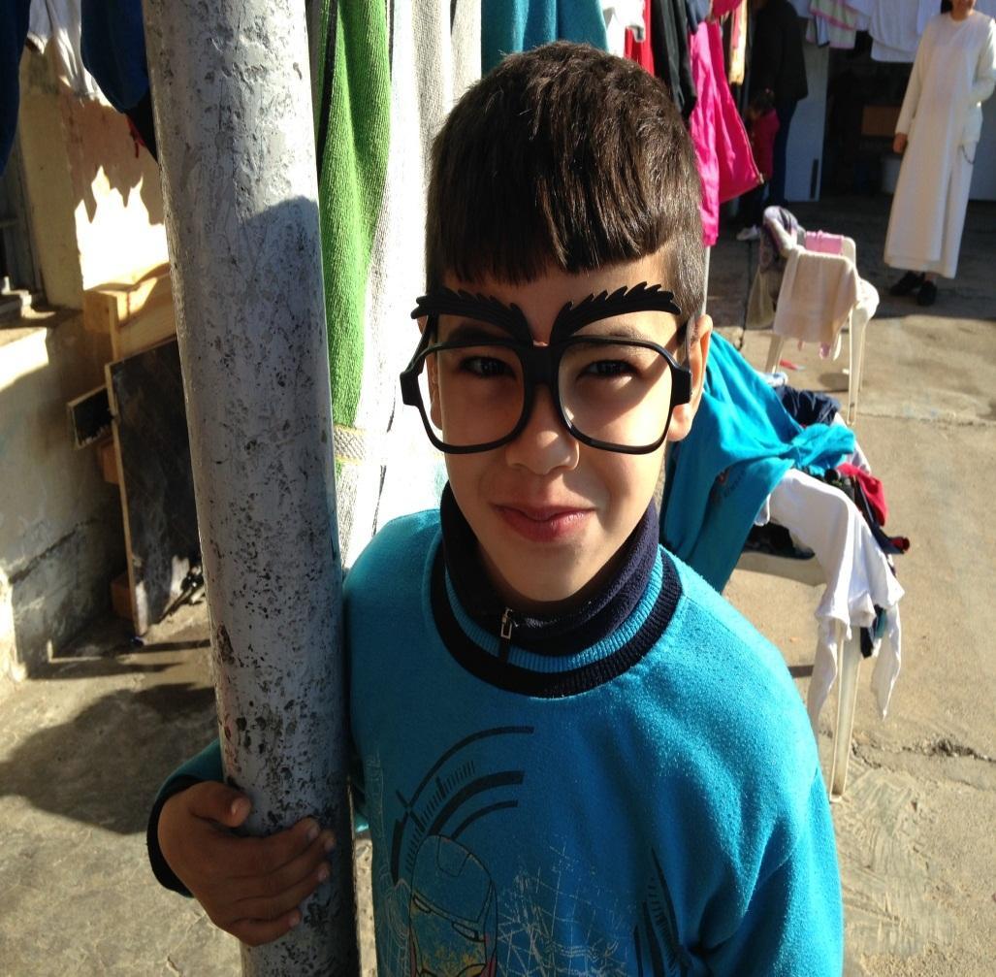

Slide 42
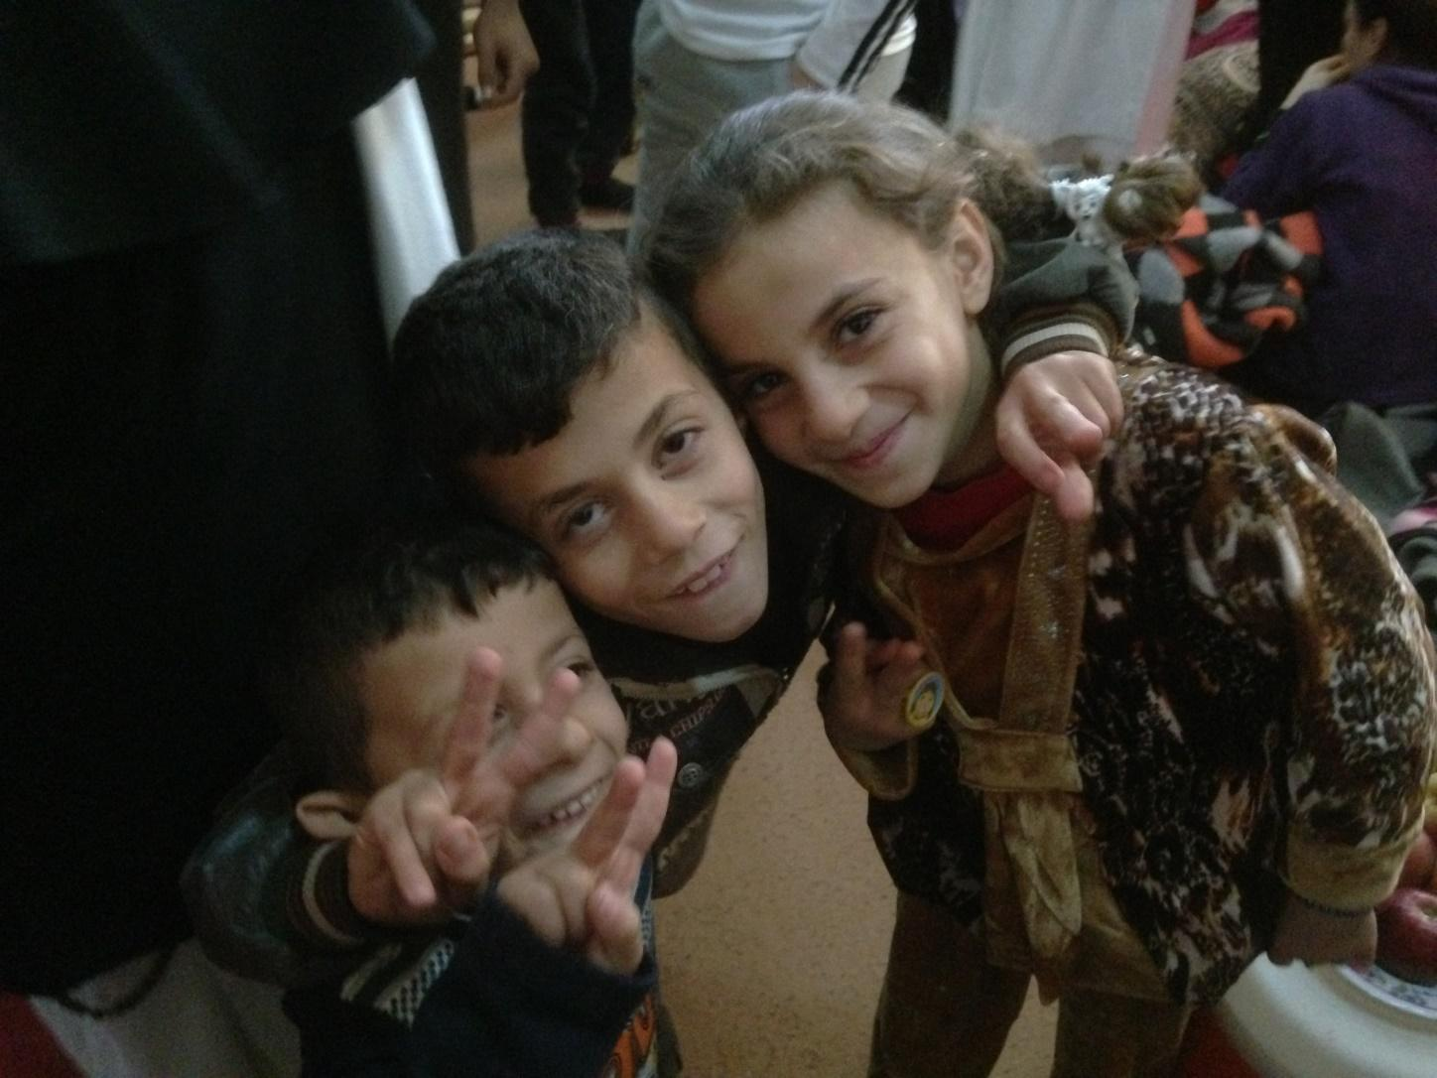

Slide 43
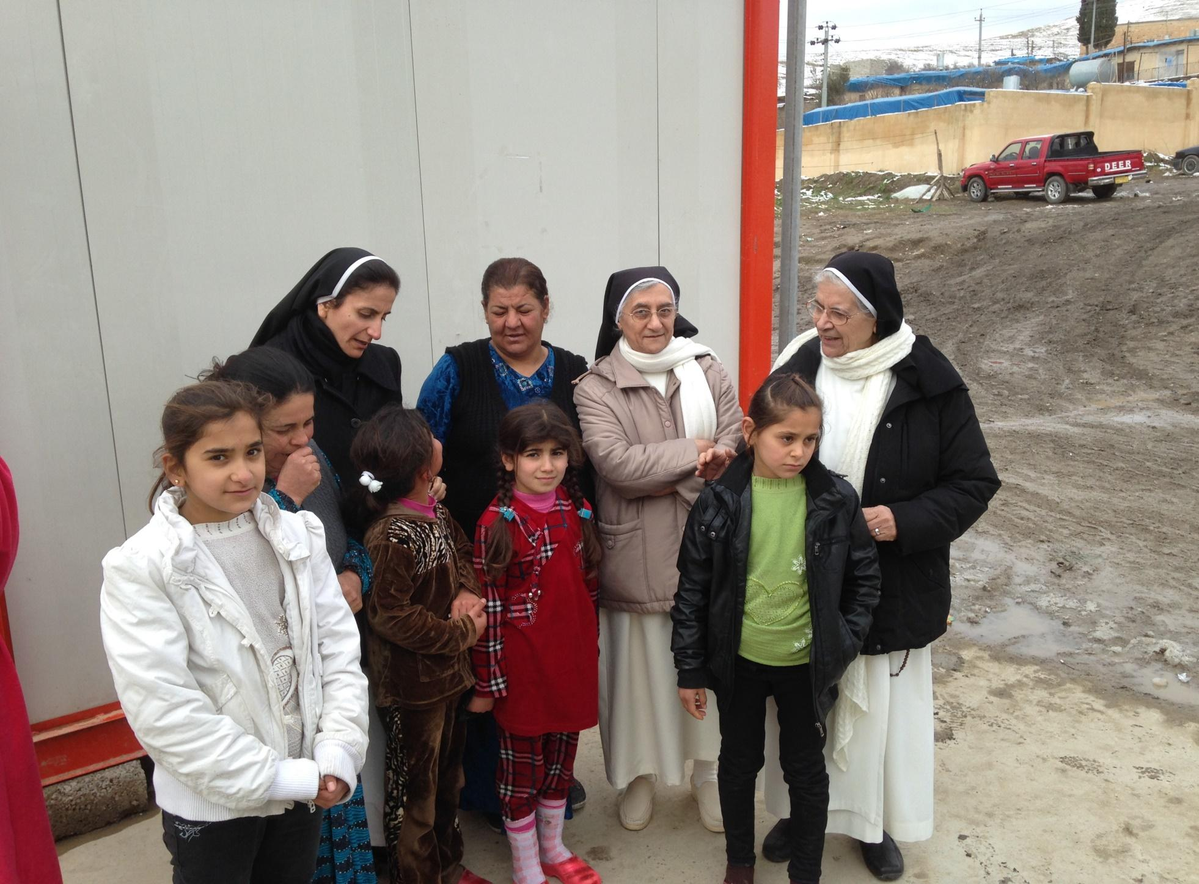

Slide 44
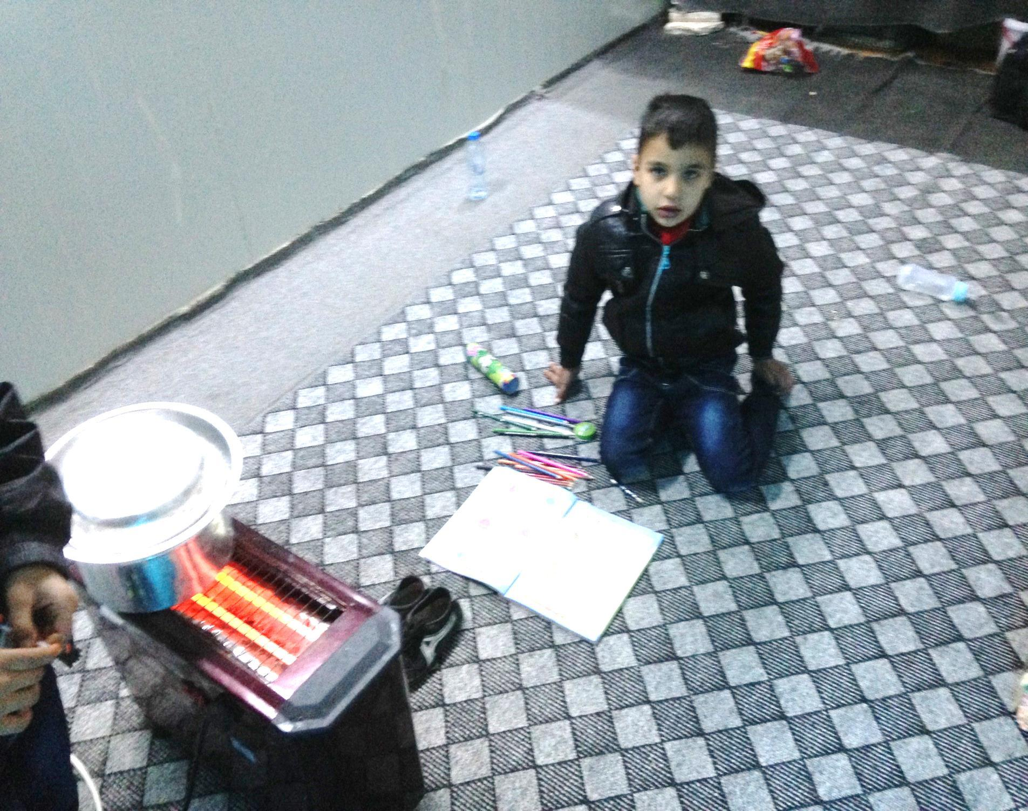

Slide 45


Slide 46
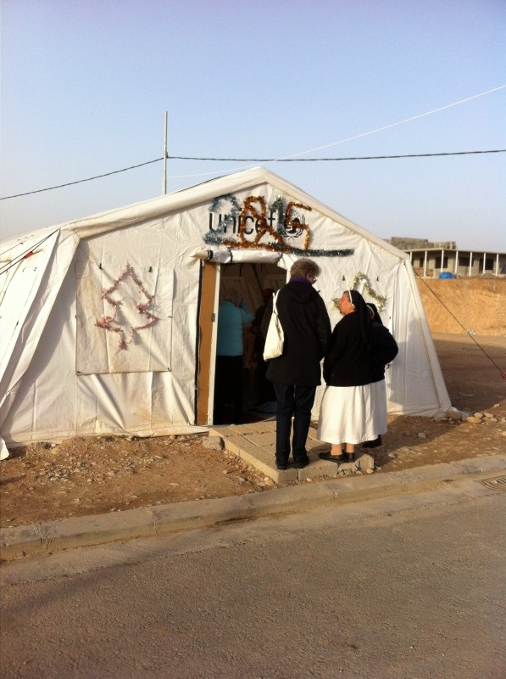
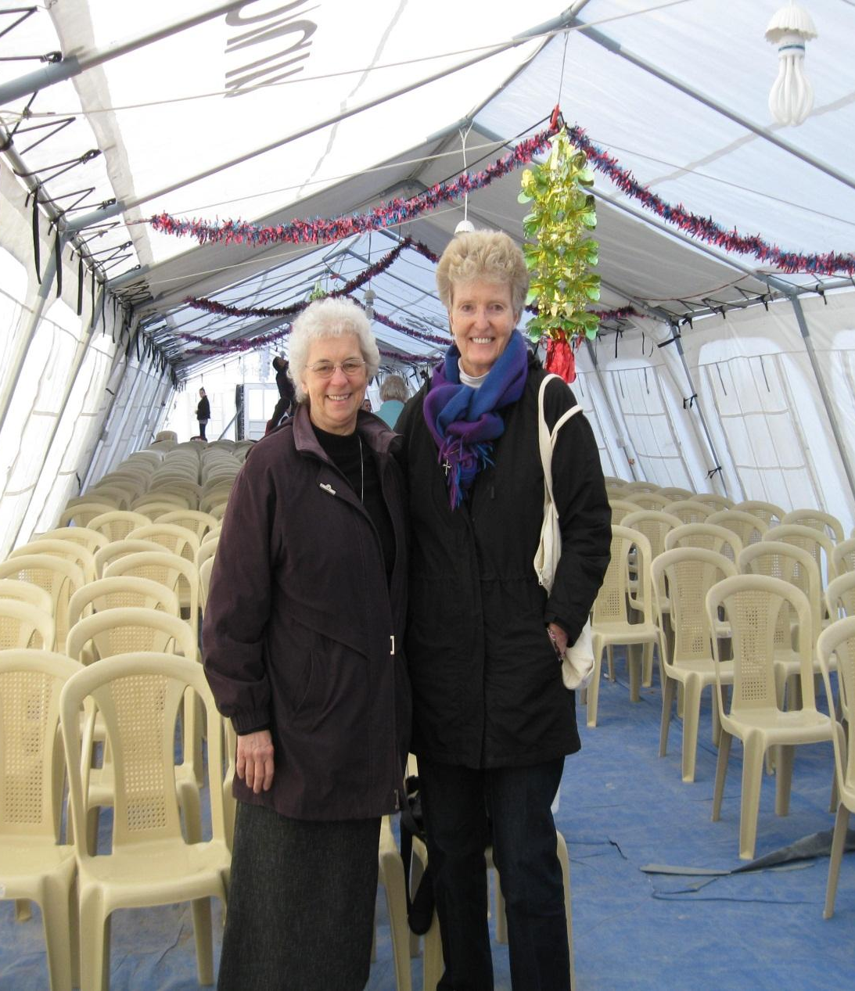

Slide 47
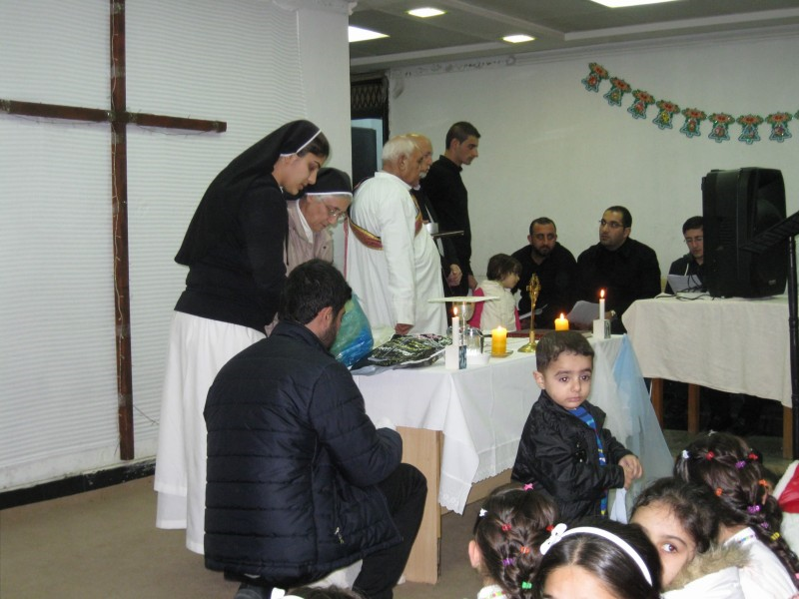

Slide 48
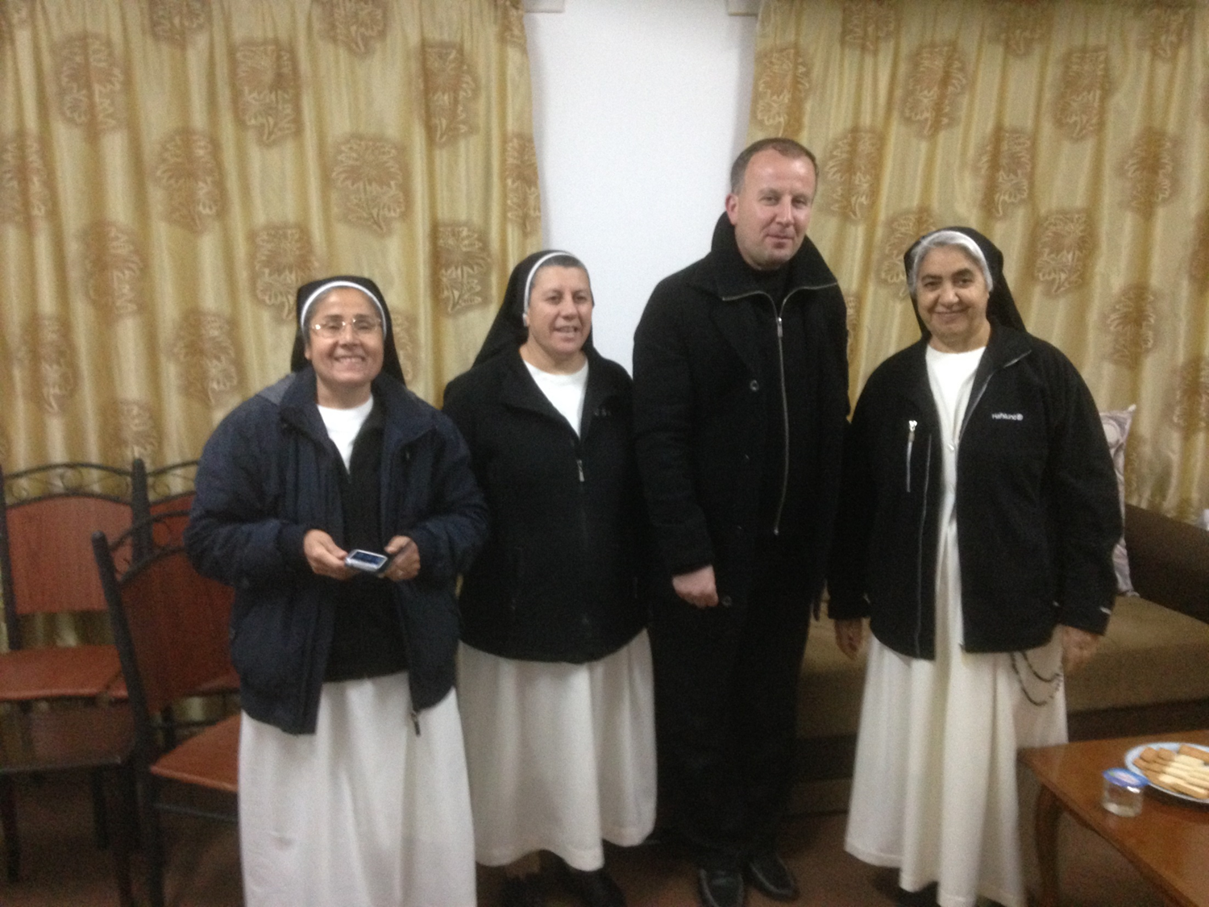

Slide 49

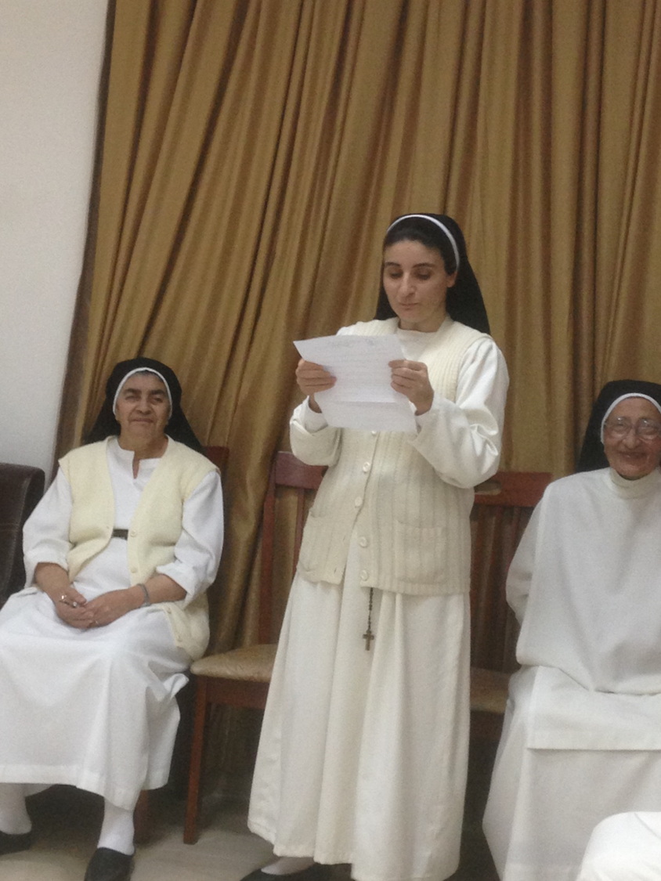
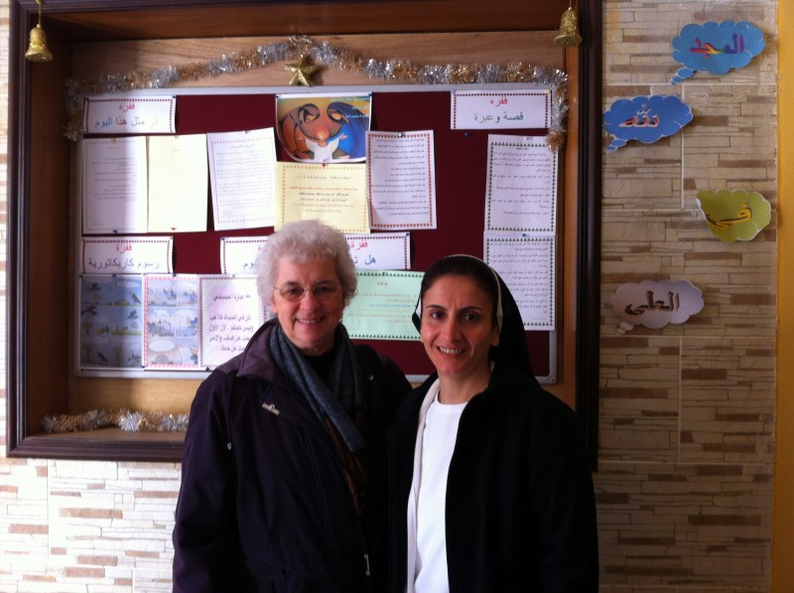

Slide 50
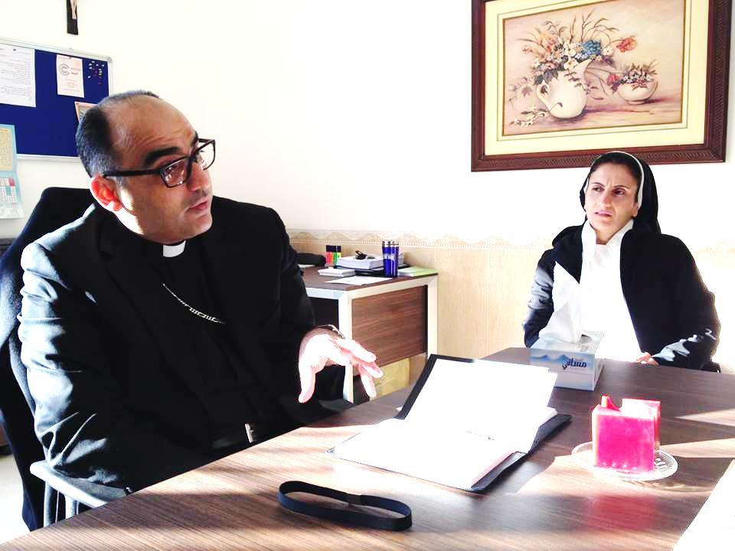
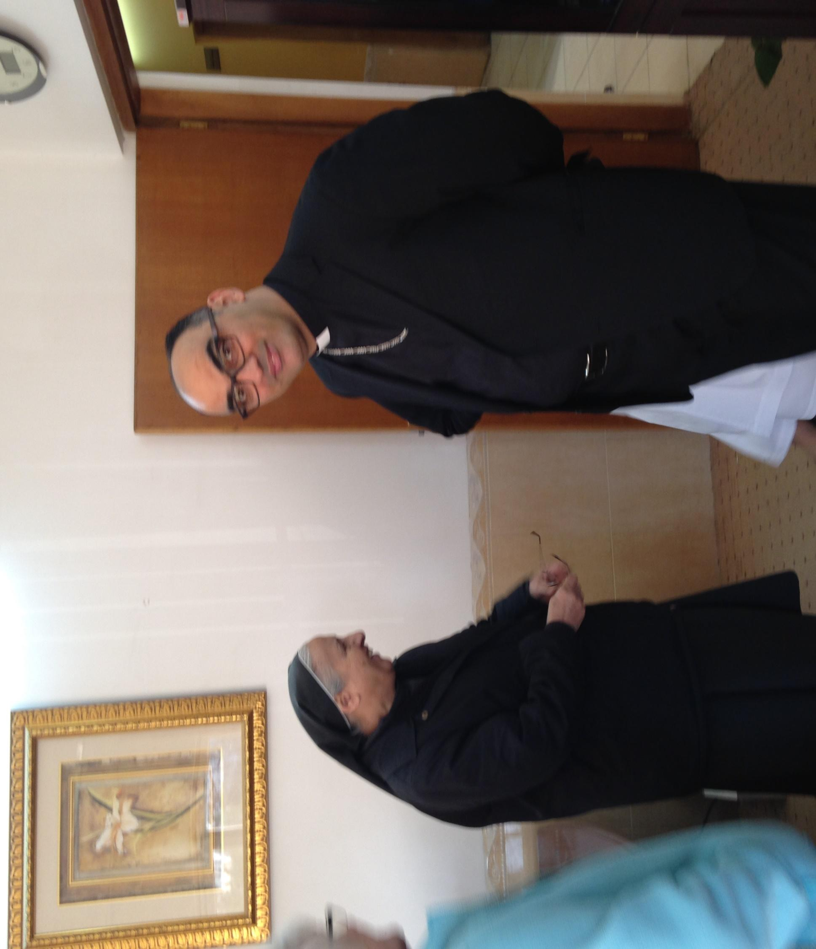

Slide 51


Slide 52


Slide 53


Slide 54


Slide 55


Slide 56
"Hope is not an attitude that allows one to sit back and wait for God to accomplish
that for which we yearn.
Rather, hope turns its face toward the future while anchoring its feet in the now.”
Source: Marilyn Chandler McIntyre, "The Hope is in the Waiting"
How do we make HOPE with the Iraqi People?

Slide 57
ADVOCACY to the U.S. Government
Pressure Central Government of Iraq and Government of Kurdistan to provide security and Infrastructure for Iraqi IDPs to remain in Iraq
Increase International Assistance in Budget to build capacity to respond to crisis in Iraq.
Expedite resettlement and increase quotas for Iraqis wanting to migrate to the United States

Slide 58
Support Ministries of Iraqi OP Sisters
Send donation to:
Adrian Dominican Sisters
In memo line of check
“ Iraqi Sisters Fund”
1257 East Siena Heights Drive
Adrian, Michigan 49221

Slide 59

May Peace Prevail in Iraq

