Slide 1
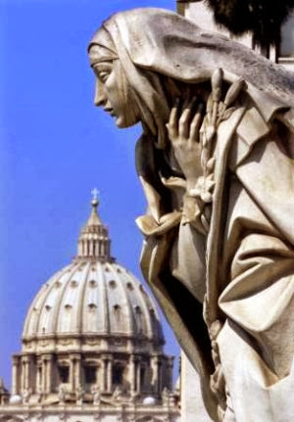
Perfectae caritatis: Sent to preach the gospel of Mercy
Dominican Sisters International ~ May 3, 2016
Sr. Barbara E. Reid, O.P.

Slide 2
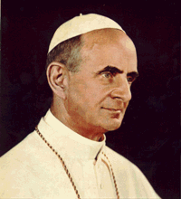
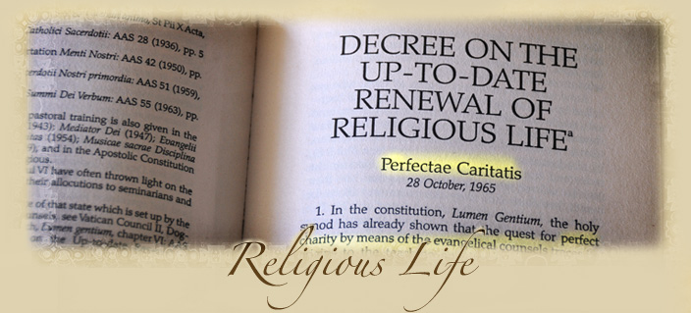
Perfectae Caritatis, 1965

Slide 3
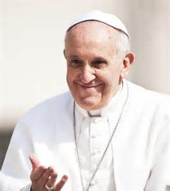
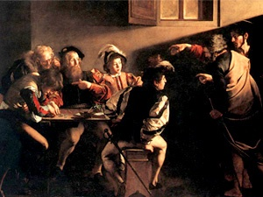

“Let yourself be mercy’d”
miserando atque eligendo
“by having mercy and choosing him”
“misericordiando”
Caravaggio, The Call of St. Matthew

Slide 4
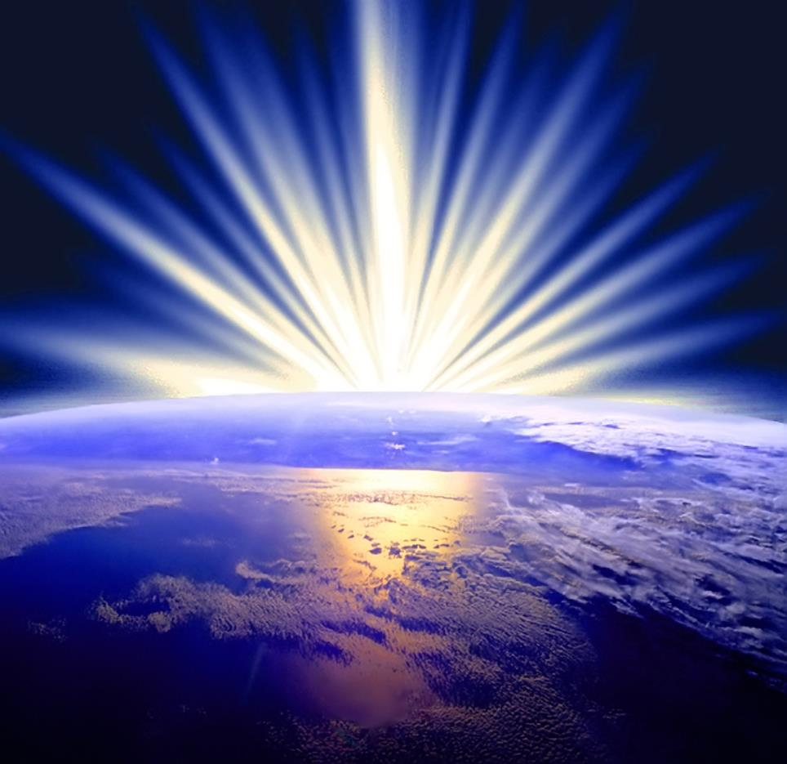

Slide 5
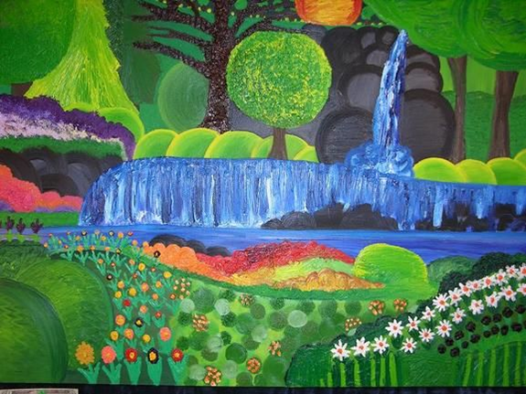

Slide 6
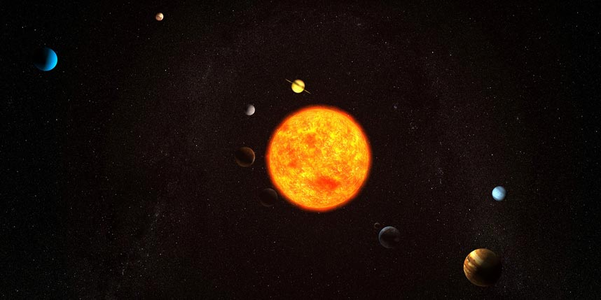

Slide 7
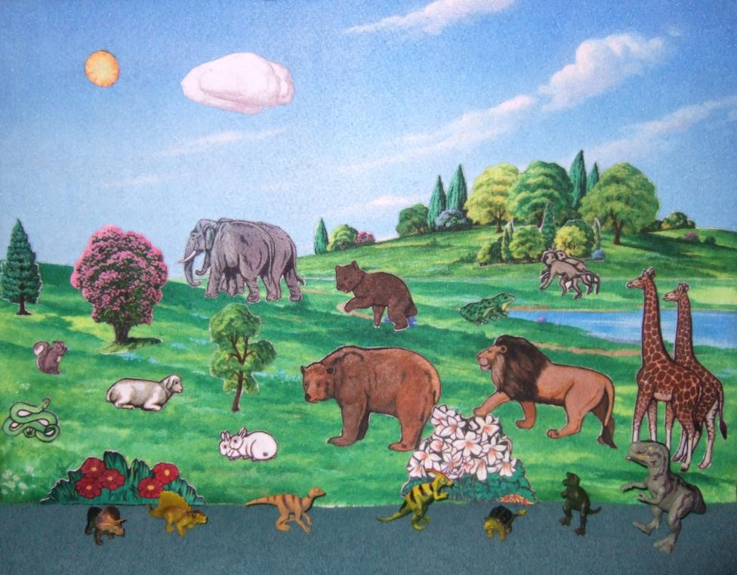

Slide 8
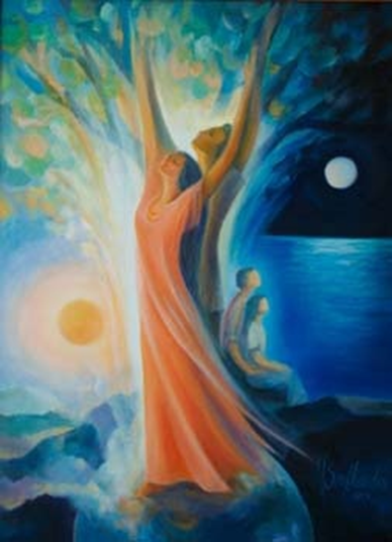
Day 7 “God saw everything that God had made, and indeed, it was very good” (Gen 1:31)
Mary Southard, CSJ

Slide 9
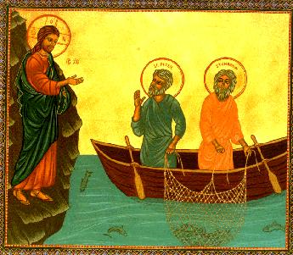
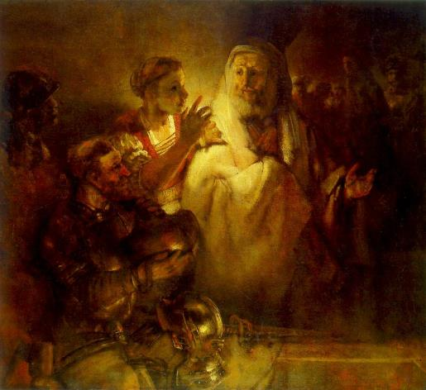
Peter
Luke 5:1-11
Luke 22:62
Rembrandt, Peter Denies Christ

Slide 10
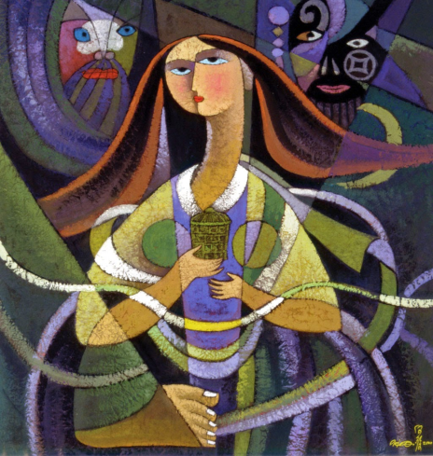
Luke 7:36-50
“Do you see this woman?”
Simon: A sinner
Jesus: A woman forgiven much
who loves much
He Qi

Slide 11
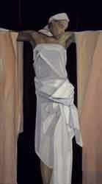
An Image of Christ
Her actions and stance prefigure Jesus’ own
(Lk 22:20, 26-27)
Ability to perceive Jesus correctly is tied to ability to perceive woman correctly
Woman Offered – Janet McKenzie

Slide 12
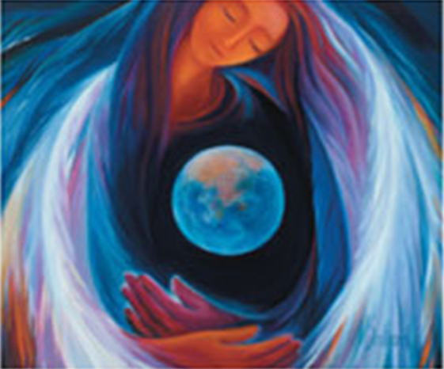
For Reflection:
What is your experience of being mercy’d?
How are we to respond to such mercy?
How do we continue to be formed as preachers of mercy?

Slide 13
II. Mercying:
Remembering
Proclaiming Justice
Praying for Mercy

Slide 14
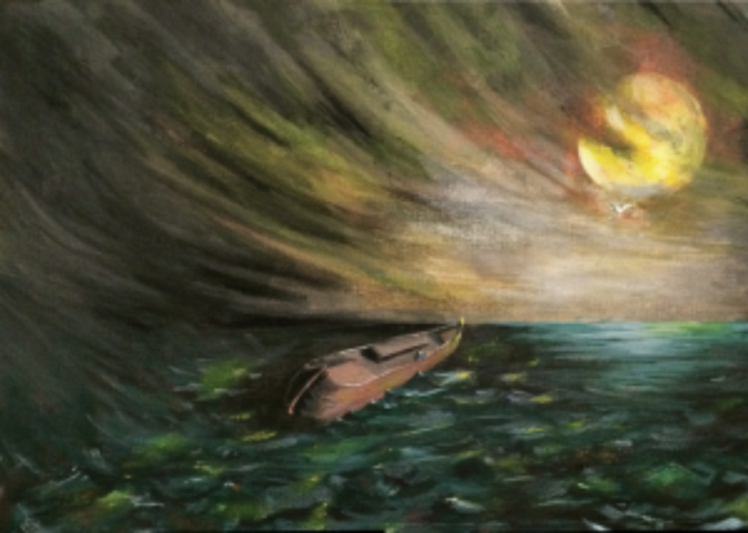
But God Remembered Noah - PhilipTrammell

Slide 15
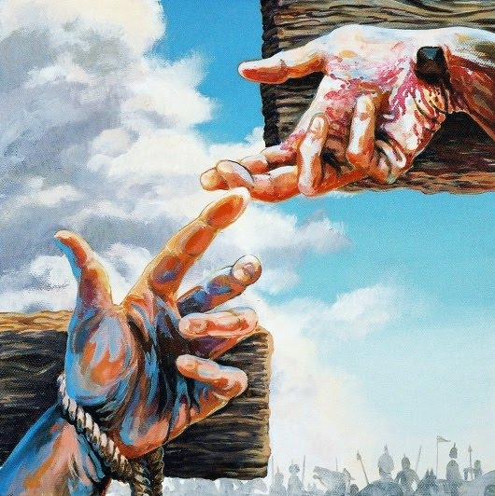
“Jesus, Remember me when you come into your Kingdom” (Luke 23:42)

Slide 16
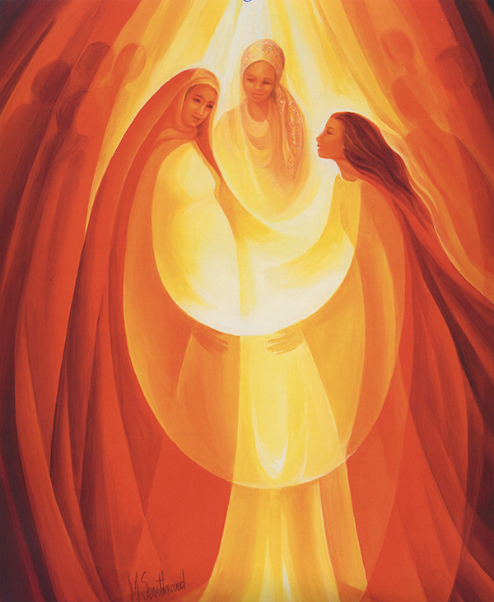
“you have helped your servant Israel in remembrance of your mercy” (1:54)
Visitation, Mary Southard, CSJ

Slide 17
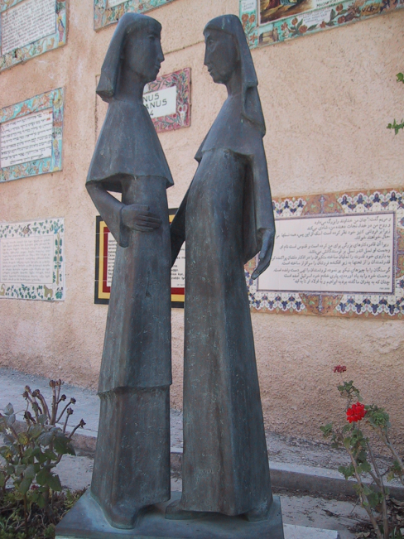
God “looks upon,” (ἐπιβλέπω)
Mary’s “humiliation,”
(ταπείνωσις, Lk 1:48)
And lifts up all the humiliated (ταπεινούς, 1:52).
ἐπιβλέπω + ταπείνωσις:
Gen 16:11
Gen 29:32
1 Sam 1:11
1 Sam 9:16
Jdt 16:19

Slide 18
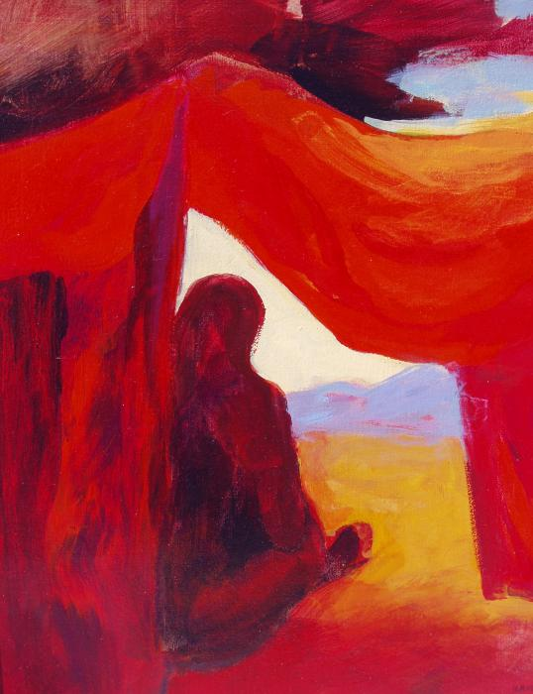
Ταπεινόω
= “to humiliate, abase, violate”
Gen 34:2 – rape of Dinah
Judg 19:24; 20:5 – Levite’s concubine
2 Kgs 13:12, 14, 22, 32
- Rape of Tamar
Lam 5:11 – ravishing of wives in Zion, maidens in Judah

Slide 19
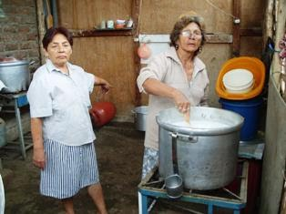
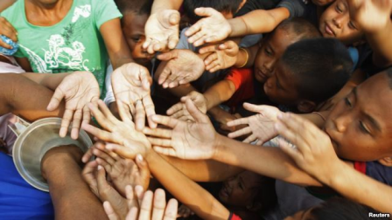
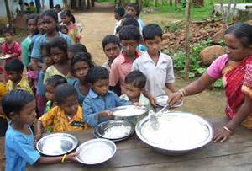
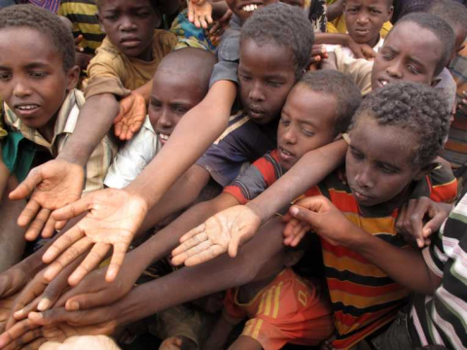
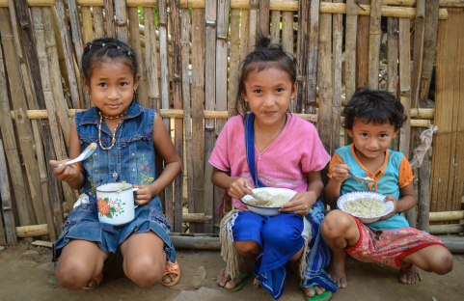
“Filling the hungry with good things” (Lk 1:53)

Slide 20
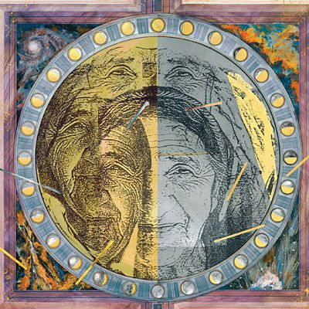
“Come, eat of my bread” Prov 9:5

Slide 21
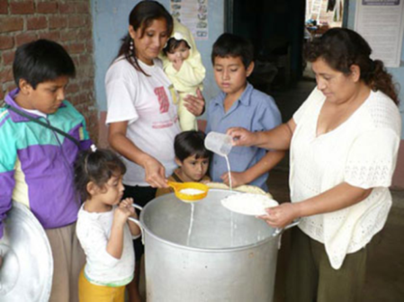
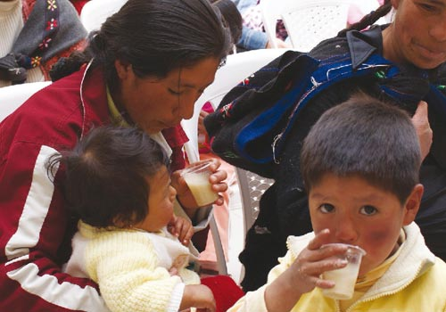

Slide 22



Slide 23
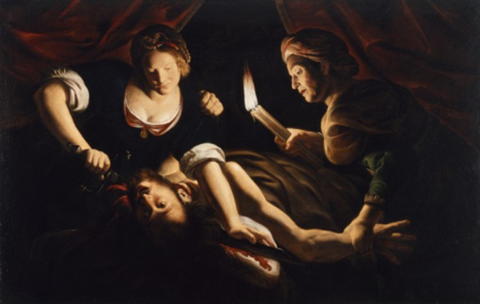
Judith
“Then Uzziah said to her [Judith], “O daughter, you are blessed by the Most High God above all other women on earth; and blessed be the Lord God, who created the heavens and the earth, who has guided you to cut off the head of the leader of our enemies.”
(Jdt 13:18)
Trophime Bigot, Judith Decapitating Holofernes

Slide 24
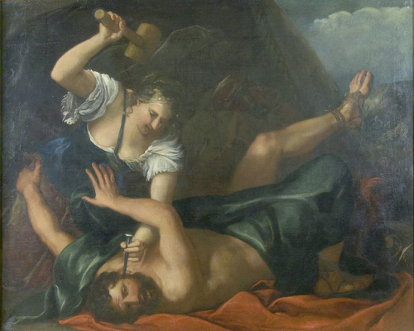
Jael
“Most blessed of women be Jael, the wife of Heber
the Kenite, of tent-dwelling women most blessed.”
(Judg 5:24)
Jael slays Sisera - Jacopo Amigoni

Slide 25
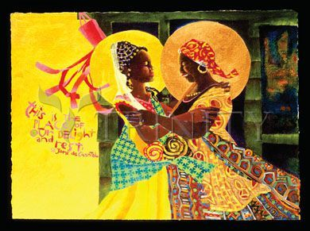
“Blessed are you among women, and blessed is the fruit of your womb…And blessed is she who believed that there would be a fulfillment of what was spoken to her by the Lord.” (Luke 1:42, 45)
M. McGrath, Windsock Visitation

Slide 26
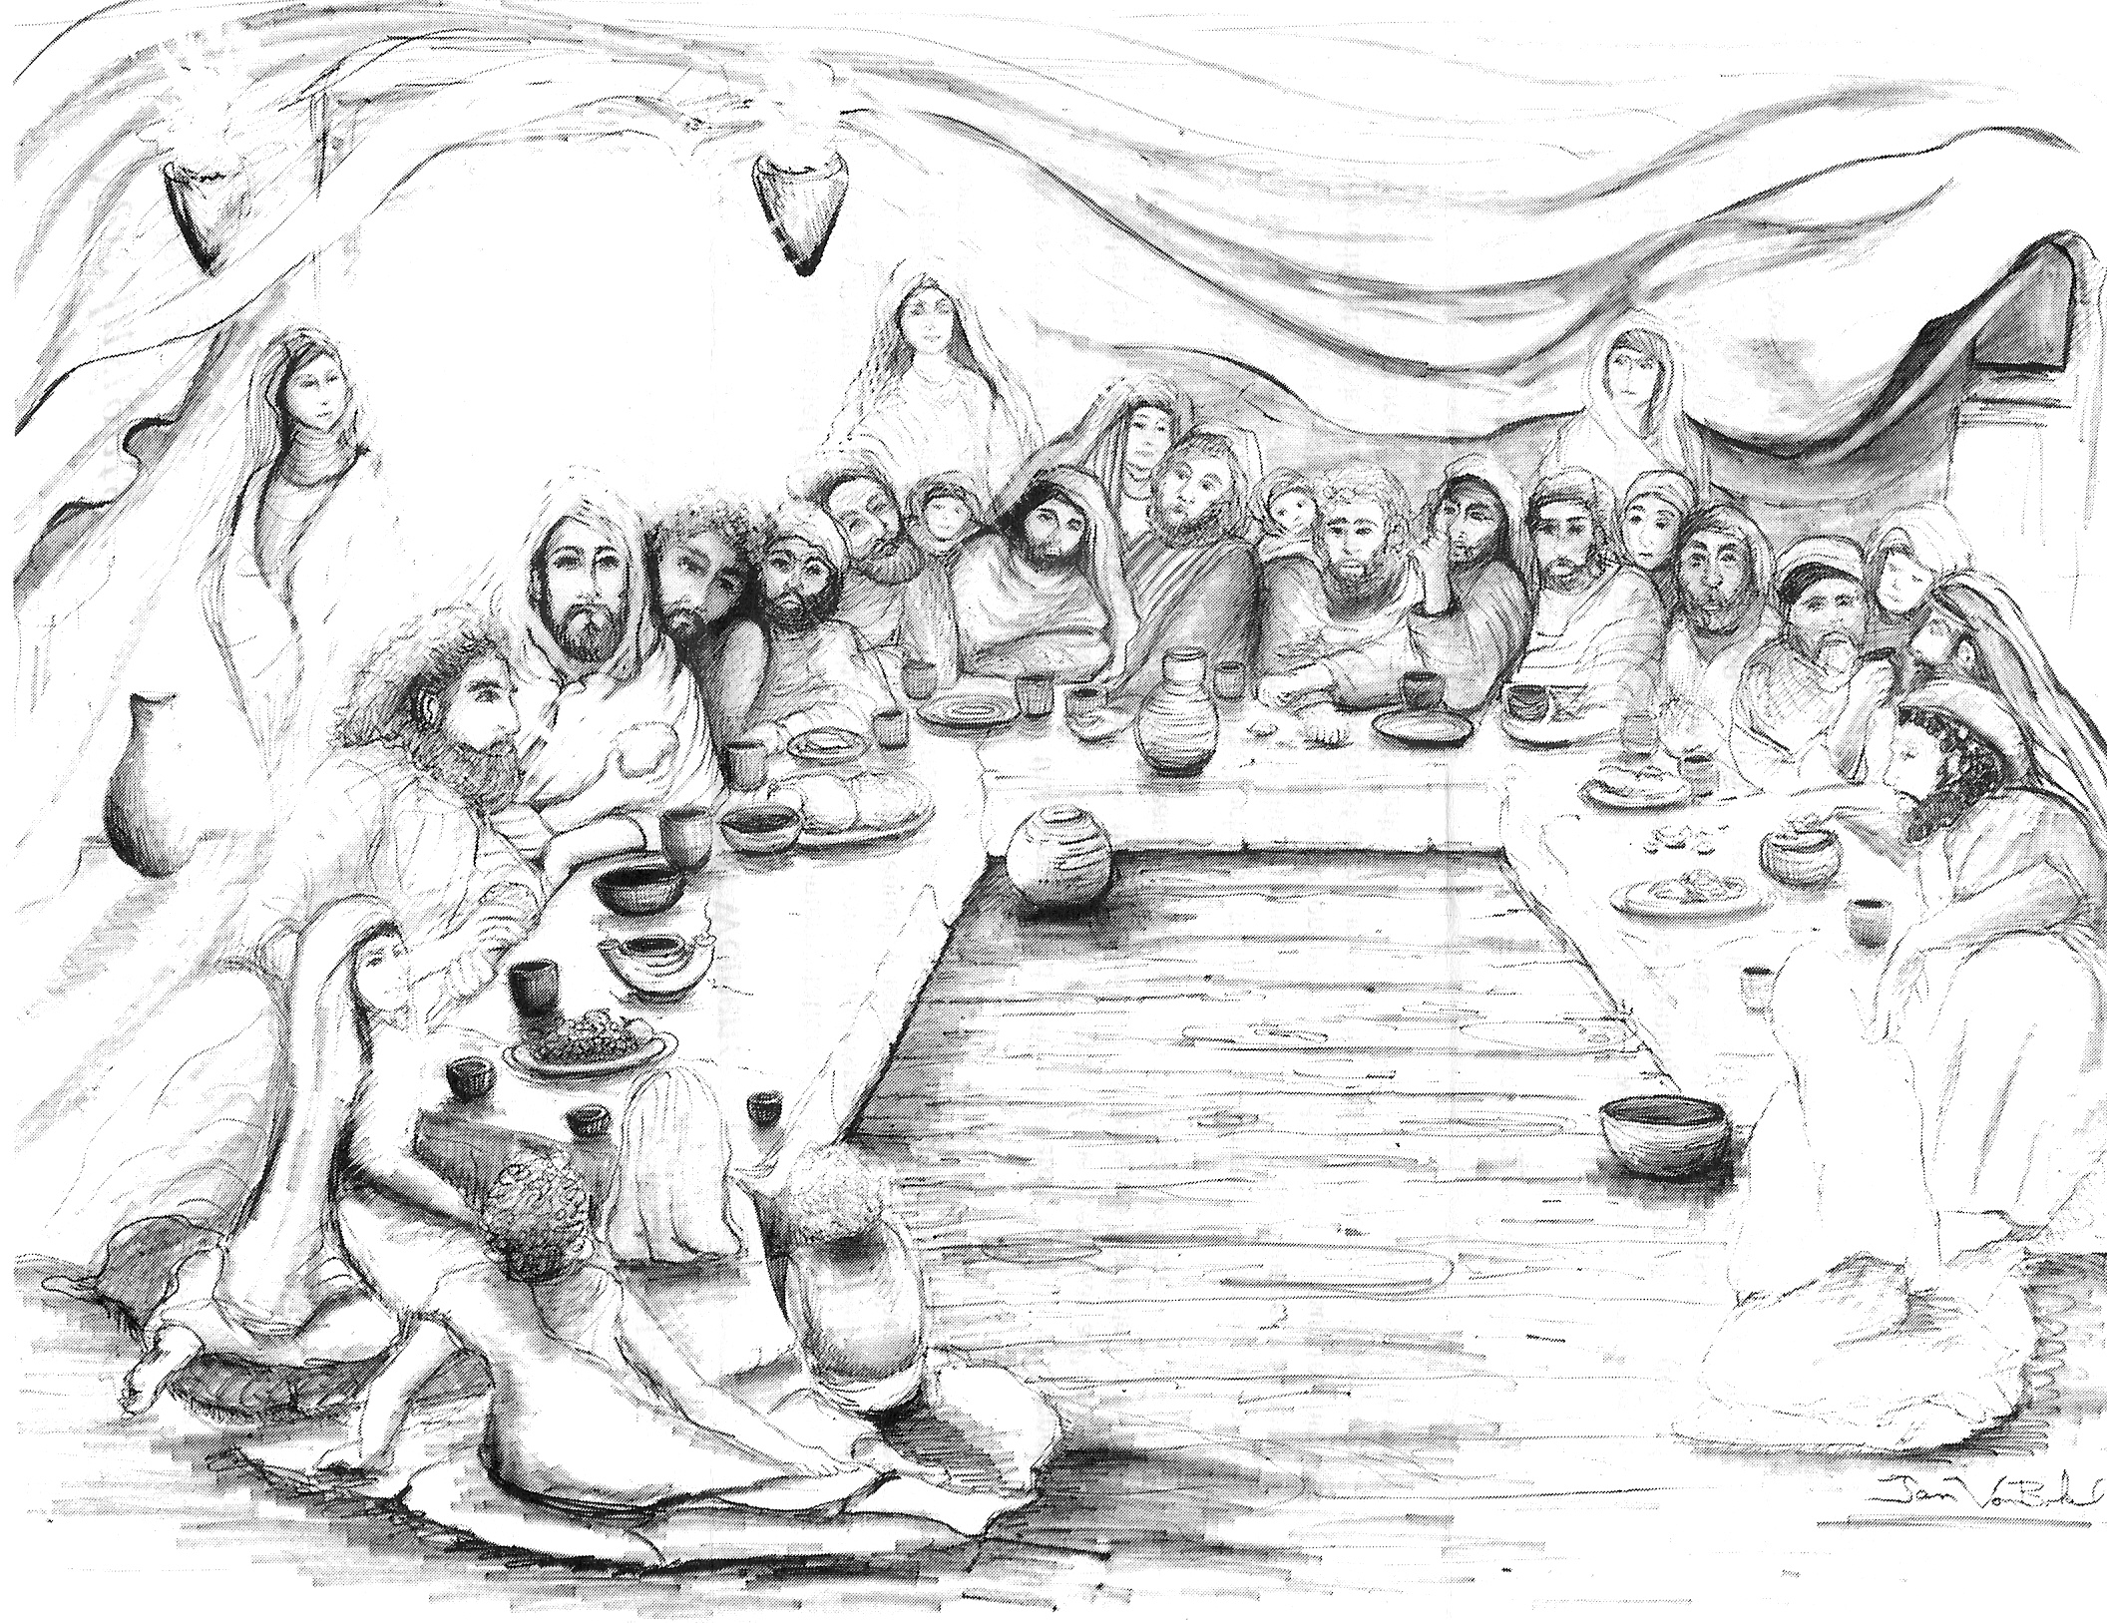
“Do this in remembrance of me” (Lk 22:19)
Jan VonBokel
Notes:
The painting by Jan VonBokel entitled “The Invitation” from New Insights, P.O. Box 115, Trenton IL 62293 www.New-Insights.com
Arhudi@accessus.net Tel 618-224-7704

Slide 27
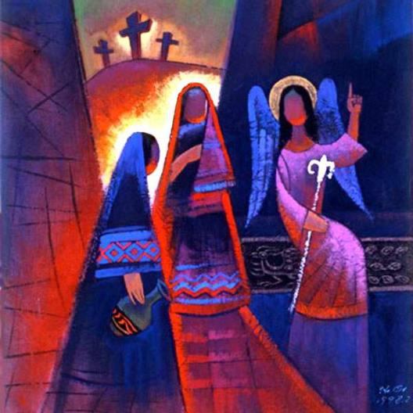
Remembering & Proclaiming (Luke 24:6-8)
“Remember”
= make present
“Remember how he told you…then they remembered…they told…”
HeQi

Slide 28
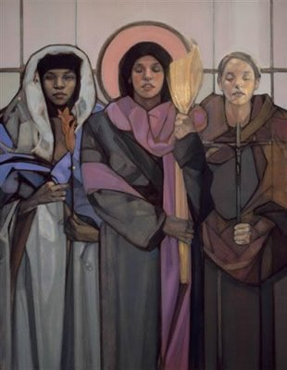
Mary Magdalene, Susanna,
and Joanna
(Luke 8:1-3)
Janet McKenzie

Slide 29
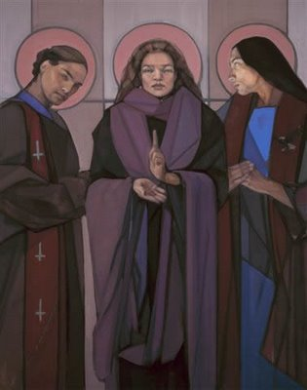
“Apostle to the Apostles”
– Janet McKenzie

Slide 30
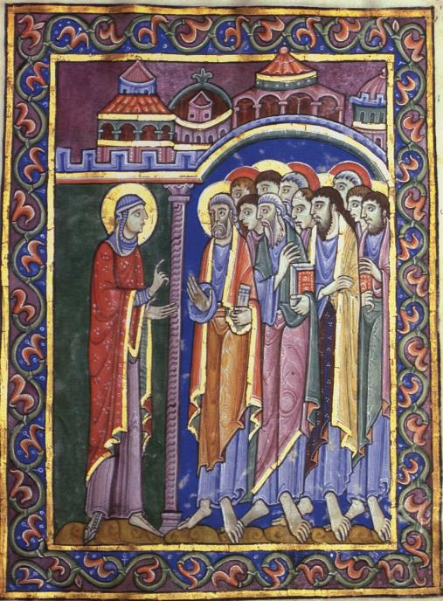
For Reflection / Discussion:
As we remember
God’s past saving deeds, how do we proclaim
justice & mercy
in the present?

Slide 31
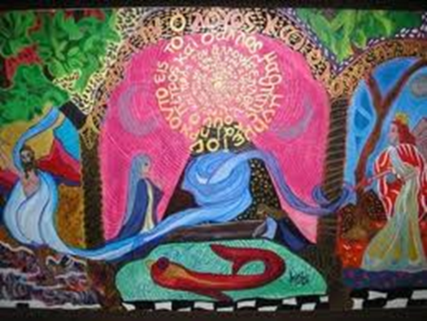
III. God’s Justice/Mercy
“God’s justice is his mercy given to everyone as a grace that flows from the death and resurrection of Jesus.”

Slide 32
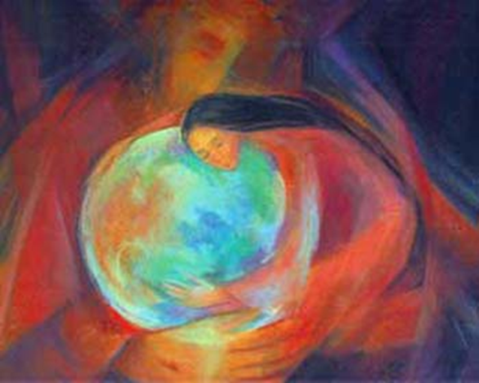
Rahamim = “Compassion”
Rehem = “womb”
Compassion, Mary Southard, CSJ

Slide 33





Slide 34
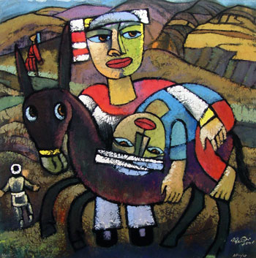
Luke 10:25-37
“moved with compassion at the sight”
Doing mercy vs.
Justifying oneself
He Qi

Slide 35
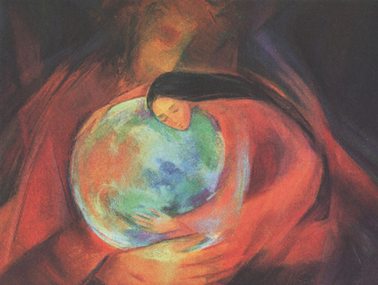
“Be merciful, just as your God is merciful” (6:36)
Σπλαγχνίζομαι / splanchnizomai
7:13 When the Lord saw her, he had compassion (esplanchnisthē) for her and said to her, “Do not weep.”
10:33 But a Samaritan while traveling came near him; and when he saw him, he was moved with compassion (esplanchnisthē).
15:20 So he set off and went to his father. But while he was still far off, his father saw him and was filled with compassion (esplanchnisthē); he ran and put his arms around him and kissed him.
“through the tender compassion (splanchna eleous) of God”

Slide 36
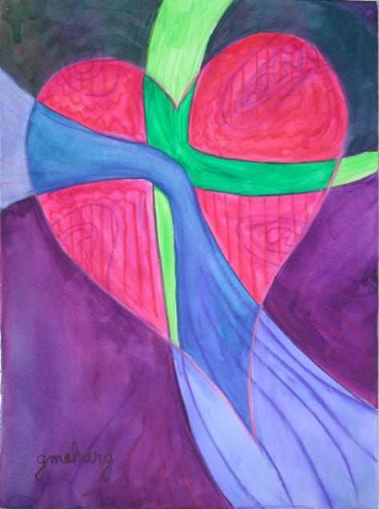
“formation of the heart” Pope Benedict XVI Deus Caritas Est (#31)

Slide 37
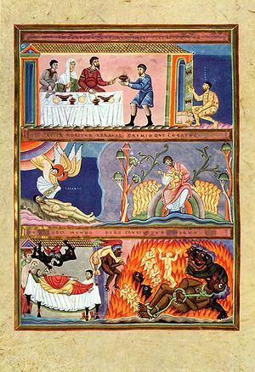
Luke 16:19-31

Slide 38
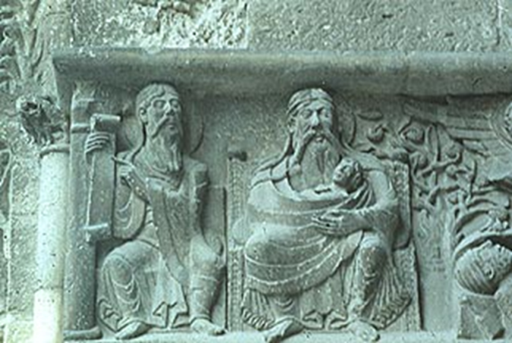
The rich man … he looked up and saw Abraham far away with Lazarus by his side (ἐν τοῖς κόλποις αὐτοῦ). He called out, ‘Father Abraham, have mercy on me.”
South Portal from the Church of Saint Pierre,
Moissac, FRANCE c. 1115-30
Lazarus in the Bosom of Abraham

Slide 39
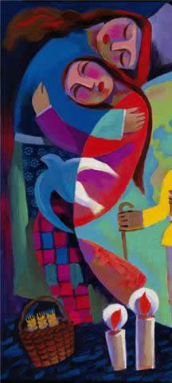
“. . . the only Son, at the breast of the Father
(εἰς τὸν κόλπον τοῦ πατρὸς) (John 1:18)
NRSV, NJB: “close to the Father’s heart,”
NAB “at the Father’s side”
John 13:23 the Beloved Disciple is reclining ἐν τῷ κόλπῳ τοῦ Ἰησοῦ,
“in the bosom of Jesus”

Slide 40
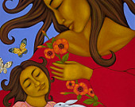
Isa 49:16
But Zion said, "The Lord has forgotten me."
Can a mother forget her infant,
Be without tenderness for the child of her womb?
Even should she forget,
I will never forget you.
See, upon the palms of my hands I have written your name;
Your walls

Slide 41
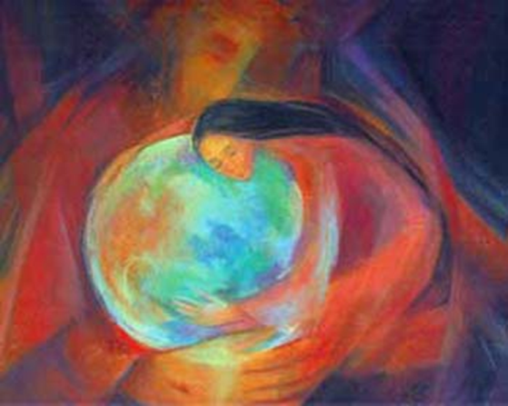
For Reflection/Discussion
How do Luke’s parables speak to you of divine justice and mercy?

Slide 42
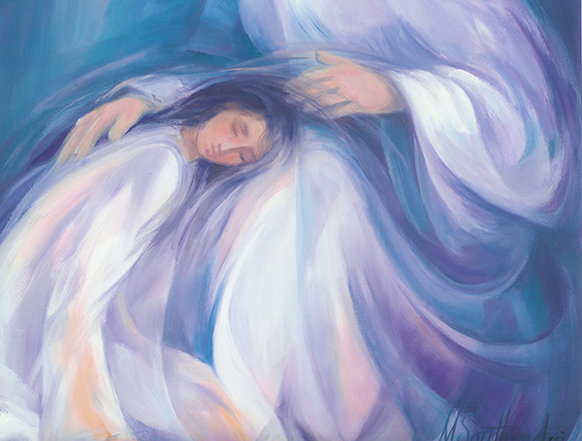
IV. Praying for Mercy, ἐλέησόν με
17:13 “Jesus, Master, have mercy on us!”
18:38-39 “Jesus, Son of David, have mercy on me!”(2x)
18:13 “God, be merciful to me, a sinner!”
Mary Southard
Healing Touch
Healing Touch
next previous
Play Previous
18/24
Next
Close
Healing Touch
next previous
Play Previous
18/24
Next
Close

Slide 43
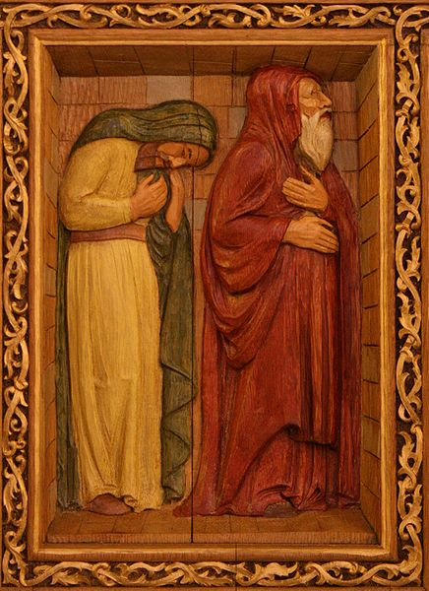
I thank you . . . I am not like [others]. . . I fast . . . I pay [tithes]. . .

Slide 44
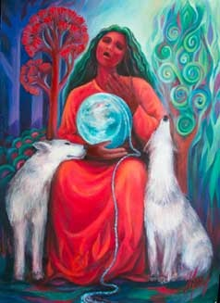
Prayer for Mercy – Luke 18:9-14
Recognizing one’s need for God
Shared humanity & bondedness with all of creation
Gratitude vs. entitlement: all is gift
Hilasthēti = “make atonement for me”
Read with 18:1-8:
prayer for God’s mercy + persistent
action for justice
Mary Southard, Pieta Lament

Slide 45
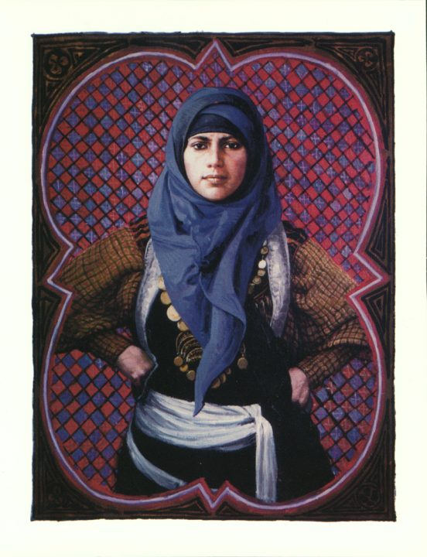
Luke 18:1-8
A godly widow
Persistently pursuing justice

Slide 46
For Reflection / Discussion:
What do you hear
in the toll collector’s prayer for mercy?
in the widow’s persistence for justice?

Slide 47

V. Our Dominican Tradition of Mercy

Slide 48

St. Dominic
Spent many nights before the cross, pleading with God to have mercy on sinners.
When a severe famine broke out, he sold everything, including his precious books to feed the starving.
Fra Angelico

Slide 49

St. Thomas Aquinas
God’s mercy as “the primordial root and the prior element to which everything else must be traced back”
Mercy is not just one of God’s attributes. It is the very core of who God is.
Mercy: "the compassion in our hearts for another person's misery, a compassion which drives us to do what we can to help him"

Slide 50

“If I were wholly inflamed with the fire of divine love, would I not then, with a burning heart, beseech my Creator, the truly merciful One, to show mercy to all my brothers and sisters?’”
St. Catherine of Siena
O immeasurable love!
O gentle love!
Eternal Fire!
You are that fire ever blazing….
You are direct without any twisting,
Genuine without any duplicity,
Open without any pretense.
Thurn the eye of your mercy on your creatures.
I know that mercy is your hallmark, and no matter where I turn
I find nothing but your mercy.
This is why I run crying to your mercy
to have mercy on the world.
---Prayer 9 [Dominican Praise, 249]

Slide 51

For Reflection / Discussion:
How is our Dominican tradition of mercy alive today?

Slide 52

VI. Continuing our Mission of Preaching the Gospel of Mercy
Faithfulness into an unknown future

Slide 53

“We know that the whole creation has been groaning in labor pains until now” (Rom 8:22)

Slide 54

“I am about to do a new thing;
now it springs forth, do you not perceive it?”
(Isa 43:19)

Slide 55

Active Waiting
Propitious Timing
Discernment
Mary and the Midwives
--Janet McKenzie

Slide 56

Pope Francis:
“the distinctive sign of consecrated life
is prophecy . . .
This is the priority that is needed right now.”

Slide 57

Luke 13:20-21

Slide 58


Slide 59


Slide 60

Vitalia – catacomb of San Gennaro, Naples (287-303)
Vitalia wearing red chasuble, standing at an altar, hands raised above 2 cups, loaf of bread at her right elbow; 2 open books behind her with names of evangelists:
she celebrates liturgy of Word & Eucharist
Notes:
Naples; wearing red chasuble, standing at an altar, hands raised above 2 cups, flat loaf of bread at her right elbow; 2 open books behind her with names of evangelists: she celebrates liturgy of Word & Eucharist

Slide 61


Stepping out on the Word of God
Maya Angelou

Slide 62

Claiming the Power of the Spirit (John 20:19-23)

Slide 63

John 20:22 // Gen 2:7 “then the Lord God formed a human from the dust of the ground, and breathed into its nostrils the breath of life; and the human became a living being.”

Slide 64

Ezek 37:5
“I will cause breath to enter you and you shall live.”
Notes:
silver.neep.wisc.edu/~lakes/Ezekiel.jpg

Slide 65

From Fear and Woundedness to Peace & Mission
If you forgive the sins of any they are forgiven them
Whomever you hold on to are held fast

Slide 66

“If you forgive the sins of any, they are forgiven them; whomever you hold are held fast.” NOT: if you retain [the sins of] any, they are retained.”
Notes:
J.M. Ford, Redeemer, Friend, Mother, 200.
Origen

Slide 67
Read 20:23 in light of
John 6:37, 39
Everything that the Father gives me will come to me, and anyone who comes to me I will never drive away;
And this is the will of him who sent me, that I should lose nothing of all that he has given me, but raise it up on the last day
10:27-29
²⁷ My sheep hear my voice. I know them, and they follow me. ²⁸ I give them eternal life, and they will never perish. No one will snatch them out of my hand. ²⁹ What my Father has given me is greater than all else, and no one can snatch it out of the Father’s hand
17:12 While I was with them, I protected them in your name that you have given me. I guarded them, and not one of them was lost except the one destined to be lost, so that the scripture might be fulfilled.
18:9 This was to fulfill the word that he had spoken, “I did not lose a single one of those whom you gave me.”

Slide 68

Thea Bowman, FSPA
1937-1990
Notes:
"Sister Thea Bowman, FSPA" portrait by Marshall Bouldin
Address to U.S. Bishops 1989

Slide 69

“we shall overcome”

Slide 70


Slide 71

John 21:15-19
Do you love me?
Then feed my sheep

Slide 72

“Very truly, I tell you, when you were younger, you used to fasten your own belt and to go wherever you wished. But when you grow old, you will stretch out your hands, and someone else will fasten a belt around you and take you where you do not wish to go.”
Body and Blood, Janet McKenzie

Slide 73


Slide 74

“Mary Magdalene with Jesus, the Christ”
--- Janet McKenzie

Slide 75

Contemplation
Letting ourselves be gazed upon with mercy
See / hear / do
mercy - justice
Individually
Communally
Pray for mercy
Freedom
joy
Winter - Mary Southard, CSJ

Slide 76

Remembering: Study Scripture & Tradition
Making God’s justice/mercy
present & visible
through our preaching
mission & acts of mercy

Slide 77

Obedience, Common Life, Communion with all of the Cosmos

Slide 78


light
so what has it been about
this life
that sometimes passed us by
at the gate of our possibility
while we hesitated
on the threshold
afraid to venture
along the twisted path
out into the unknown road
that would take us
we know not where
can we endure
to know not where
and set out even so
--Mary Horn, OP

Slide 79


Slide 80

For Reflection / Discussion:
How is the Spirit leading us into the next moment of our mission to preach the gospel of mercy?
Lucy D’Souza
Notes:
Mary of Magdala,
A radiant woman in red, the color of love,
as she comes from the light of the risen Lord to bring the good news to the disciples who are still in the dark and in fear. "Mary Magdalene went and said to the disciples, "I have seen the Lord" and she told them that he had said these things to her" (Jn 20:18).
What is particularly remarkable in this story is the great courage Mary shows by going to the tomb, her loving persistence as she is looking for his body, and the fact that Jesus gives her the mission to tell his disciples the good news of his resurrection. It was this mandate to proclaim the good news that caused St. Augustine to call her "apostle of the apostles."

