Slide 1


Slide 2

Call to Prayer:
ALL:
Creator of the Stars
God of Epiphanies
You are the Great Star
You have marked my path with light.
1) You have filled my sky with stars
naming each star
guiding it
until it shines into my heart
awakening me to seeing
new revelations
and brighter epiphanies.

Slide 3

2) O infinite Star Giver
I now ask for wisdom and courage
to follow these stars
for their names are many
and my heart is fearful.
1) They show me wherever I go:
the star of hope
the star of mercy and compassion
the star of justice and peace
the star of tenderness and love
the star of suffering
the star of joy.

Slide 4

2) And every time I feel the shine
I am called
to follow it
to sing it
to live it
all the way to the cross
and beyond.
ALL:
O Creator of the Stars
You have become within me
an unending Epiphany.
Adapted from SEASONS OF YOUR HEART: Prayers and Reflections
Macrina Wiederkehr OSB

Slide 5

Silent Reflection:
What Star beckons you at this time?
Sharing at tables:

Slide 6
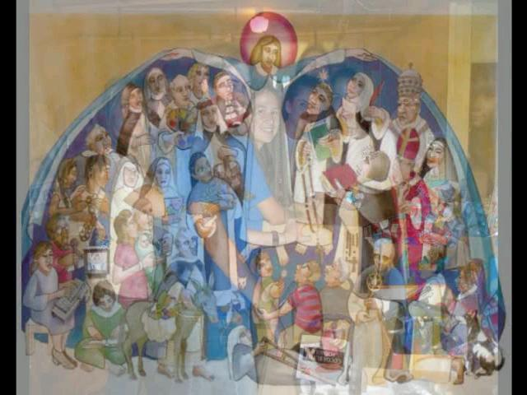
DOMINIC’S FOLLOWERS PAST, PRESENT, and FUTURE!

Slide 7
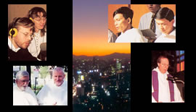

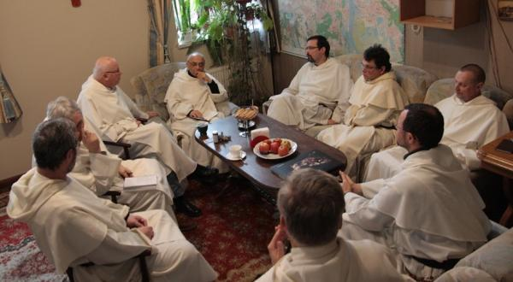
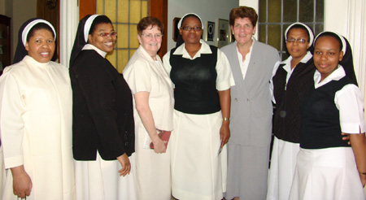
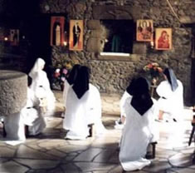
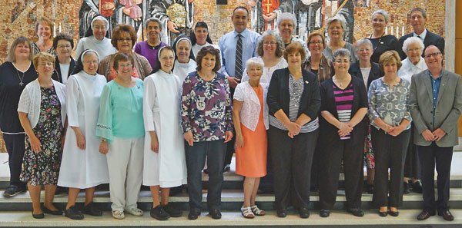
All over the world there are friars, nuns, sisters, brothers, laity and associates who continue to follow Dominic’s star.

Slide 8
For public use of "We are One" please see:
We Are One by Joyce Johnson Rouse ©1995 Rouse House Music (ASCAP) Used by permission. All rights reserved. As recorded by Earth Mama® on Love Large CD Available at www.earthmama.org

Slide 9
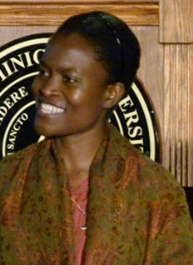
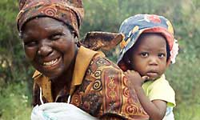


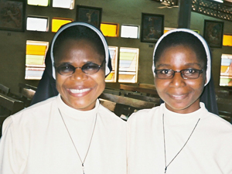
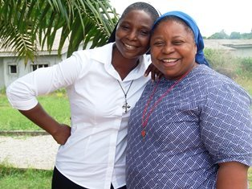

DOMINICANS ARE IN
In Africa
Algeria Angola
Benin Burundi
Cameroon Central Africa
Chad Congo
Egypt Ethiopia
Ghana Democratic Republic of the Congo
Ivory Coast Burkina Faso
Kenya La Reunion
Lesotho Morocco
Mozambique Nigeria
Rwanda South Africa
Tanzania Zambia
Zimbabwe

Slide 10
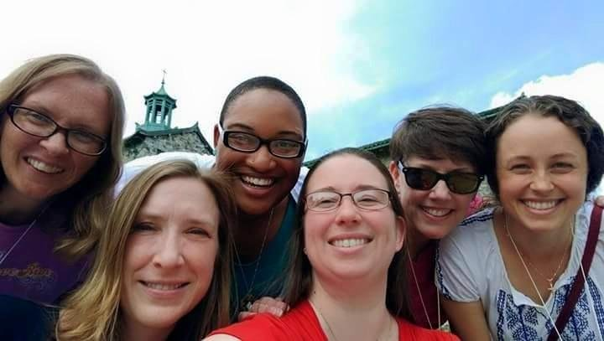
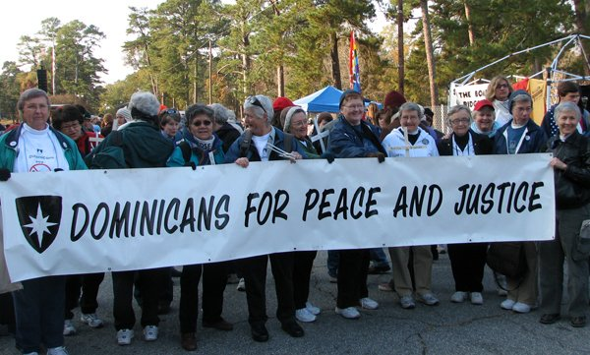
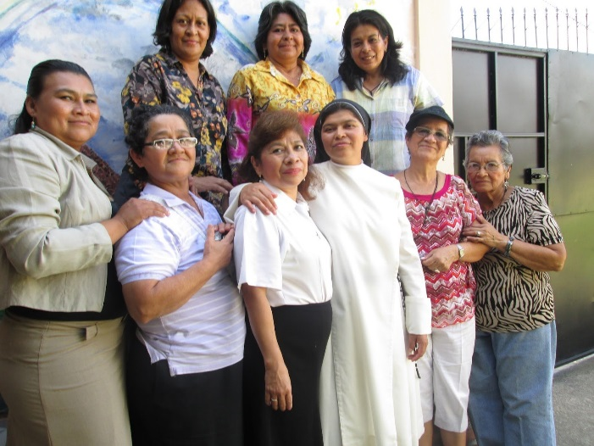
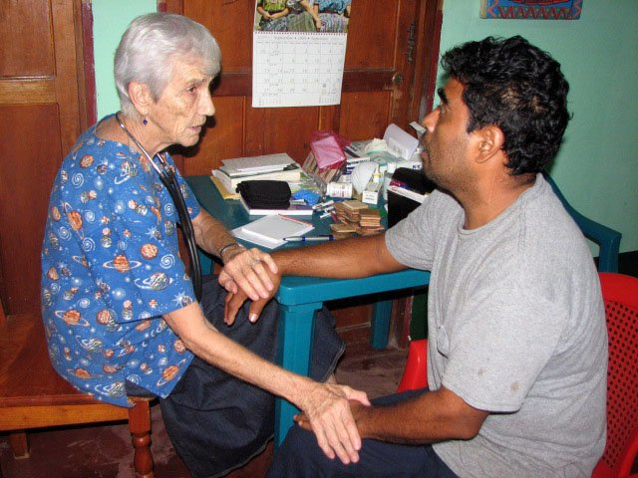

DOMINICANS ARE IN
NORTH AMERICA
Canada
United States
CENTRAL AMERICA
Costa Rica México
El Salvador Nicaragua
Guatemala Panamá
Honduras Belize

Slide 11
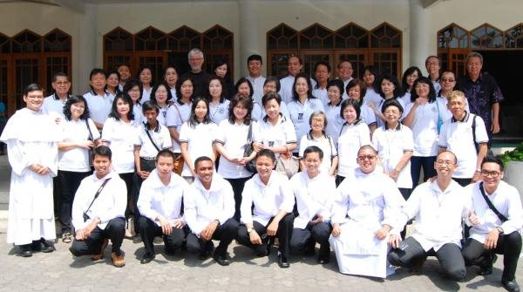


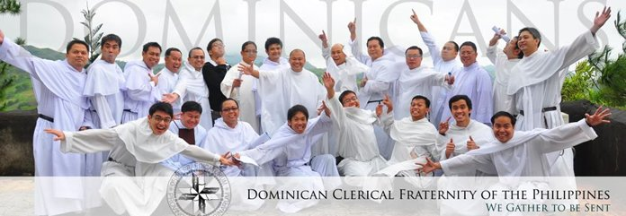
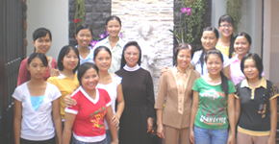
DOMINICANS ARE IN
THE FAR EAST
Cambodia/Thailand China
Hong Kong Indonesia Japan
North Korea Philippines
South Korea Vietnam
Taiwan

Slide 12
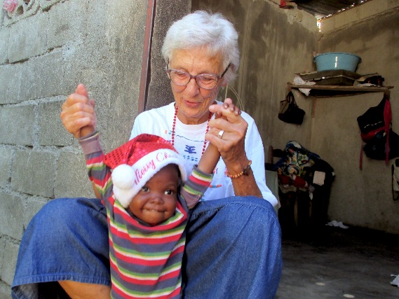
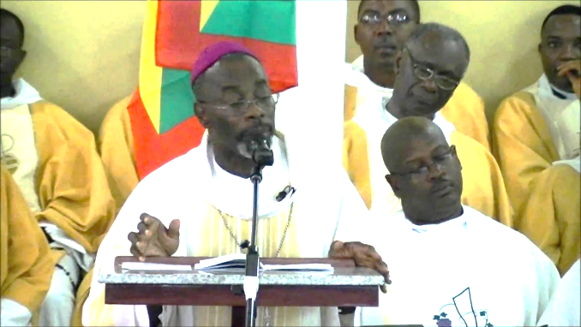
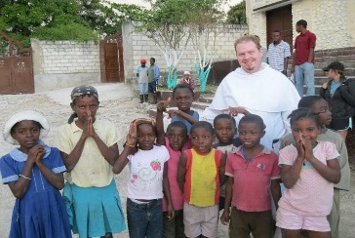

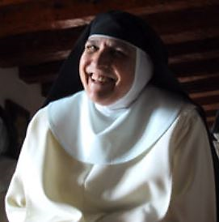
DOMINICANS ARE IN
THE CARIBBEAN
Aruba Barbados
Cuba Dominican Republic Guadalupe Haiti
Jamaica Martinque Puerto Rico Santa Lucia Trinidad-Tobago

Slide 13
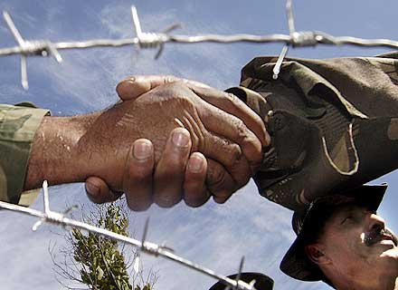
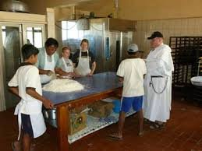
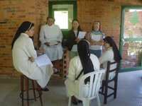
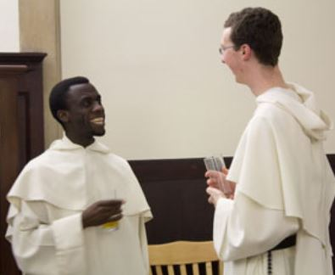

DOMINICANS ARE IN
SOUTH AMERICA
Argentina Brazil
Bolivia Chile
Colombia Ecuador
Paraguay Perú
Uruguay Venezuela

Slide 14

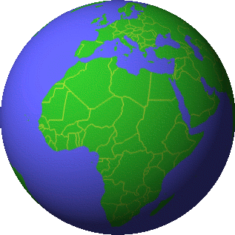

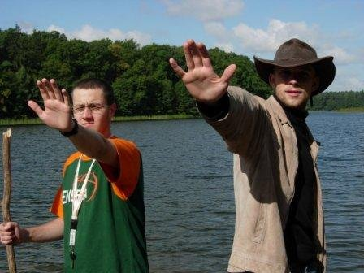

DOMINICANS ARE IN
In Europe
Albania Austria Belarus Belgium Poland Bosina
Croatia Denmark
England Estonia France Germany Greece Holland Hungary Ireland Italy
Latvia Lithuania Malta Norway Portugal Rumania Ukraine Switzerland Slovakia
Czech Republic

Slide 15


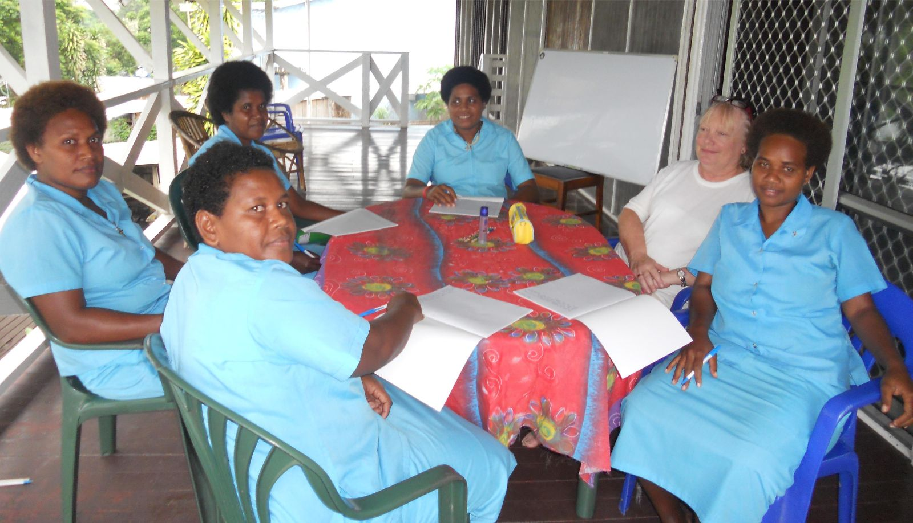
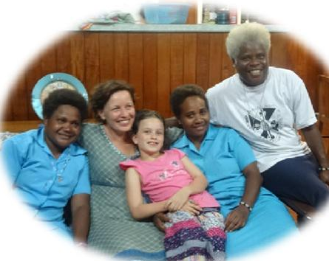
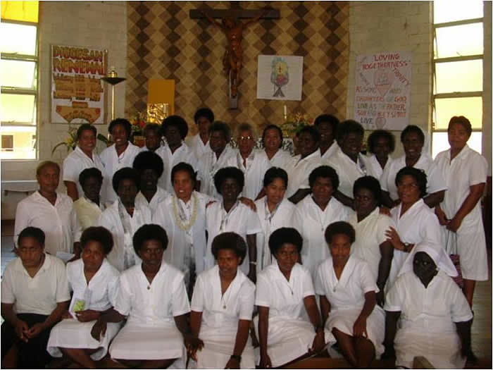
DOMINICANS ARE IN
AUSTRALIA and MICRONESIA
Australia New Zealand
Papua New Guinea Solomon Islands

Slide 16
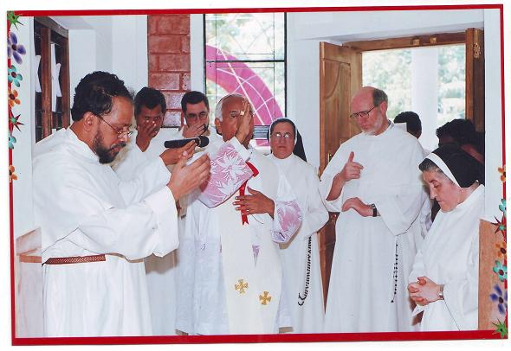
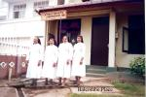
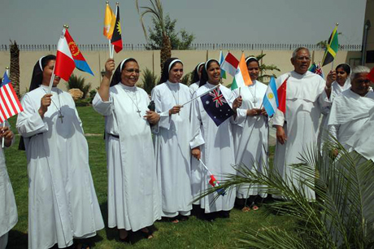
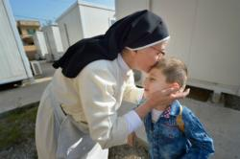
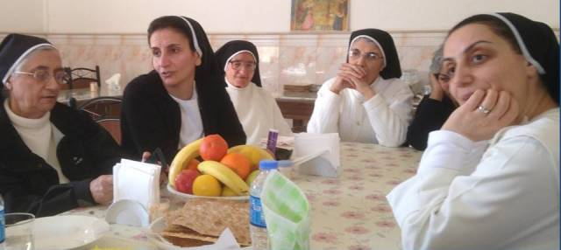

DOMINICANS ARE IN
CENTRAL ASIA
Bangladesh India
Nepal Pakistan
Sri Lanka Myanmar
MIDDLE EAST
Arabia Gulf Iraq
Israel/Palestine Lebanon
Jordan Palestine
Syria Turkey

Slide 17
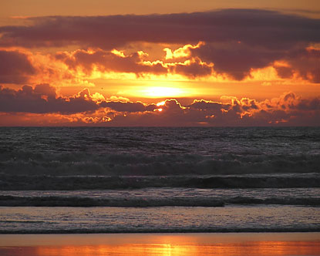

Slide 18
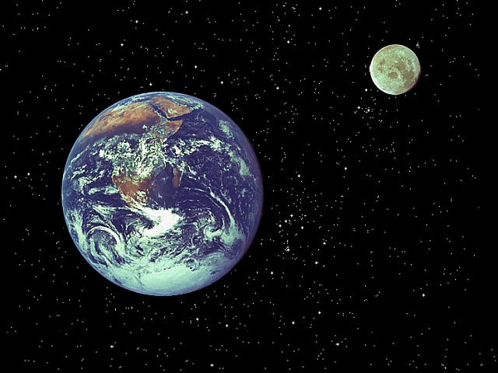

Slide 19
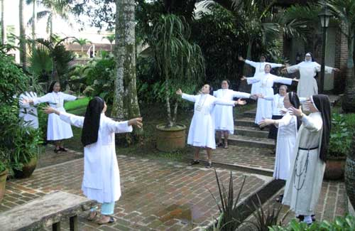

Slide 20
1216-2016
DOMINICANS

Slide 24
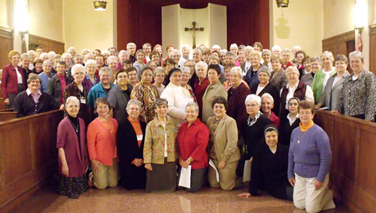
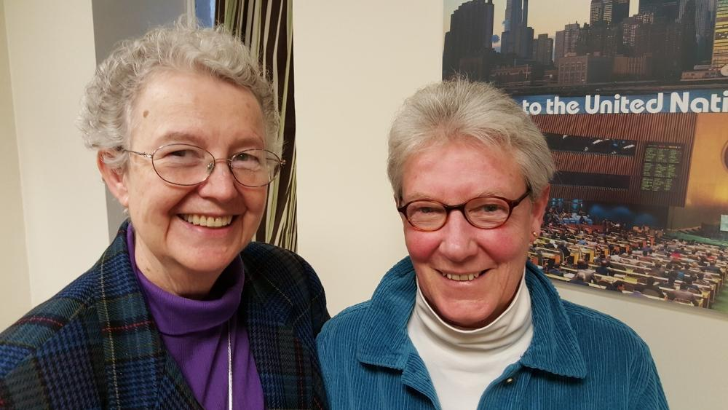
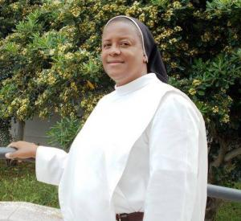
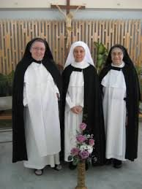
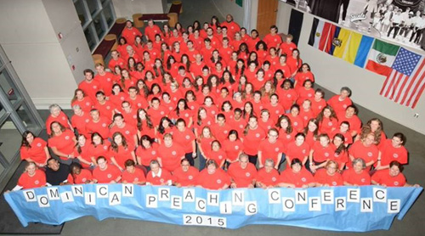
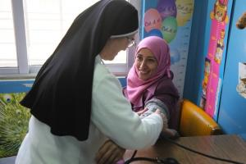
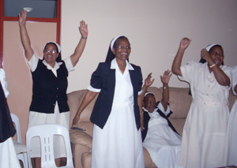
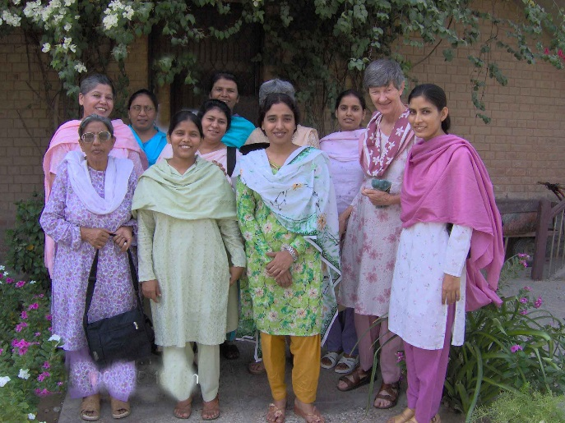


1216 - 2016
DOMINICANS

Slide 25
