Slide 1

N
DOMINICANS IN THE PROMOTION AND DEFENSE OF HUMAN RIGHTS:
PAST, PRESENT, FUTURE

Slide 2
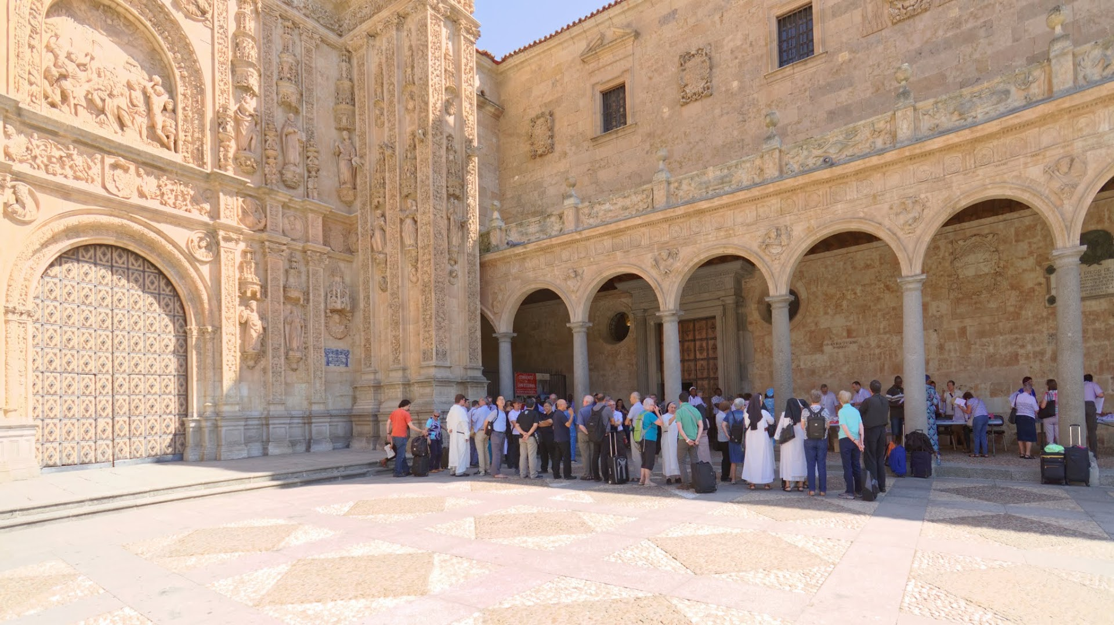
San Esteban, Salamanca

Slide 3
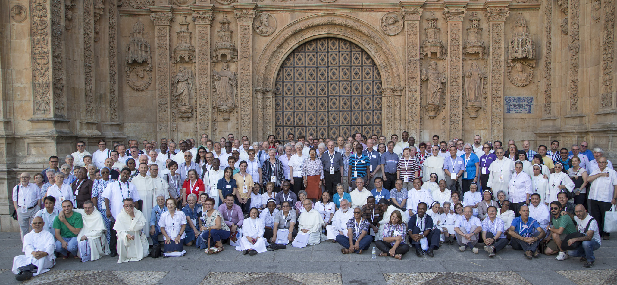
200 Dominicans and Colleagues
from 50 countries

Slide 4
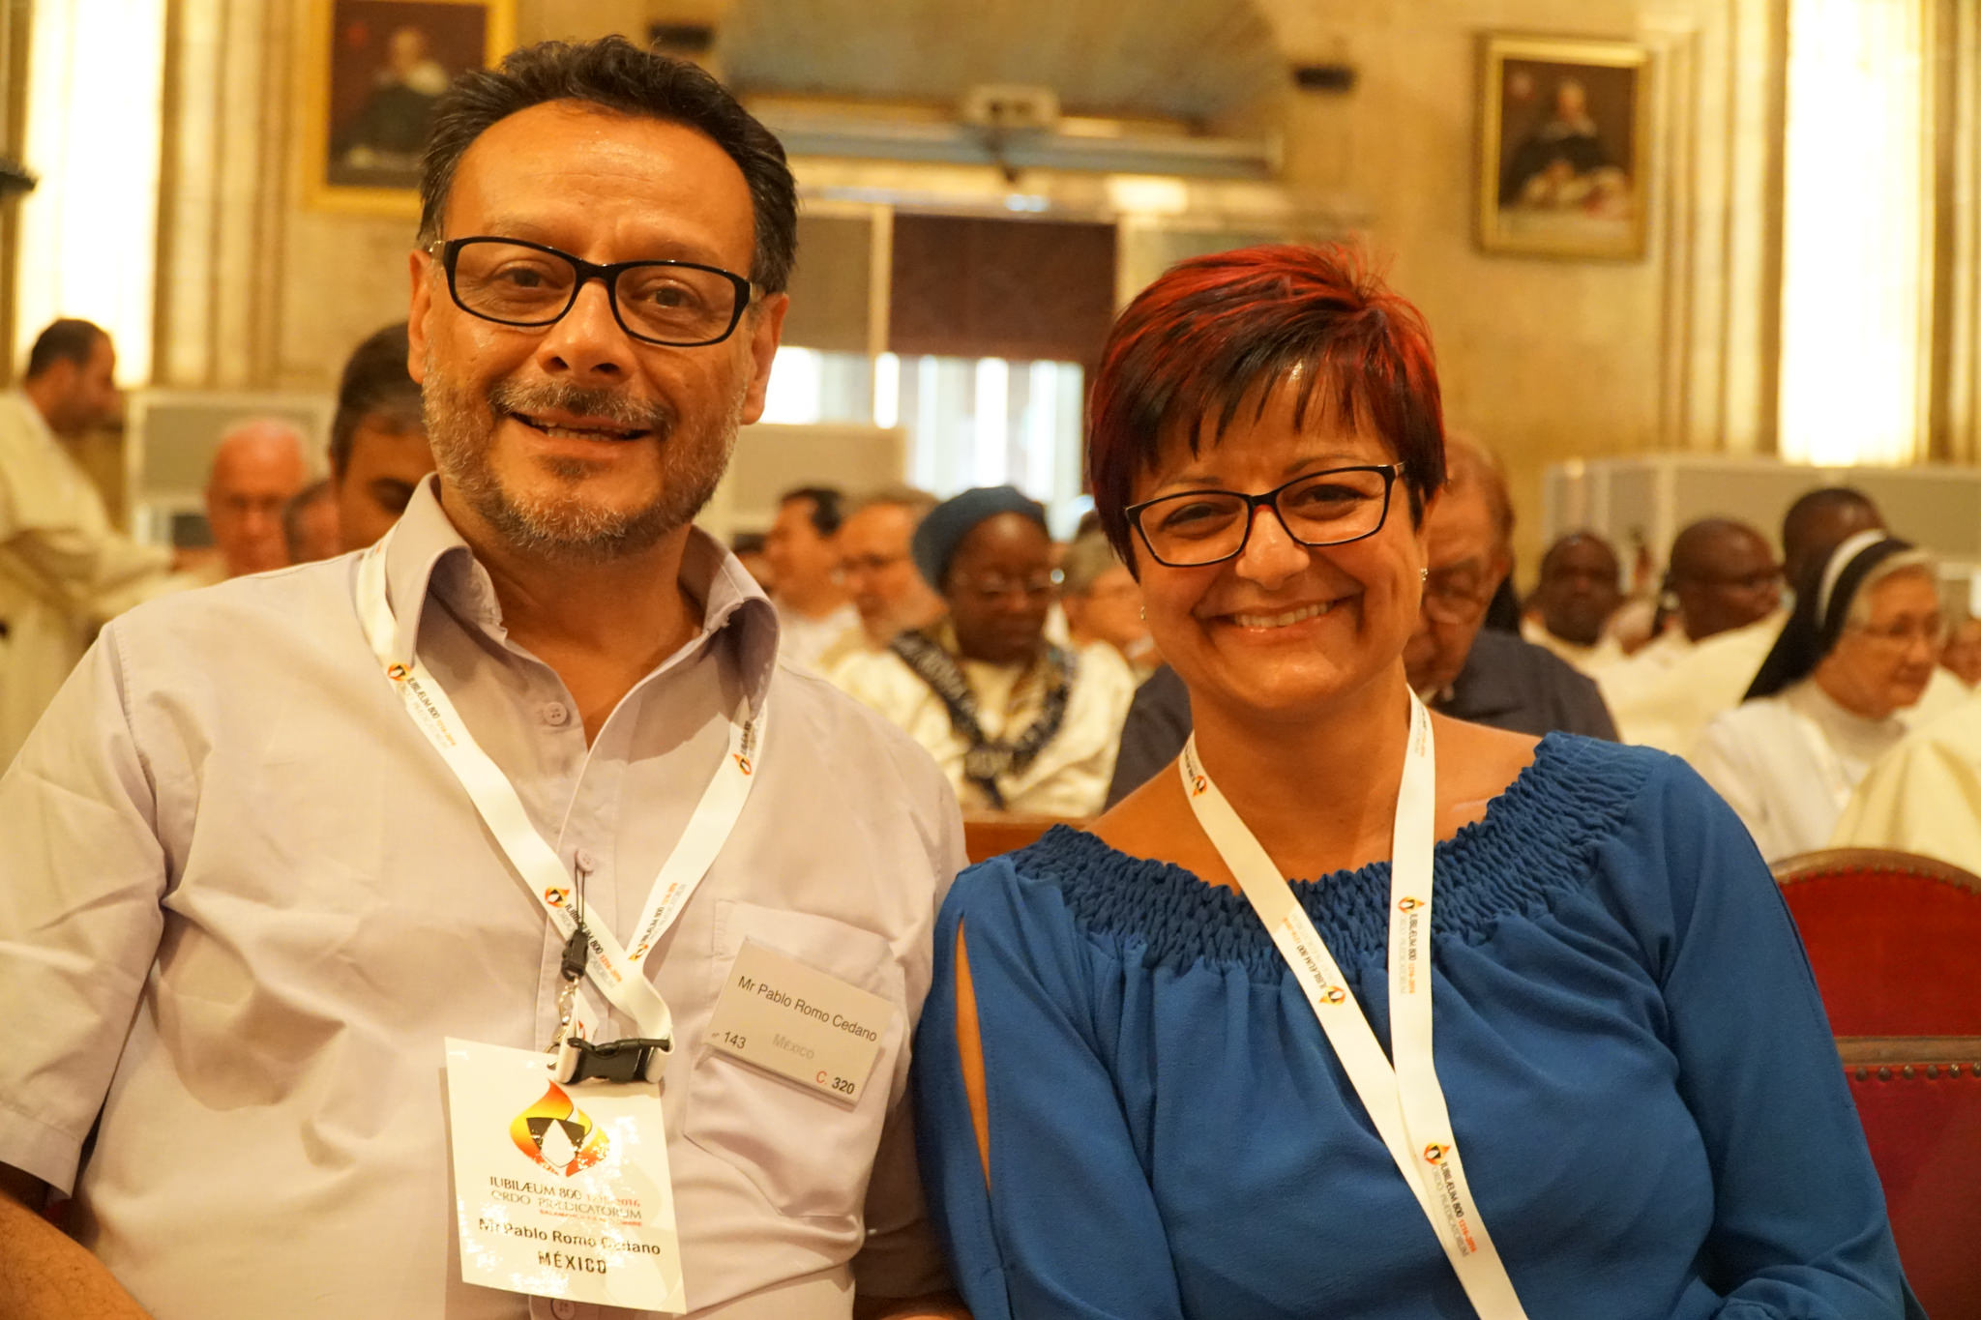
Facilitators
Pablo Romo and Patrizia Morigante
Notes:
Pablo from Mexico; one-time OP and also General Justice Promoter; Patrizia formerly with DSI

Slide 5
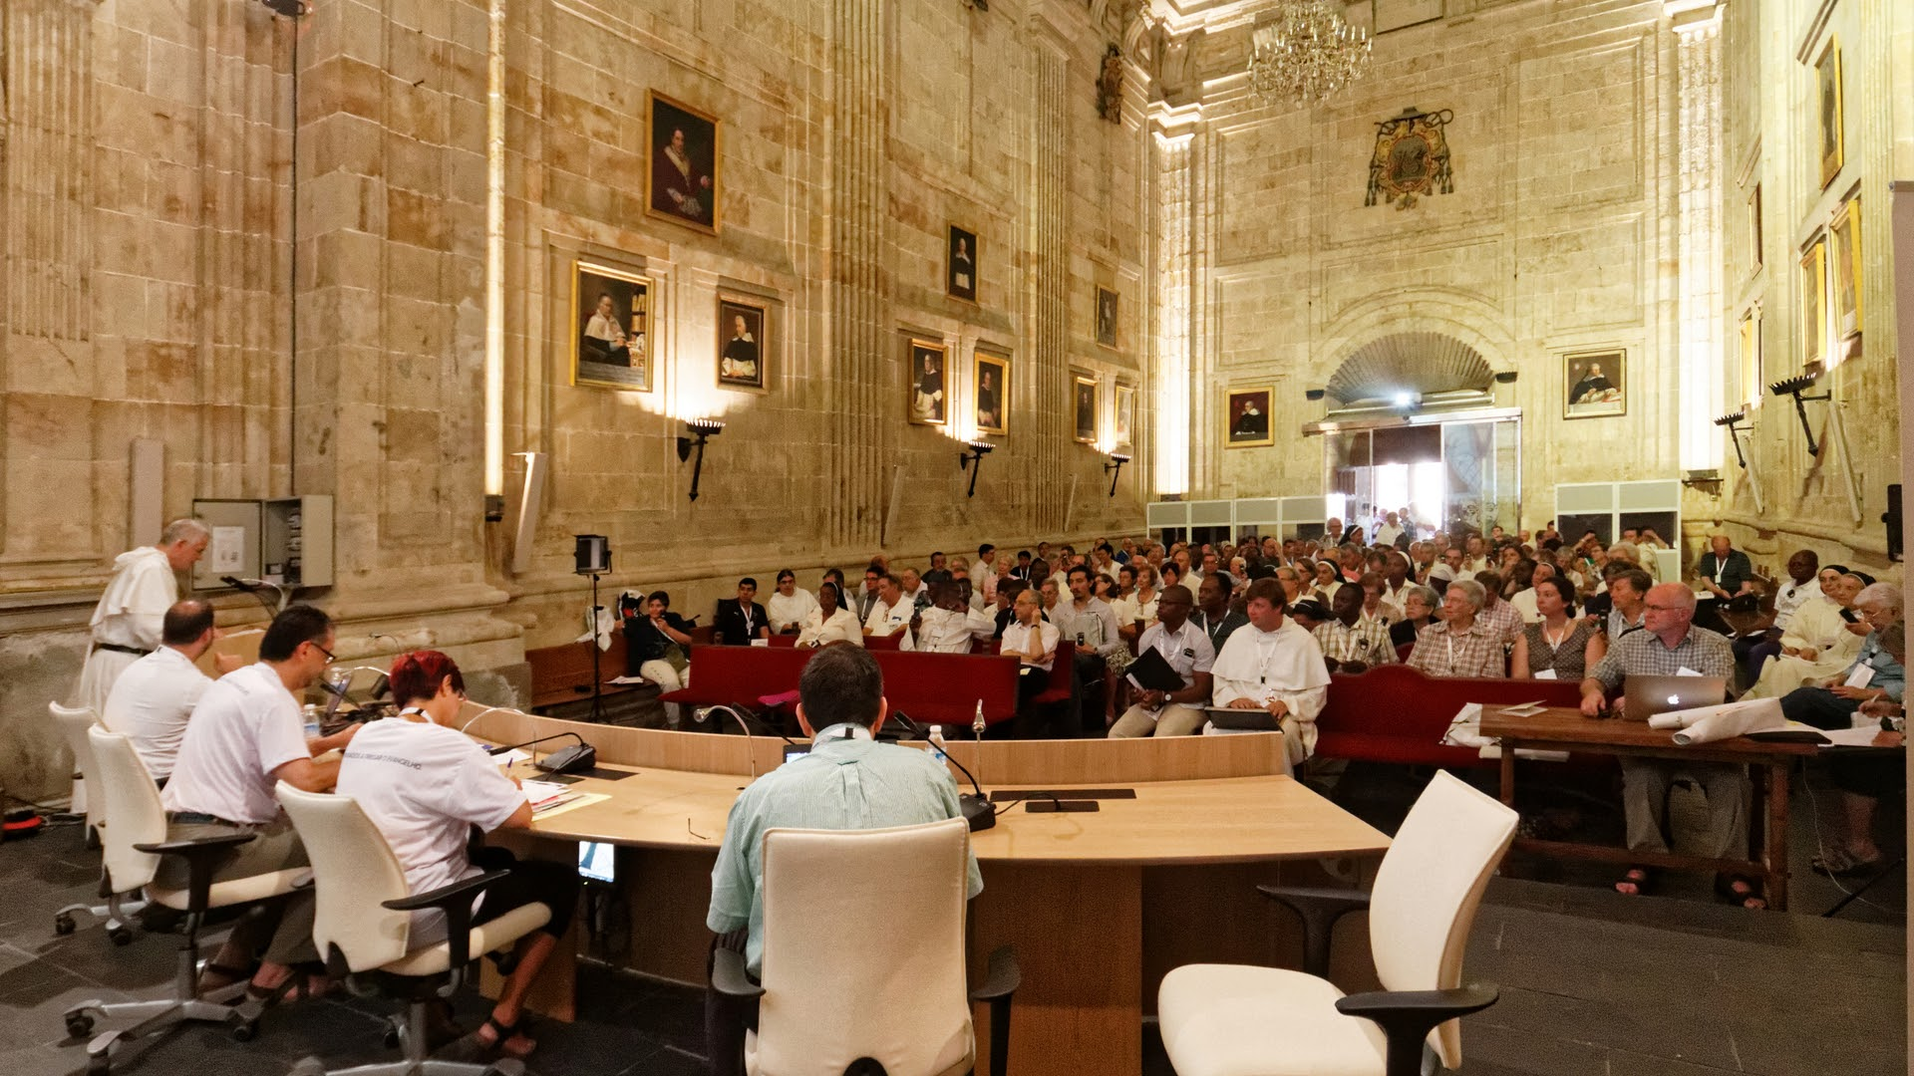
Notes:
Meeting one - the only air came through that doorway at the back.

Slide 6
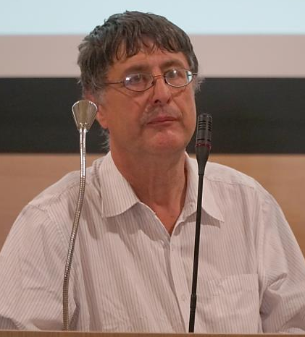
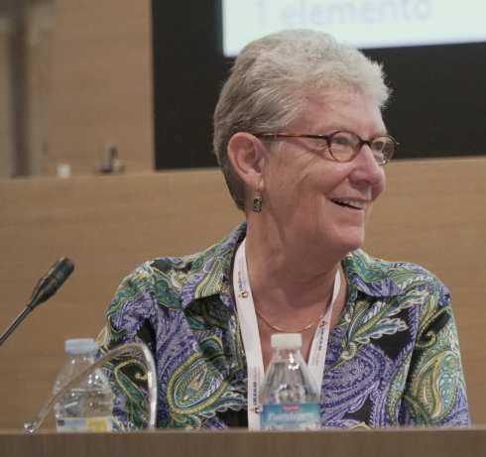
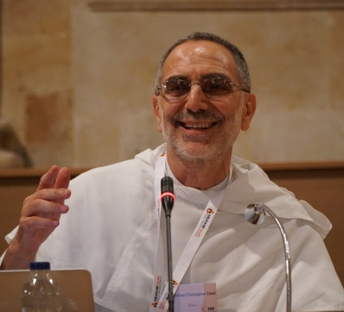
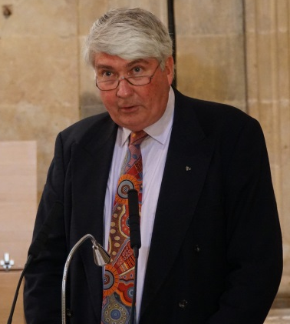
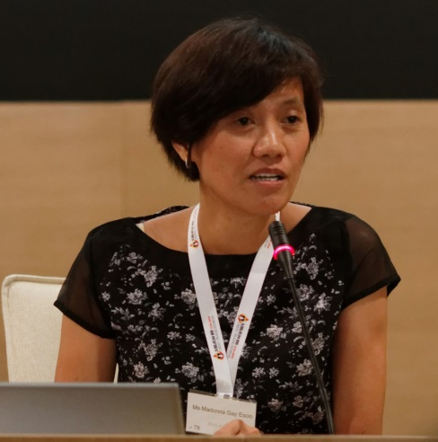
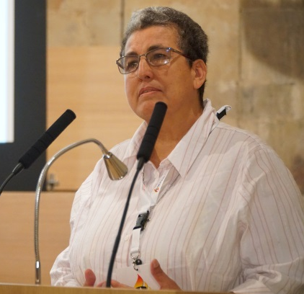
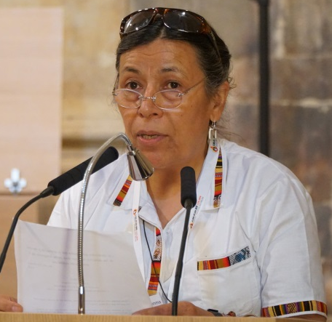
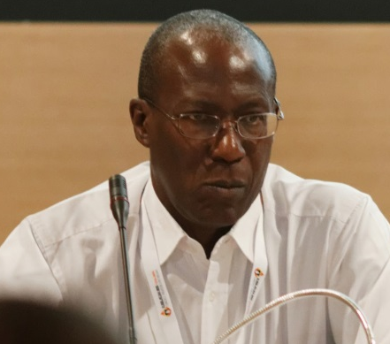
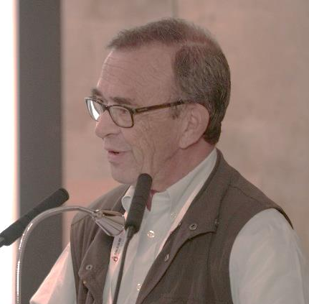
History of engagement in human rights
Church’s view on human rights
Obstacles to Dominican preaching
Dominican involvement today
Key global human rights challenges today
Notes:
Hearing from a Dominican historian, participants reflected on the history of Dominican engagement in the human rights arena, even before the development of the term “human rights.” After hearing about the Church’s view on human rights, the group was challenged to look at obstacles that prevent the defending of human rights being integral to Dominican preaching. Along with presenters sharing about Dominican involvement today, others highlighted key global human rights challenges in our time.

Slide 7
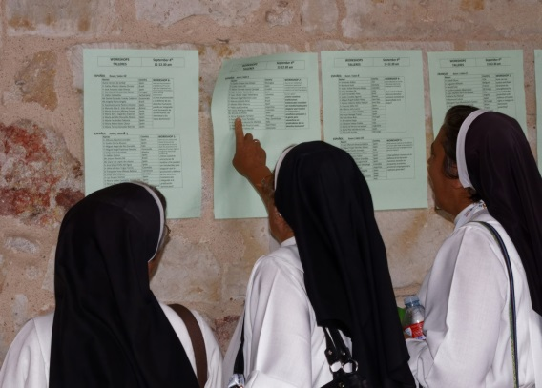
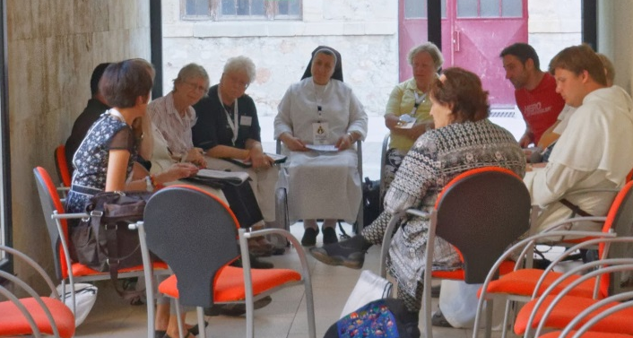
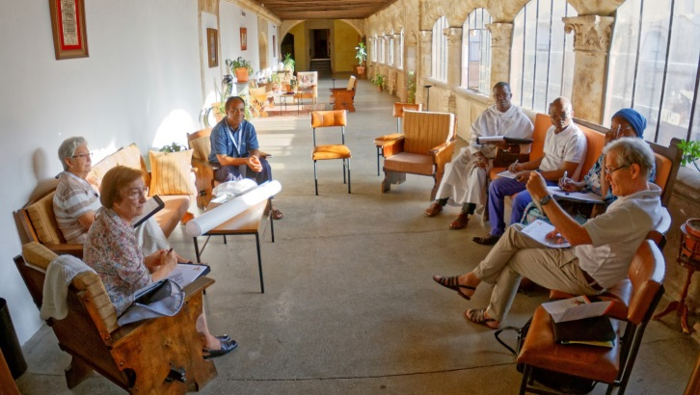
Workshops
Strengthening J & P structures
Engaging intellectual institutions
Having greater impact on the United Nations system
Developing networks on human rights issues
Noting processes that general
chapters need to consider
6. Integrating promotion/defense
of human rights into the formation process

Slide 8
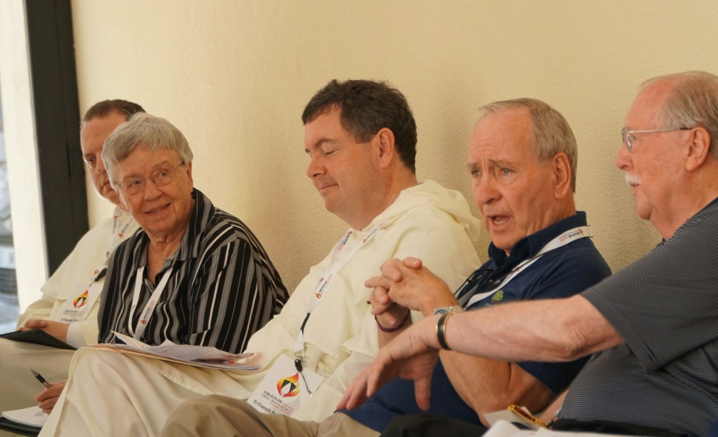
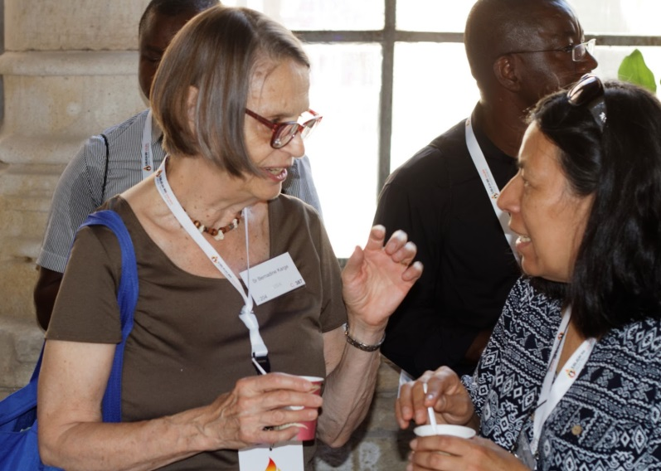
Commitments
Embrace as an integral part of our Dominican charism the mission of justice and peace as constitutive to the preaching of the gospel.
Integrate Catholic Social Teaching and the defense of human rights into all aspects of the formation of the Dominican Family – brothers, sisters, nuns, laity, associates, priest fraternities, youth, and other movements and members of the family

Slide 9
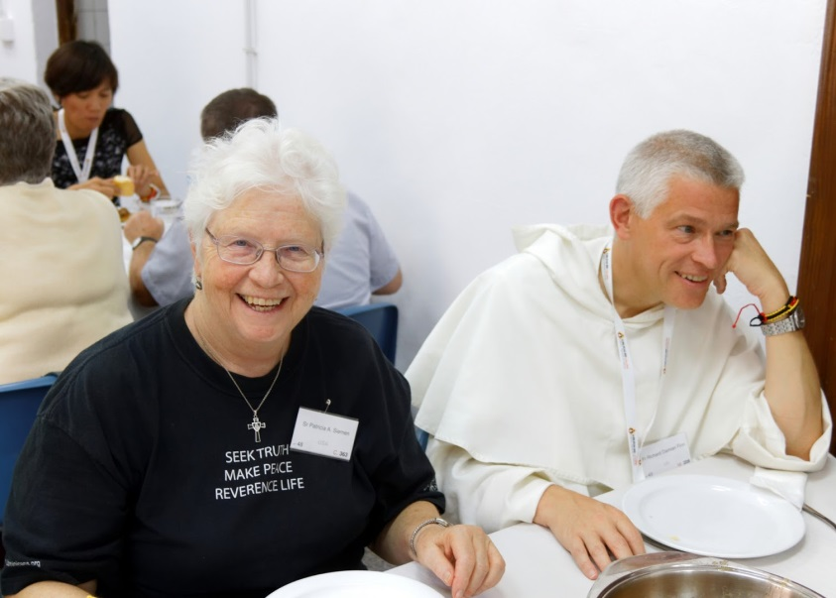
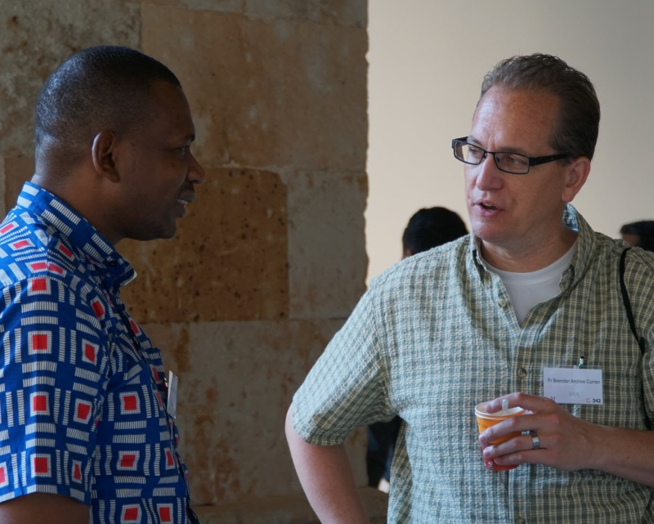
Promote the study of Laudato Si as a means for teaching an integral ecology that combines the well-being of humans with the whole of creation.
Adopt and promote the Salamanca Process which calls on Dominicans, our educational institutions, and ministerial programs to direct our study, research, analysis, and action towards addressing the challenges our world faces, thus creating a passionate synergy between our intellectual and apostolic lives

Slide 10
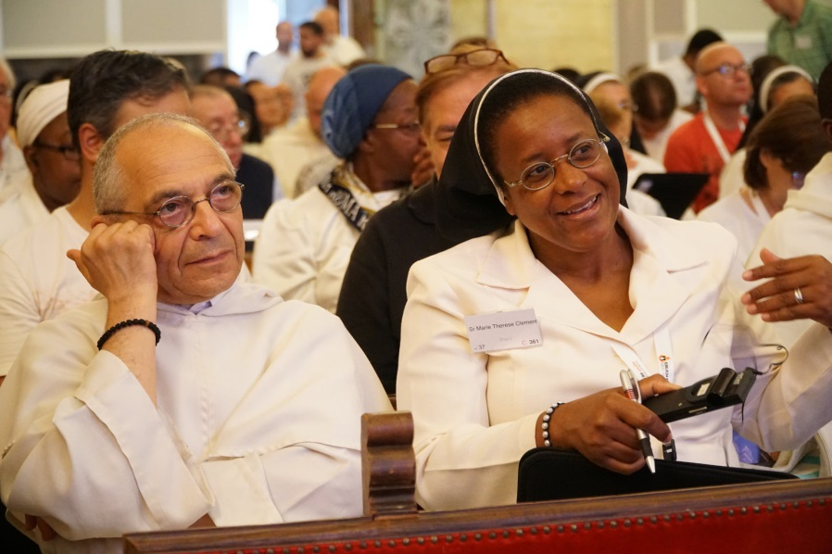
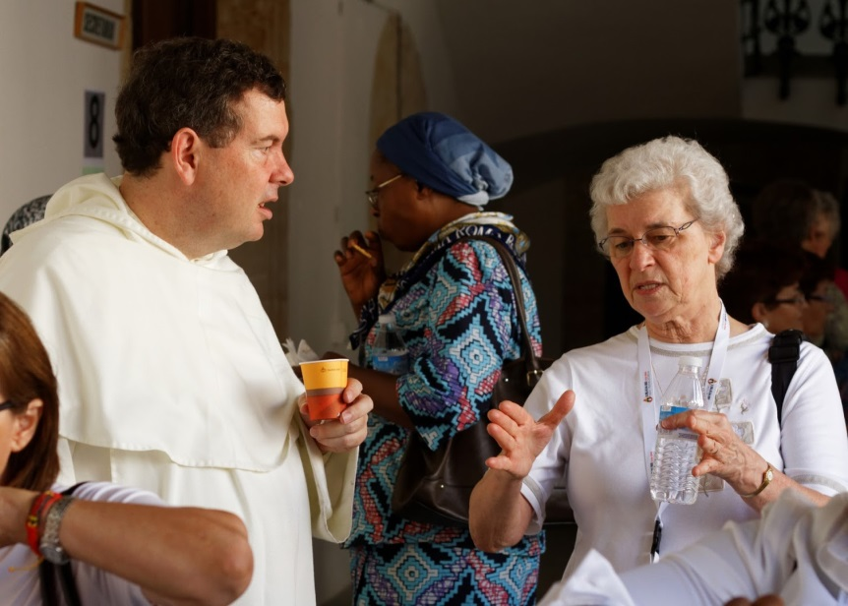
Create and strengthen networks that enable collaboration at all levels of our mission.
Improve our structures of communication, using modern technologies effectively and seeking alternatives when necessary.

Slide 11
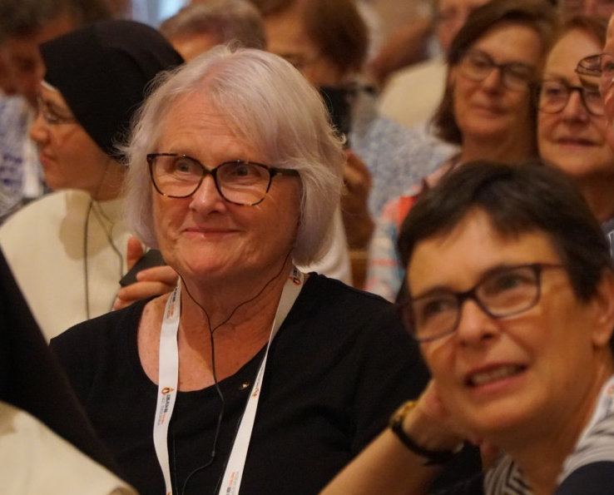
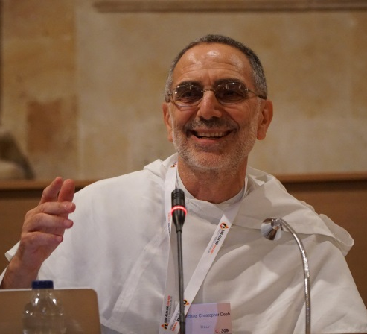
Develop and strengthen structures at all levels that facilitate the Dominican Family working together to address the root causes of injustice.
Strengthen the Dominican presence at the United Nations by ensuring that the voices of those suffering human rights abuses are heard at the highest levels through the sharing of the Dominican family on the ground and by increasing resources dedicated to that mission and concrete justice and peace projects.

Slide 12
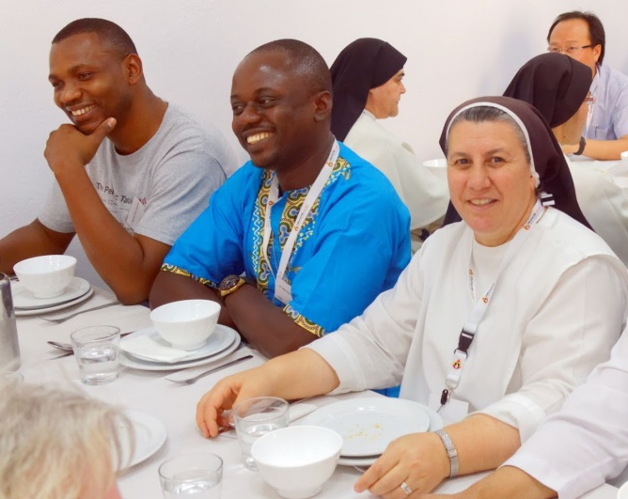
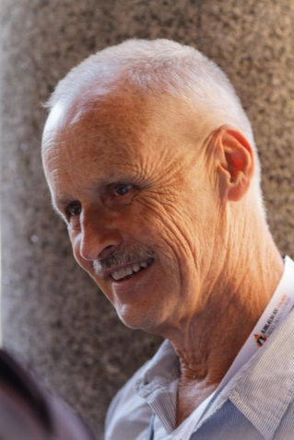
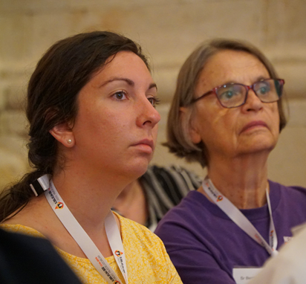
Be in solidarity with our brothers and sisters whose mission experience is difficult and dangerous due to political, religious or economic factors.
Support those who take prophetic stands, like our early brothers and sisters, against sinful structures of power that oppress people and violate the whole of creation.

Slide 13
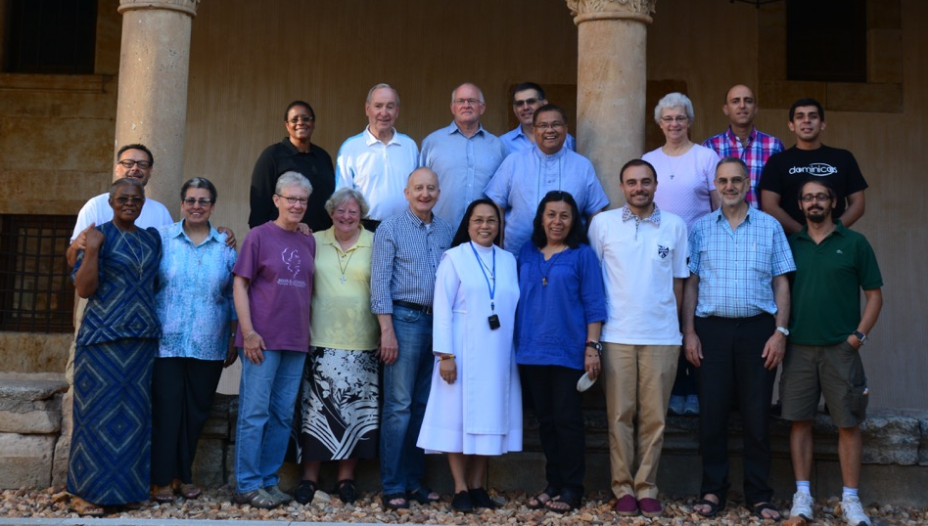
Dominican International Commission on Justice & Peace

