Slide 1

Celebrating 800 years of Dominican Life and Mission
Dominican Sisters Conference
Leadership Meeting
October 5-9, 2016

Slide 2
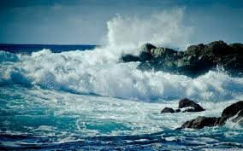
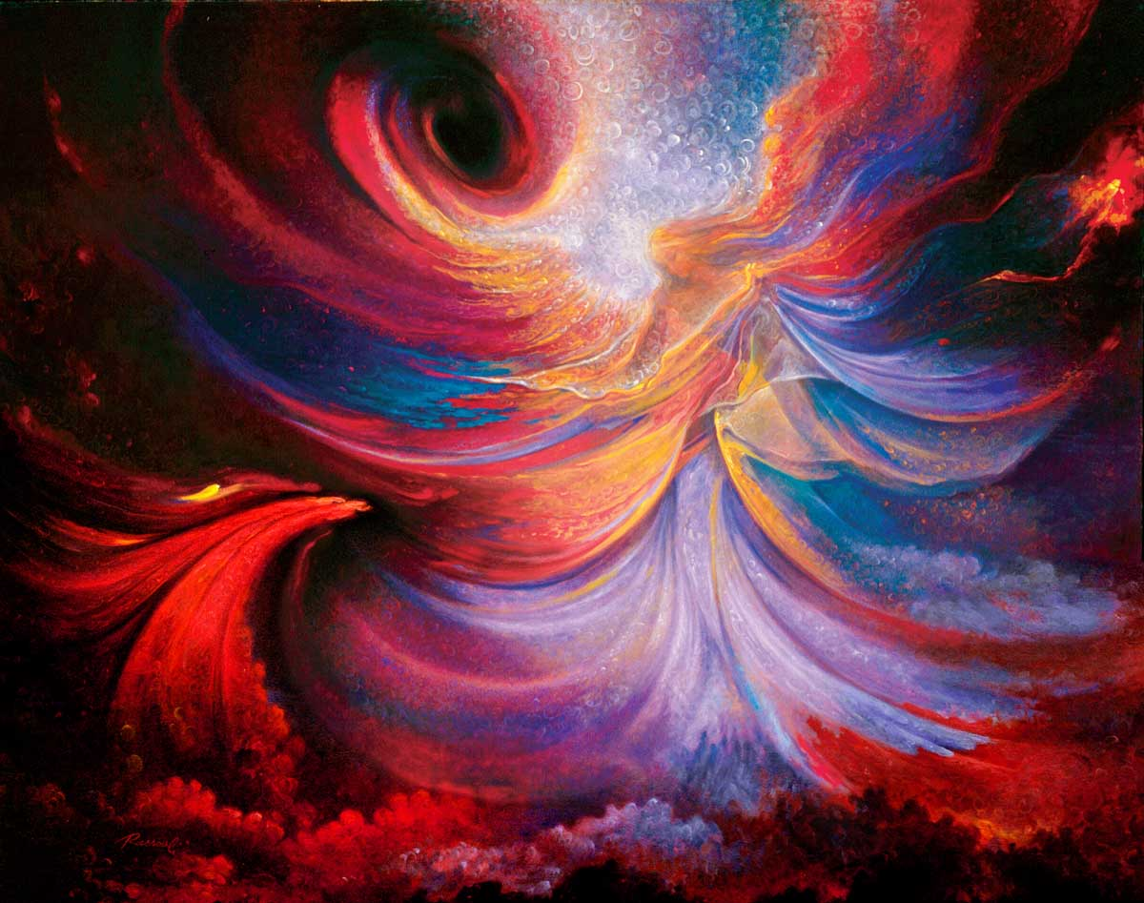
Like the joy of the sea
coming home to shore,
May the music of laughter
break through your soul.
As the wind wants to make
everything dance,
May your gravity
be lightened by grace.

Slide 3
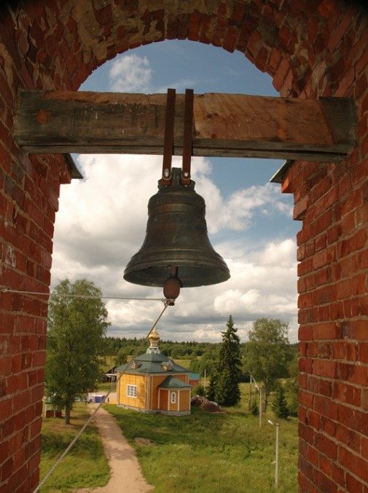

Like the freedom
  of the monastery bell,
May clarity of mind
make your eyes smile.
2) As water takes
whatever shape it is in,
May you be free
in your becoming.

Slide 4

As silence smiles
  on the other side of what’s said,
May a sense of irony
give you perspective.
2) As time remains free
of all that it frames,
May fear or worry
never put you in chains.

Slide 5
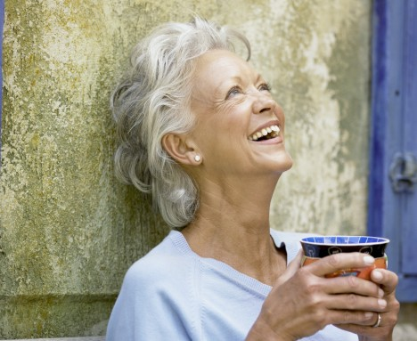
ALL:
May our prayer of listening
deepen enough
To hear in the distance
the laughter of God.

Slide 6

Dominican Blessing

