Slide 1
Shareholder Advocacy and Climate Change – Evolution of the “Asks”
2013
Raising the Bar Initiative – 150 Proposals Filed
Goals to reduce emissions in operations and product
2007
Leave Global Climate Coalition
2000
1989
Sign the Valdez Principles – CERES Principles
Utility companies to increase efficiency
1993
2005
Ford reports on climate risk
Science-Based Goals and the Road to Paris
2015
1997 Reporting and Disclosure of Climate Risks

Slide 2
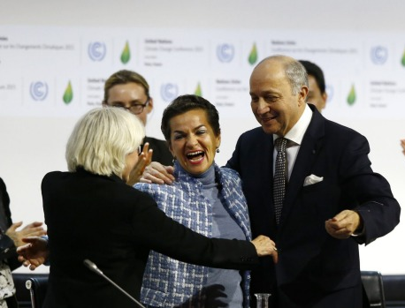
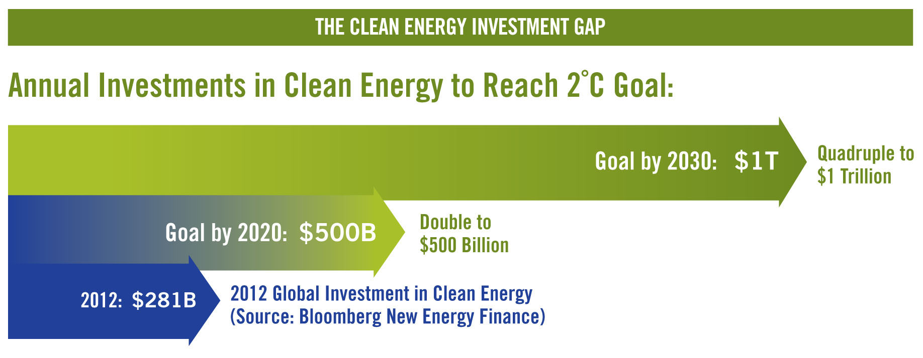
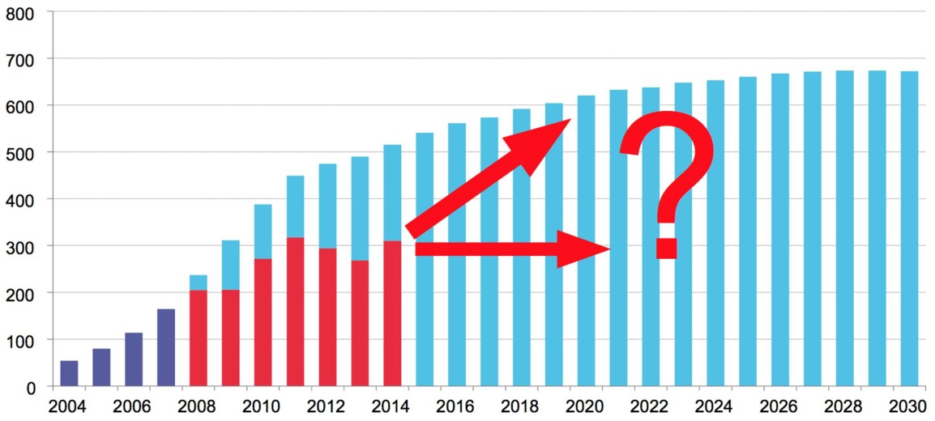
Investing in Climate Solutions: The Clean Trillion
The Clean Trillion represents both a major investment opportunity and a daunting global challenge.

Slide 3
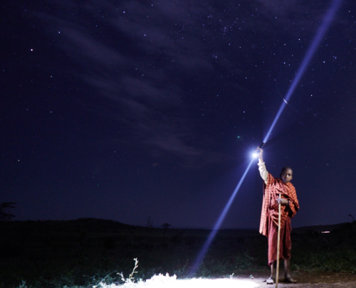
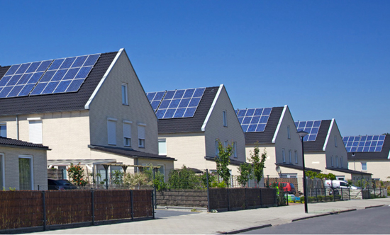
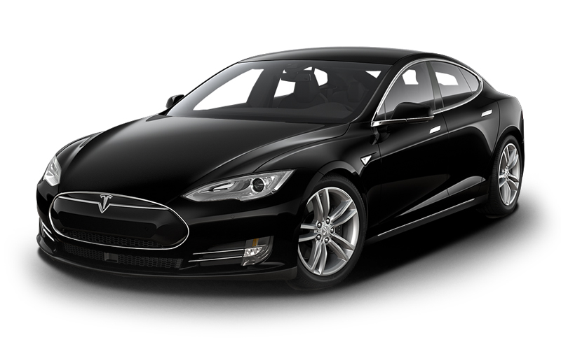
Climate Finance
Distributed Renewables in Africa and India
MTA Green Bond
Apple $1.5 Billion Green Bond
Tesla Motors
Low-Income Housing with Solar

Slide 5
OPSCC Common Climate Finance Fund

