Slide 1
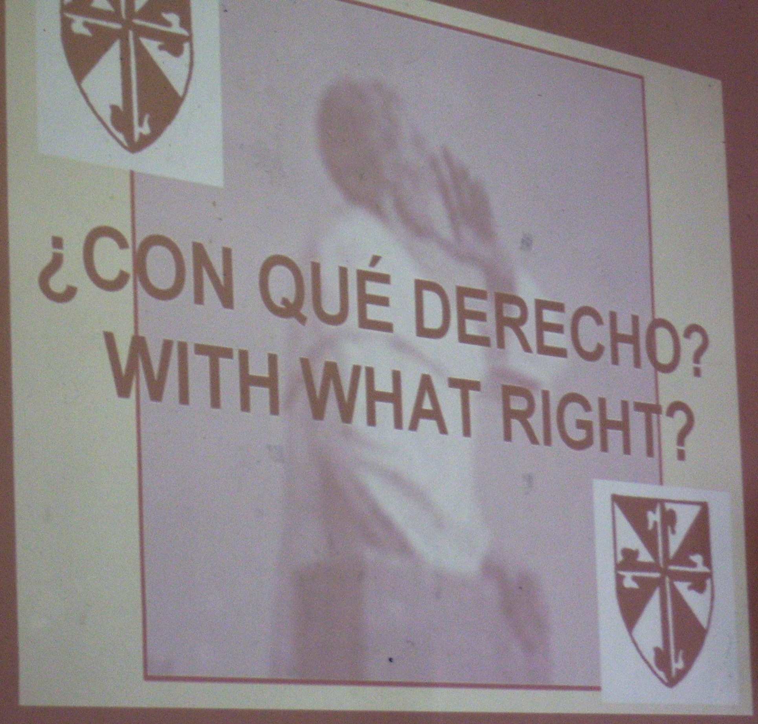
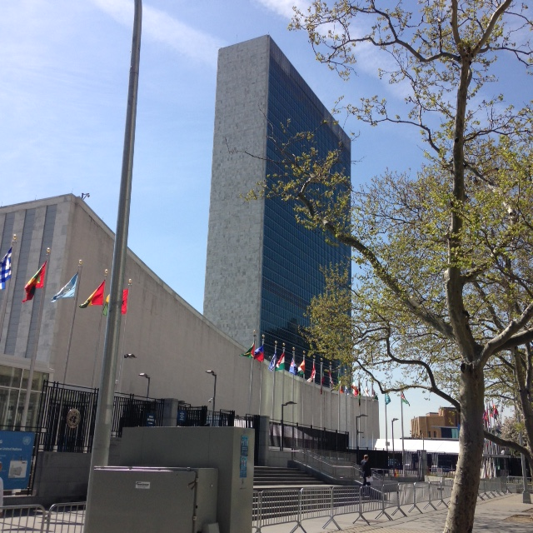
Dominicans In The Promotion and Defense of Human Rights:
Past, Present, Future
Salamanca, Spain
1-5 September 2016
The Dominican Presence At the
United Nations - New York
Margaret Mayce, OP

Slide 2
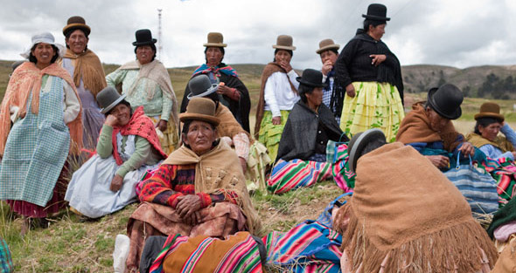
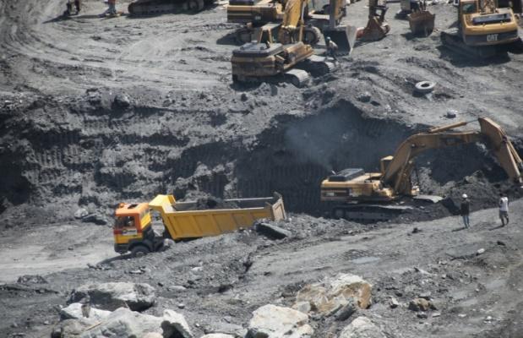
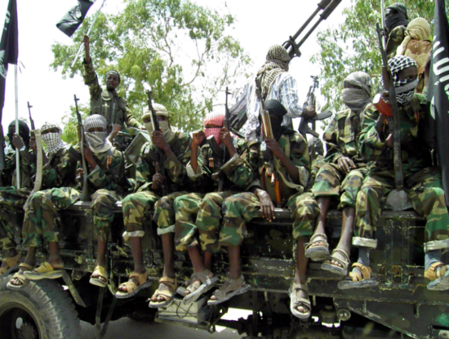
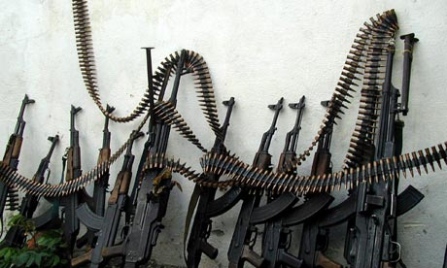

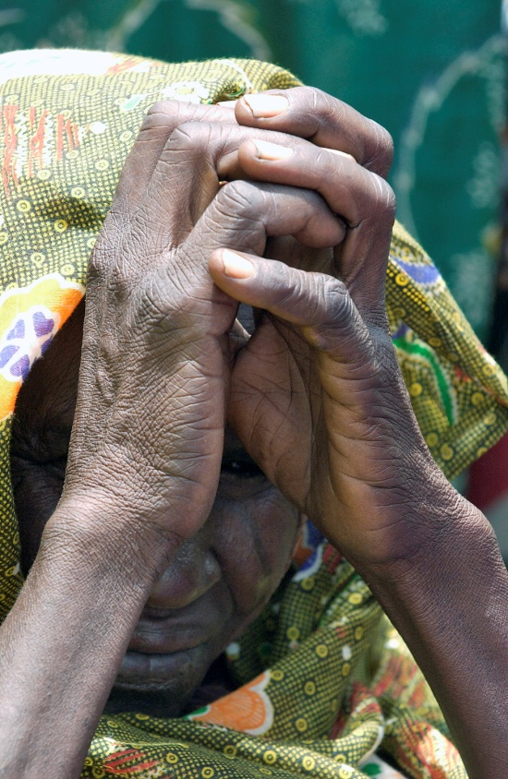
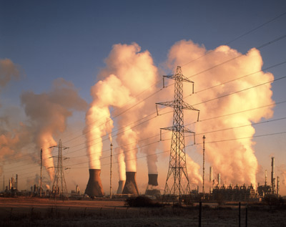
Article 1 :
To maintain international peace and security, and to that end : to take effective collective measures for the prevention/removal of threats to the peace
EXTRACTIVE INDUSTRIES
INEQUALITY
VIOLENCE
POLITICAL CORRUPTION
ARMS TRADE
UNFAIR TRADE AGREEMENTS
POVERTY
CLIMATE CHANGE

Slide 3
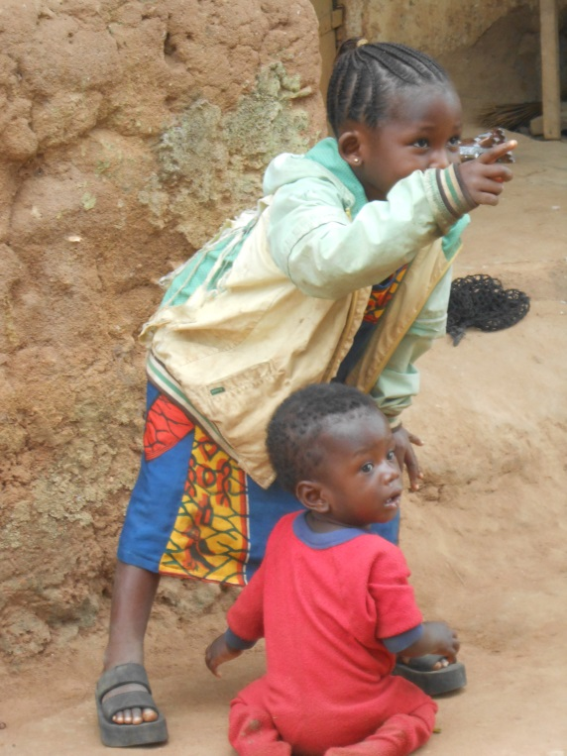
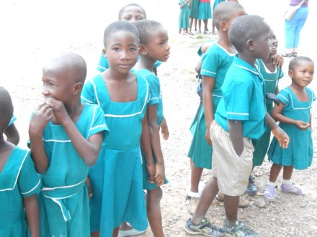
ECONOMIC AND SOCIAL COUNCIL (ECOSOC) :
Three dimensions of sustainable development:
economic
social
environmental
COMMISSION FOR SOCIAL DEVELOPMENT
COMMISSION ON THE STATUS OF WOMEN
AGENDA 2030:
SUSTAINABLE DEVELOPMENT GOALS

Slide 4
VENUES FOR ADVOCACY :
NGO COMMITTEE FOR SOCIAL DEVELOPMENT
HUMAN RIGHTS-BASED APPROACH / RESPECT FOR INTEGRITY OF EARTH
GENDER EQUALITY IN DECISION-MAKING / LEADERSHIP POSITIONS
SOCIAL PROTECTION FLOORS
PARTICIPATORY ECONOMICS
QUALITY EDUCATION
INNOVATIVE SOURCES OF FINANCING FOR DEVELOPMENT :
FINANCIAL TRANSACTION TAX
GLOBAL FUND FOR SOCIAL PROTECTION
REDUCTION OF MILITARY SPENDING

Slide 5
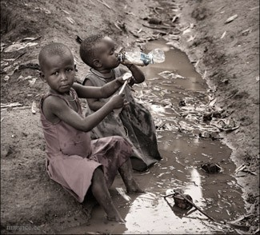
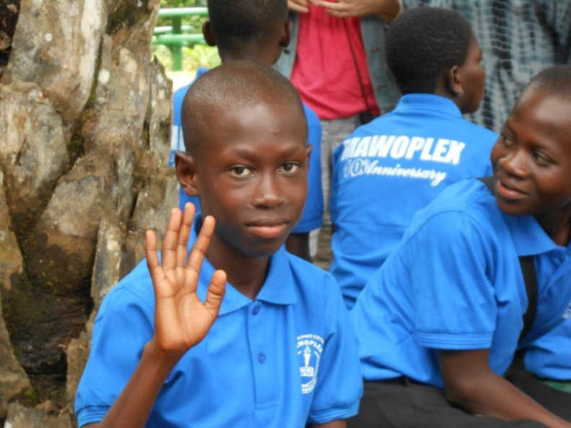
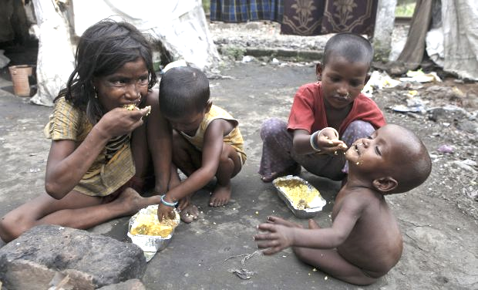
JULY 2010 UN GENERAL ASSEMBLY RESOLUTION –
THE RIGHT TO WATER AND SANITATION
SOCIAL PROTECTION FLOOR :
ACCESS TO ESSENTIAL HEALTH CARE
BASIC INCOME SECURITY FOR CHILDREN
BASIC INCOME SECURITY FOR OLDER PERSONS
BASIC INCOME SECURITY FOR PERSONS UNABLE TO EARN SUFFICIENT INCOME

Slide 6


Slide 7
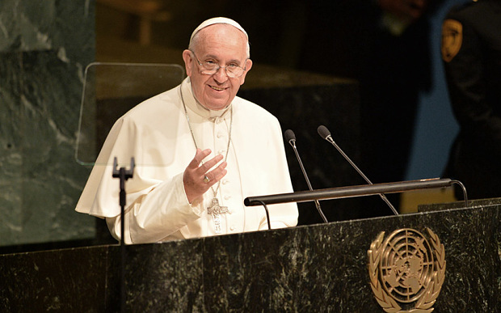
The natural environment and the vast ranks of the excluded. Their rights must be forcefully affirmed,
by working to protect the environment
and by putting an end to exclusion.
25 September 2015
UN General Assembly

Slide 8

HUMAN RIGHTS
RIGHTS OF NATURE
PEACE AND SECURITY

Slide 9

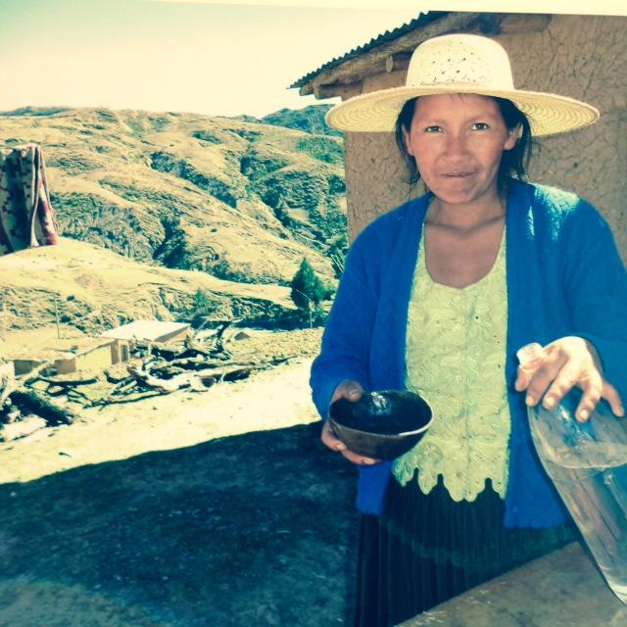
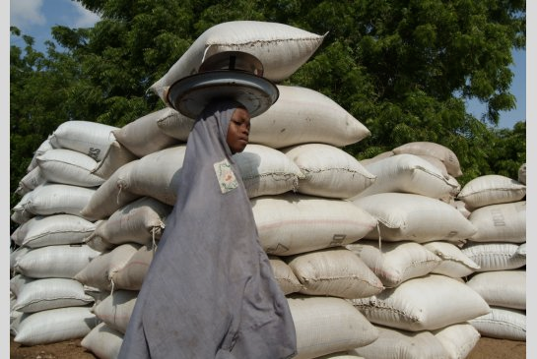
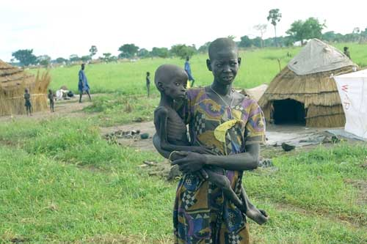
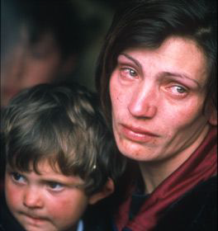
2. COMMISSION ON THE STATUS OF WOMEN :
PLIGHT OF THE GIRL CHILD
PARTICIPATION OF DSI SINCE 2013

Slide 10
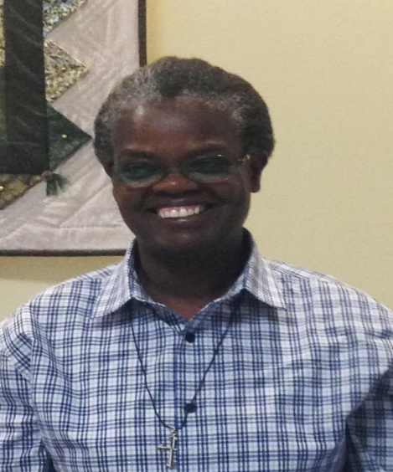
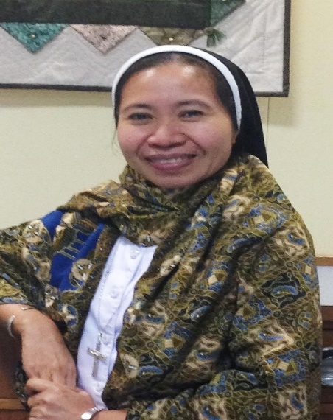
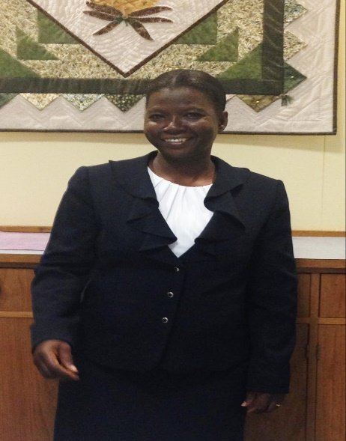
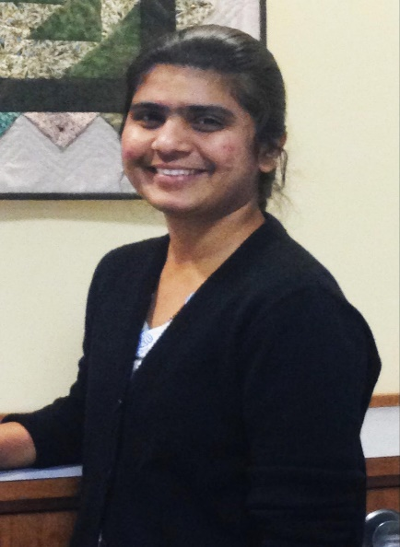
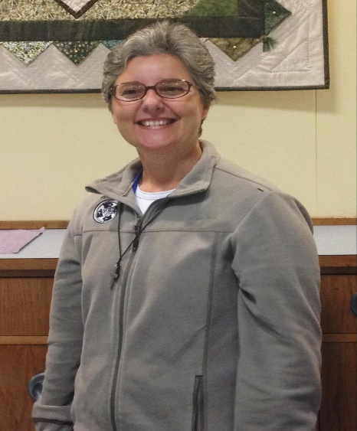
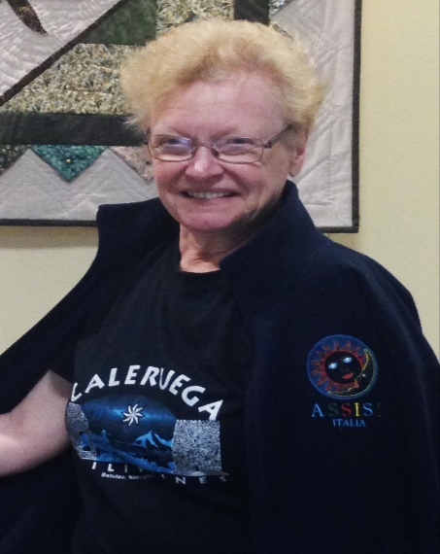
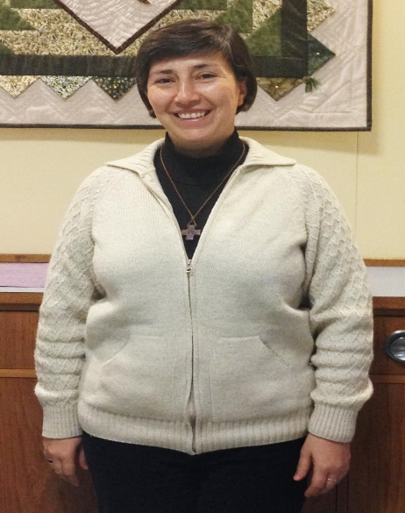
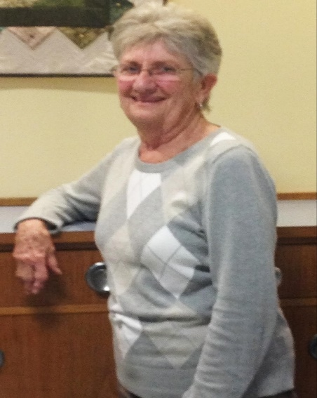
Julienne Nikiema – Ivory Coast
Anjanar Parmar - India
Bernadette Mwita -Kenya
Elsie Bagaypo – East Timor
DSI 2016
Viviana Sisack – Argentina
Mary Alice Hannon - USA
Ana Belen Verissimo –
Brazil
Else-Britt Nilsen - Norway

Slide 11
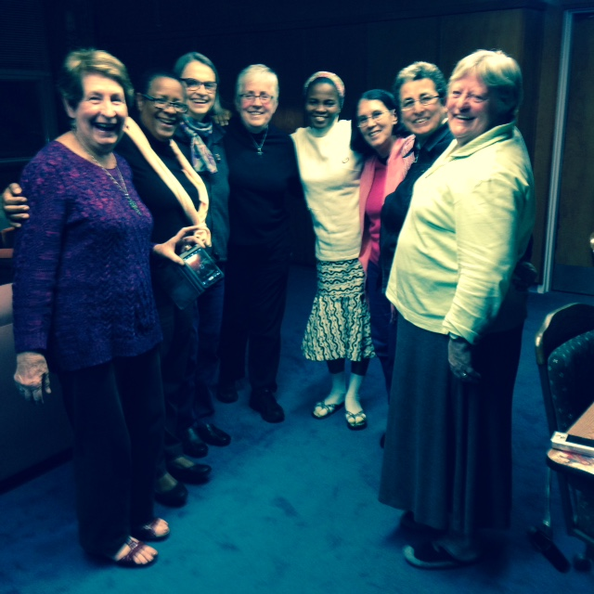
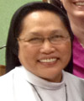
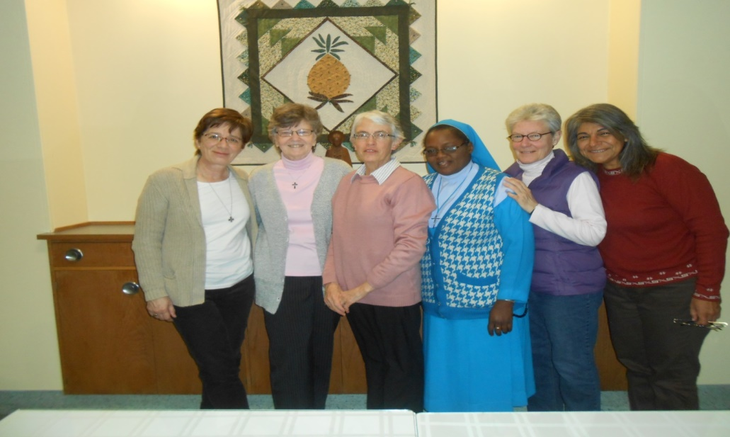
DSI 2014
Pilar Del Barrio – Spain
Anne Fitzgerald – USA
Alison Munro – So. Africa
Coronata Korie - Nigeria
Maria Alejandra Leguizamon –
Peru
Cecille Espenilla - Philippines
DSI 2015
Maureen O’Connell –Australia
Marie Therese Clement – DSI
Bernadine Karge – USA
Pat Farrell - USA
Emmanuela Okafur – Nigeria
Sandra Ede – Brazil
Celestina Veloso Freitas – DSI
Marjolein Brunein - Netherlands

Slide 12
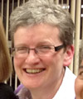
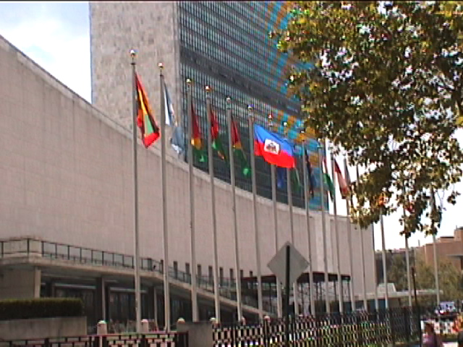
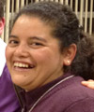
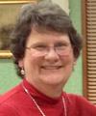
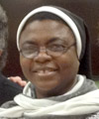
DSI 2013
Cecille Espenilla - Philippines
Edel Murphy - Ireland
Pamela Robles Espinosa –
Peru
Corinne Sanders - USA
Paulina Chioma Ogbonaya Nigeria

Slide 13
AN ASSESSMENT:
COLLABORATION: IN NEW YORK - RUN (RELIGIOUS AT THE UN) -
100+ RELIGIOUS CONGREGATIONS
SUCCESS???
CONSISTENCY OF MESSAGE
PERSISTENCE OF EFFORTS
HOW CAN WE IMPROVE?
GREATER COORDINATION AT GRASSROOTS LEVEL
GREATER COORDINATION – UN-NY / DSI JUSTICE PROMOTER /
UN – GENEVA
COLLABORATION ON UNIVERSALPERIODIC REVIEWS
GREATER COMMUNICATION AMONG US ALL

Slide 14
RUN - RELIGIOUS AT THE UN
60 MEMBERS
Representing @ 100 religious congregations
@ 100,000 members serving in 177 countries
Represented by 30 UN accredited NGOs
Some are individual NGOs (DLC); others are coalitions of NGOs
(UNANIMA; VIVAT)
A dream :
More effective joint advocacy at the UN
Enhanced communication with/education of members on the ground regarding pressing global issues

Slide 15
Conrad Hilton Foundation:
One-year facilitated planning process:
Assess modes of analysis, advocacy styles, mans of communication & collaboration;
Articulate a collective vision
Identify / assess feasibility of strategies / partnerships
Strengthen advocacy capacity of RUN and their members on the ground
To pursue a collaborative, strategic, impactful global justice approach

Slide 16
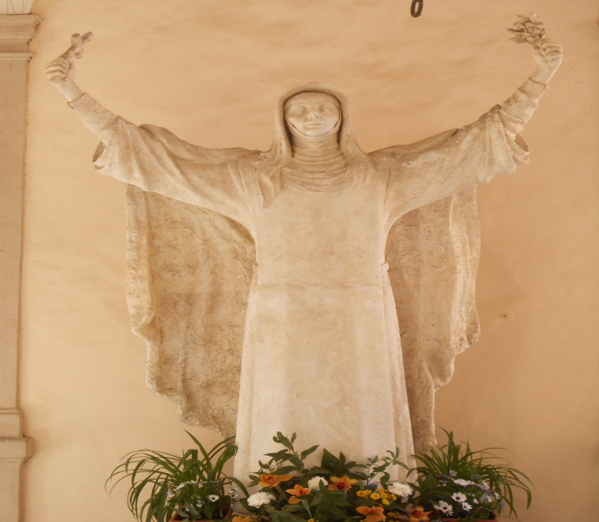
I HAVE COME THAT THEY MAY HAVE LIFE AND HAVE IT TO THE FULL…..
HOPE IS A STATE OF MIND, NOT OF THE WORLD.
HOPE IN THIS DEEP AND POWERFUL SENSE,
IS NOT THE SAME AS JOY THAT THINGS ARE GOING WELL,
OR WILLINGNESS TO INVEST IN ENTERPRISES THAT ARE OBVIOUSLY HEADING FOR SUCCESS,
BUT RATHER, AN ABILTY TO WORK FOR SOMETHING
BECAUSE IT IS GOOD. VACLAV HAVEL
LET US CRY OUT AS IF WE HAD A MILLION VOICES,
FOR IT IS SILENCE THAT KILLS THE WORLD!

